Slide 1
Big data boosting academic visibility: Research, Research Translation and Innovation
Dr. Walid Hassan
Head of Consultancy Services and Client Education
Clarivate Analytics 2018
ITU, 2018

Slide 2
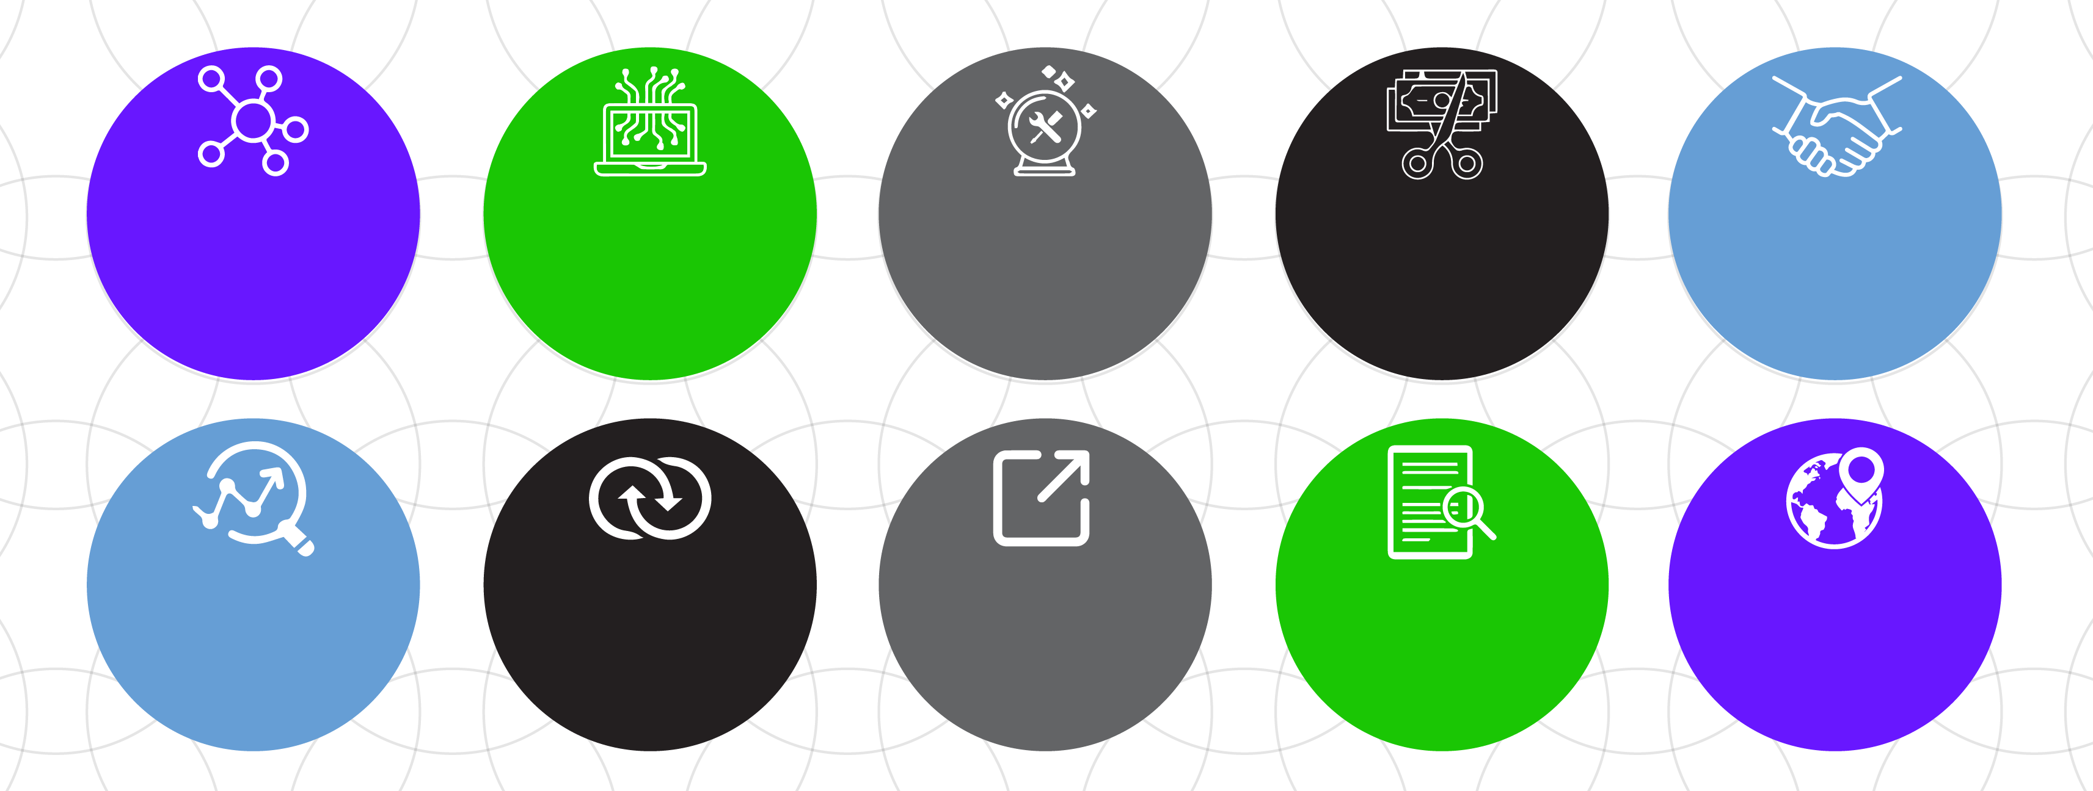
The world of today: major challenges and opportunities
Data growing
in volume and complexity
Cyber threats
and data privacy compliance
Difficulty predicting
the future amidst constant change
Doing more
with less
Knowing who to partner with
and how
Spotting emerging research trends
Interdisciplinary data for research
“Free information”/ open science/
open data
AI / text
mining
Globalization & regionalization

Slide 3
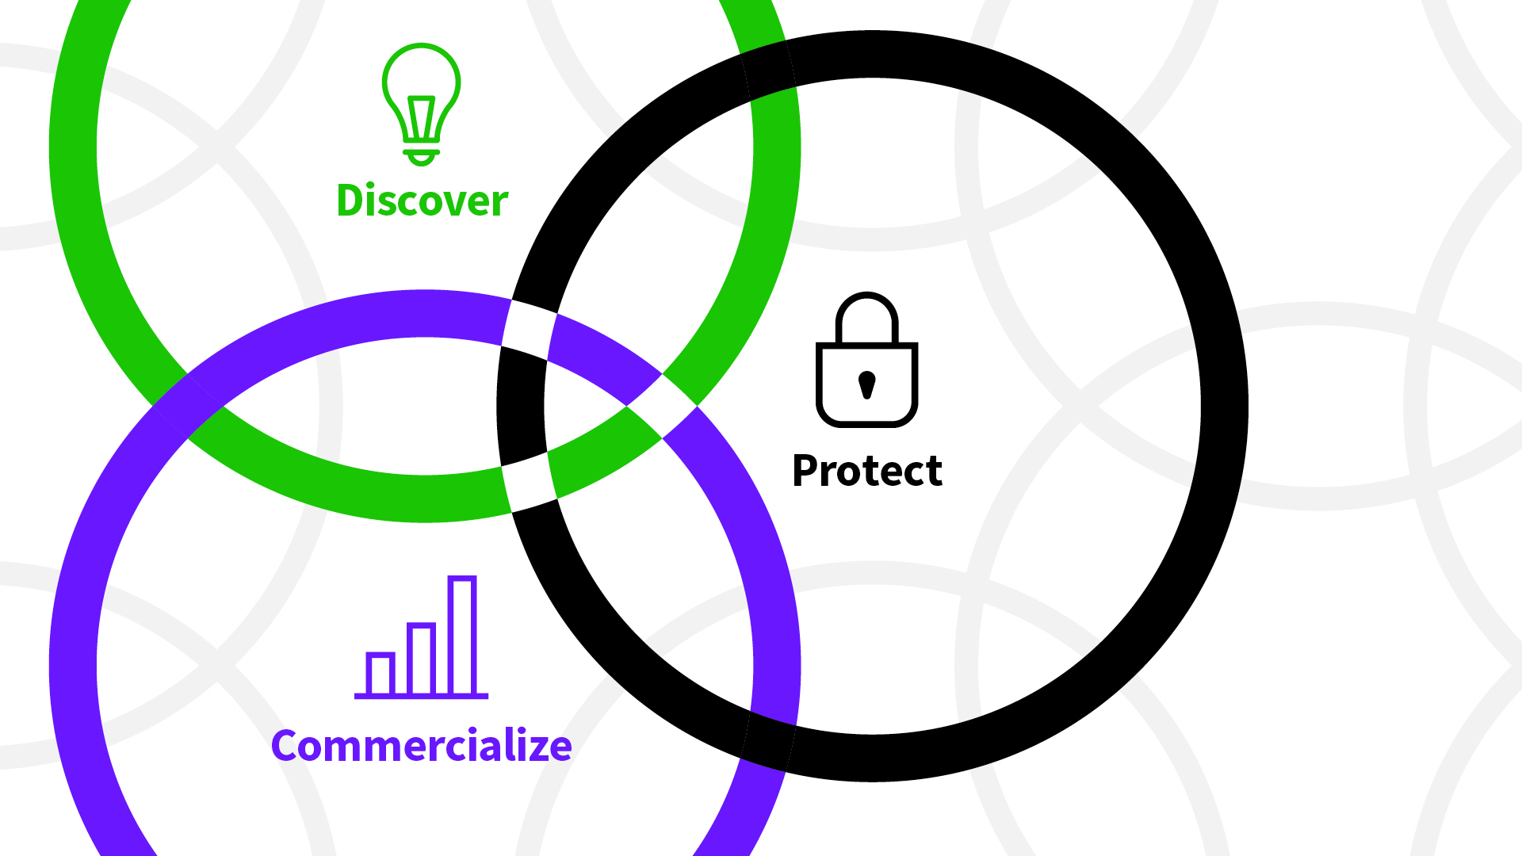
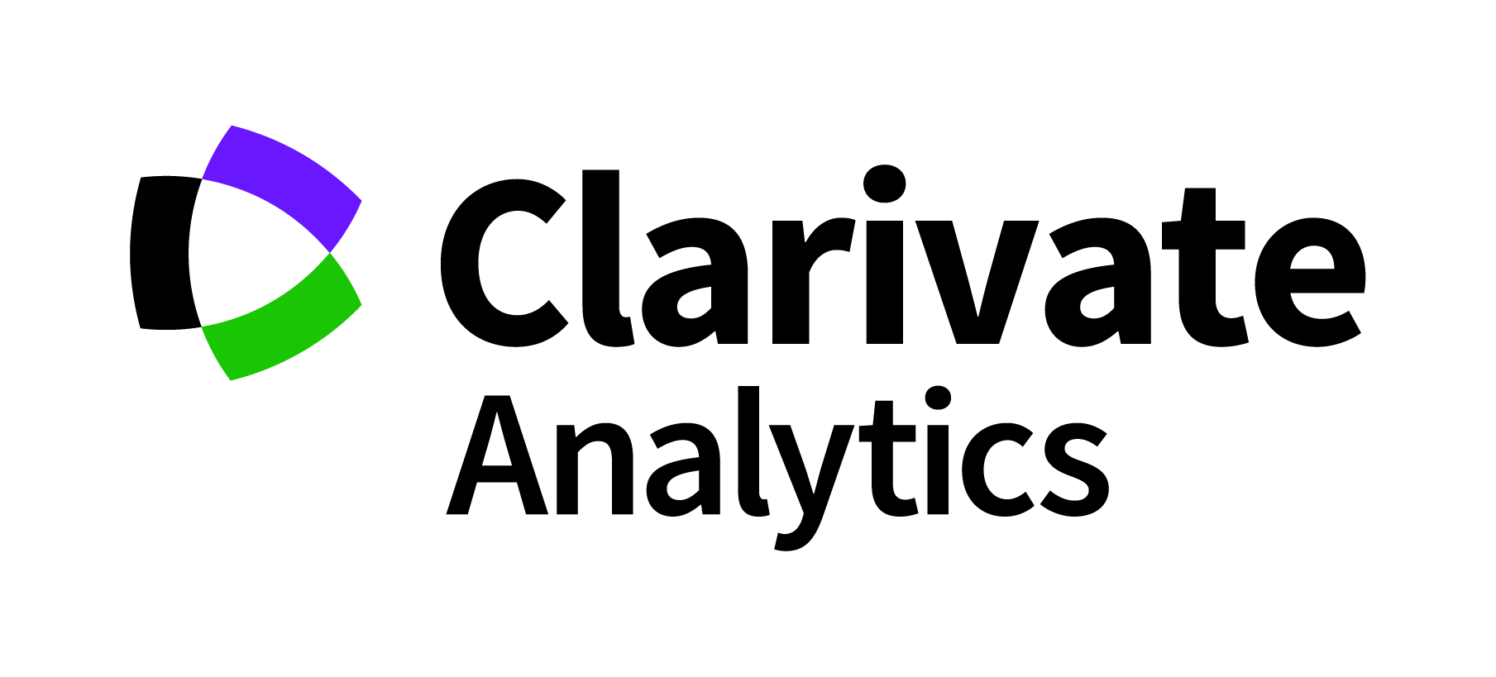
Clarivate operates at the center of the innovation lifecycle

Slide 4
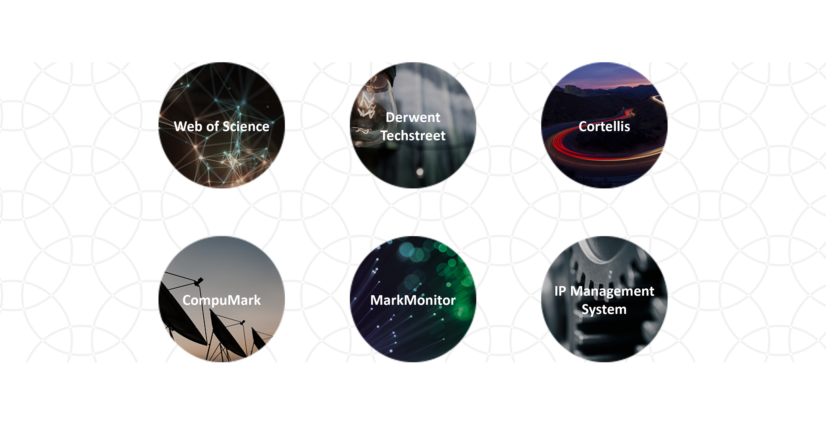
A portfolio of trusted brands
Scientific and
academic research
Patent research intelligence
Industry codes and standards
Life sciences
intelligence
Trademark research
and protection
Domain and brand protection
Intellectual property
management

Slide 5
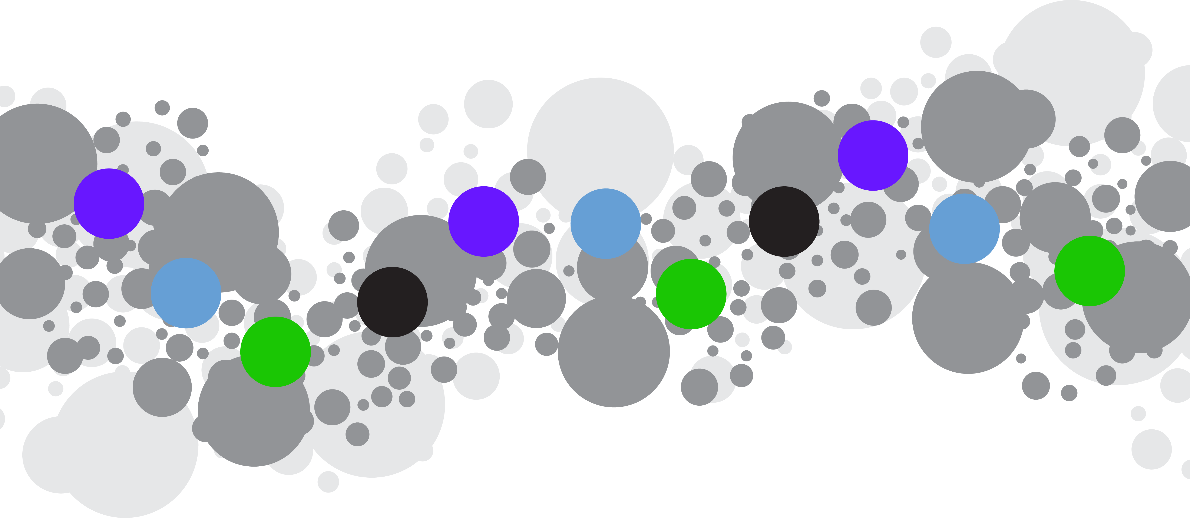
More than a century and a half of trusted insights
Clarivate Analytics launched, following sale of Thomson Reuters Intellectual Property and Science business
CLARIVATE ANALYTICS
Zoological Records founded by Zoological Society of London and British Museum
SCIENTIFIC AND ACADEMIC RESEARCH
Thomson Reuters acquired
MARKMONITOR
BIOSIS founded by Society of Bacteriologists and Botanical Society
SCIENTIFIC AND ACADEMIC RESEARCH
Monty Hyams begins selling patent bulletins from his home, Derwent
IP AND STANDARDS
Thomson acquired trademark research companies Thomson & Thomson and COMPUMARK
2012
1864
1963
1980s
2011
2016
1926
2017
1957
1997
1955
Cortellis launched
LIFE SCIENCES
Web of Science launched
SCIENTIFIC AND ACADEMIC RESEARCH
Publons acquired
SCIENTIFIC AND ACADEMIC RESEARCH
Dr. Eugene Garfield invents citation indexing and searching
SCIENTIFIC AND ACADEMIC RESEARCH
ISI founded
SCIENTIFIC AND ACADEMIC RESEARCH
Notes:
Key points:
We provide data and analytics, using the best balance of technology, judgment and long-term experience.
Thirty years of bibliometric expertise and 50 years of citation analysis serve as the backbone of a full range of data, tools and technology in one, integrated, ever-evolving resource.
Web of Science documents the most influential research as directly judged by researchers themselves, providing the basis for assessing and benchmarking the research performance of individuals, institutions, nations, and regions.
It is the only resource that provides consistent controlled indexing for all authors, addresses, funding acknowledgements, and cited references, providing users with a complete view of the scholarly record.
Provides the foundation for finding, tracking and evaluating research.
Provides the data, analytics and tools to connect the global research community.
Additional speaker’s notes:
Our authoritative content has been painstakingly built by expert curators, passionate about their discipline:
ZR founded in 1864 by Zoological Society of London & British Museum; ZR also serves as the world’s unofficial register of scientific names in zoology
Biosis founded in 1926 by two American Societies; combined, they represent the authority of animal biology & life science literature.
In 1963 research scientist, Monty Hyams, began selling weekly patent bulletins from his home in London – named “Derwent”; Derwent is now the world’s most comprehensive collection of global patent data. Its unique abstracting, indexing and coding make Derwent authoritative - used by all major patent authorities.
ISI was founded by Eugene Garfield in late 1950’s. In 1960, ISI introduced the first citation index for papers published in academic journals. ISI was acquired by TR in 1992.
Web of Science and Journal Impact Factor metric is widely accepted as most influential measure of success in Science
MarkMonitor was founded in 1999 by a serial entrepreneur, Faisal Shah. It protects brands from online counterfeiting and piracy, and assists with organization domain management. It protects domains for Internet giants such as Apple, Google, Intel, Yahoo and eBay.
Prous Integrity was a family-run business based in Barcelona, set up by eminent Spanish scientist Josep Prous. It provides researchers with detailed scientific data across multiple disciplines to support development of new drugs, which increasingly relies on data intensive techniques.
Web of Science: The first web-based citation indexing resource of research and professional journals
Building on Dr. Eugene Garfield’s revolutionary concept of citation indexing and development of the Science Citation Index in 1961, we launched the Web of Science in 1997. The Web of Science's body of citation statistics, documenting the most influential research in any given field as directly judged by researchers themselves, provides the basis for assessing and benchmarking the research performance of individuals, institutions, nations, and regions. Thirty years of bibliometric expertise and 50 years of citation analysis serve as the backbone of a full range of data, tools and technology in one, integrated, ever-evolving resource.
Clarivate Analytics was also the first to market with analysis and bibliometric tools. Journal Citation Reports was the first tool for in-depth analyses and ranking of research and professional journals. InCites was the first-ever research evaluation tool on the Web, allowing the most comprehensive citation-based analysis of institutional research.

Slide 6
“The reasonable man adapts himself to the world; the unreasonable one persists in trying to adapt the world to himself. Therefore all progress depends on the unreasonable man”..
George Bernard Shaw, Man and Superman (1903) "Maxims for Revolutionists"

Slide 7

Content
Situation Analysis
Back to basics, Challenges
On R&D Strategies

Slide 8
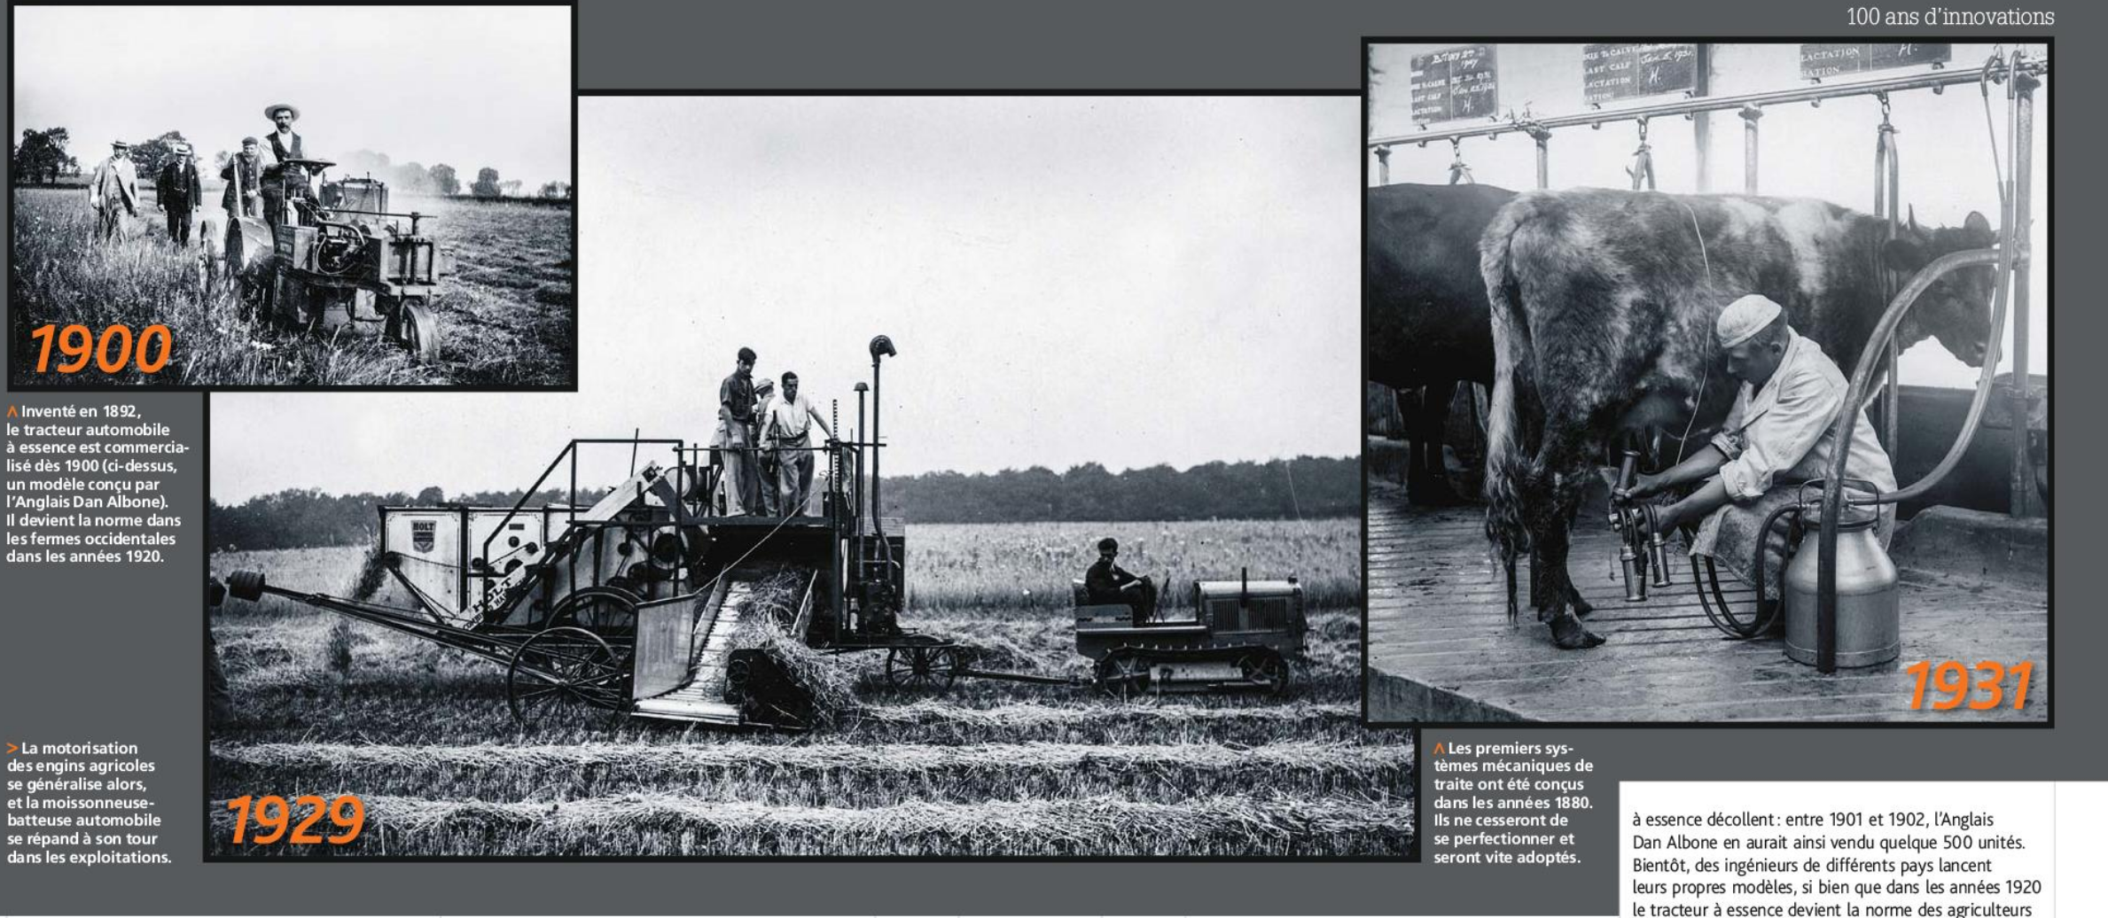

Agriculture: A witness
Credits: Science et Vie 27/02/2016

Slide 9
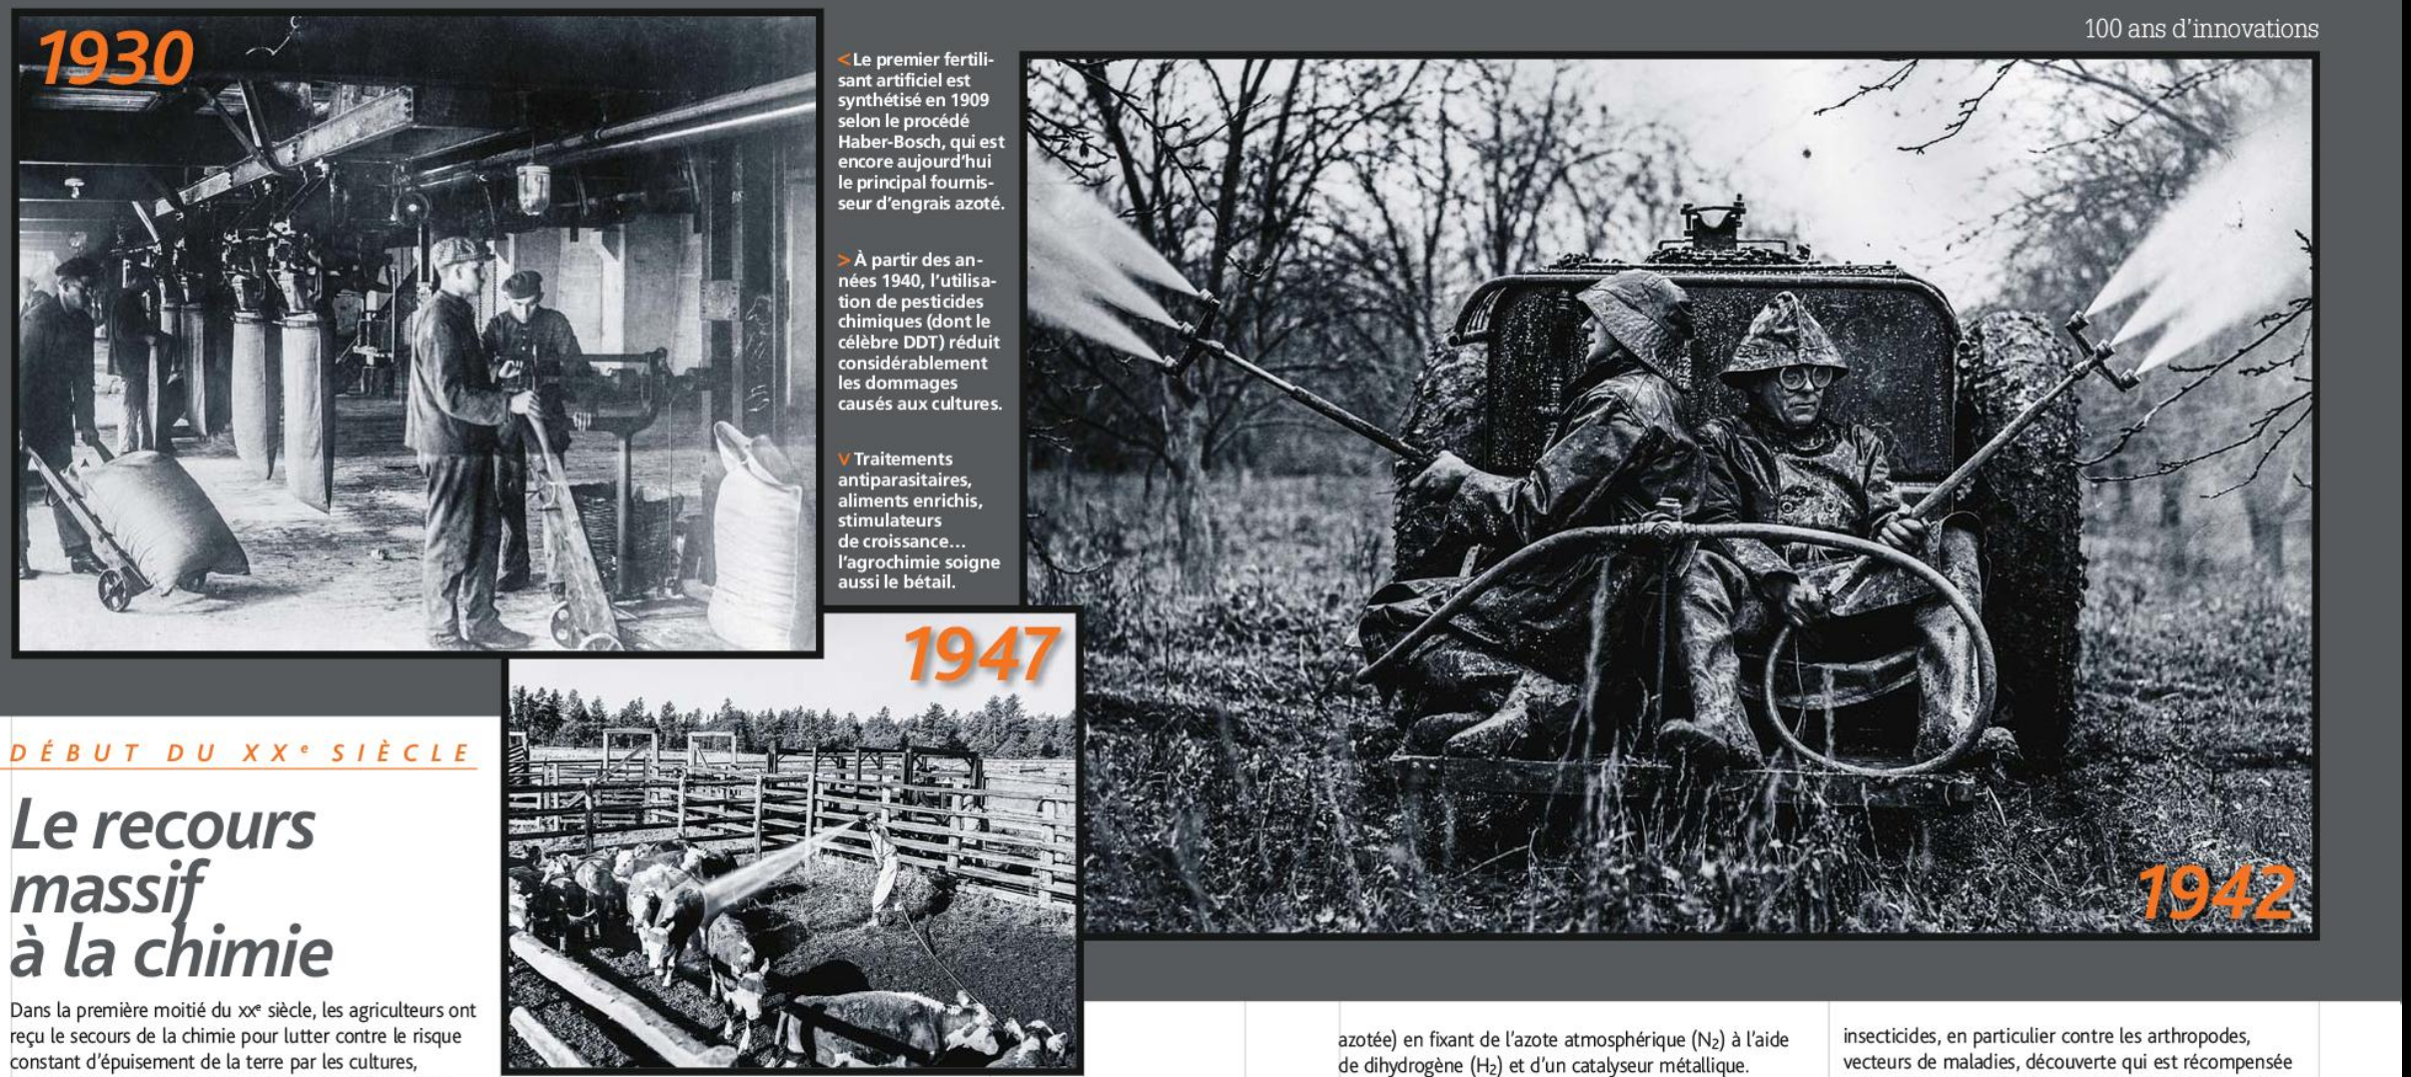
Agriculture: A witness
Credits: Science et Vie 27/02/2016

Slide 10
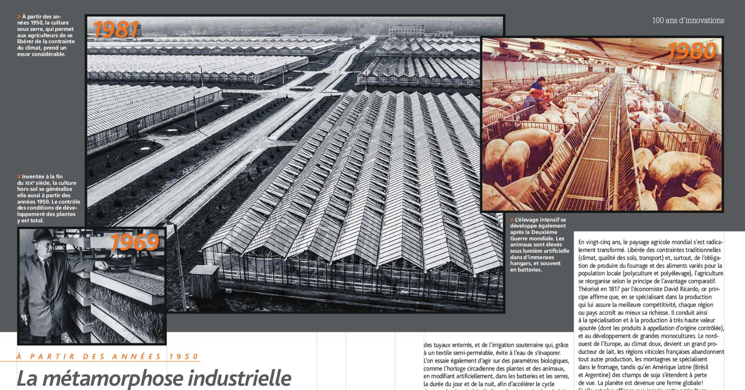
Agriculture: A witness
Credits: Science et Vie 27/02/2016

Slide 11
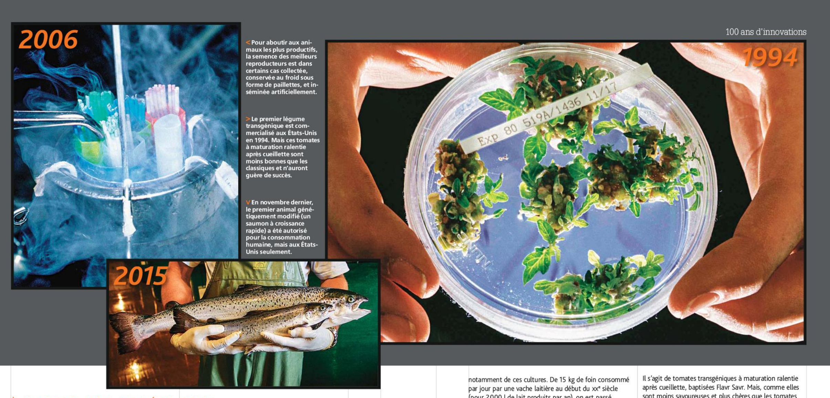
Agriculture: A witness
Credits: Science et Vie 27/02/2016

Slide 12
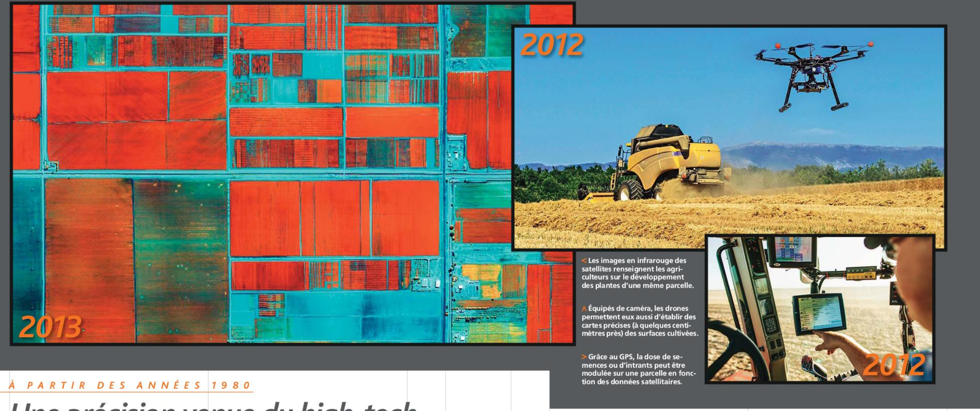
Agriculture: A witness
Credits: Science et Vie 27/02/2016

Slide 13
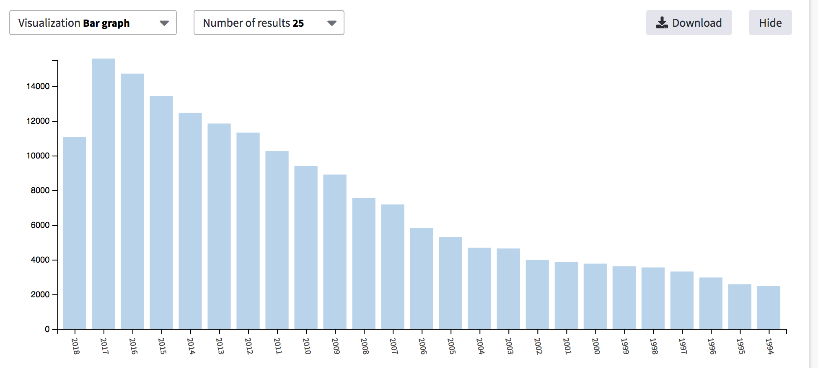
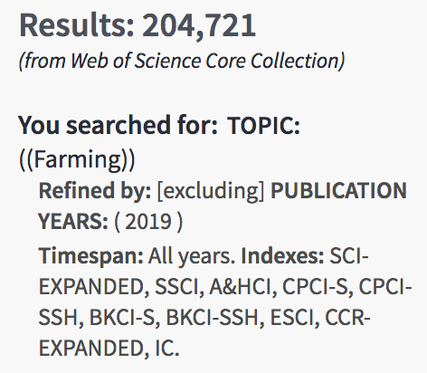

Agriculture: A witness (WOS, #Pubs)

Slide 14
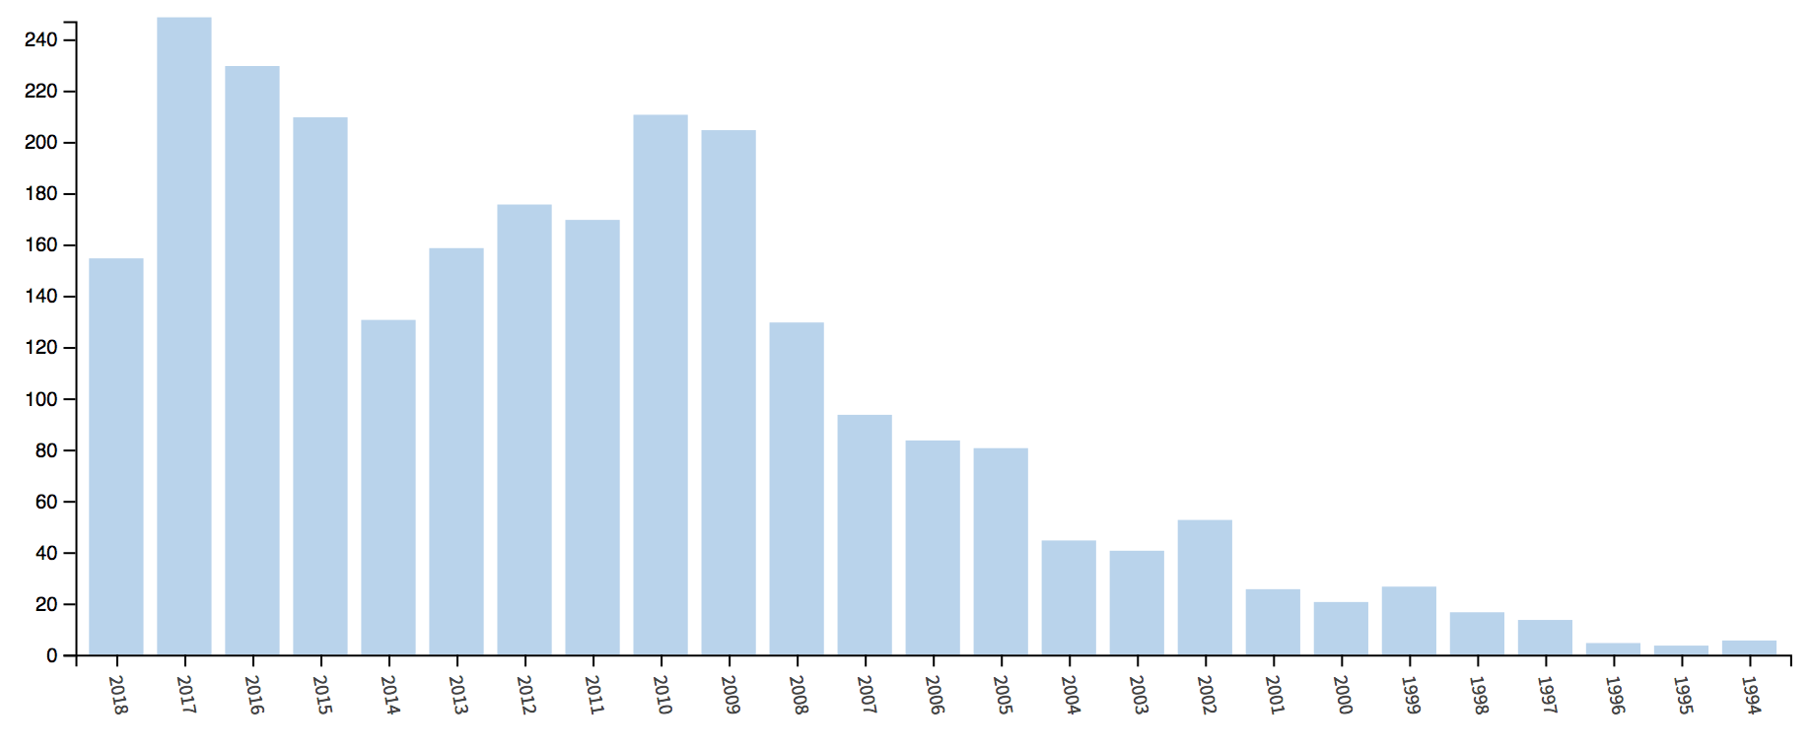
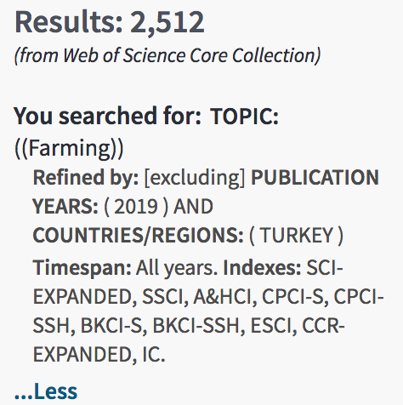
Agriculture: A witness (Turkey #Pubs WOS)

Slide 15
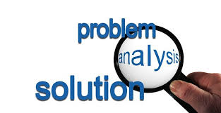
Scope

Slide 16
Who is concerned?
Research Process
PhD Students/Researchers
Research Managers`
Decision Makers
Researchers: PhD Students and Researchers
Research Managers: Research unit managers, department managers, etc..
Decision makers: Research Laboratory Managers, Institution Management, etc..
Dr. Walid Hassan 11/9/2018

Slide 17
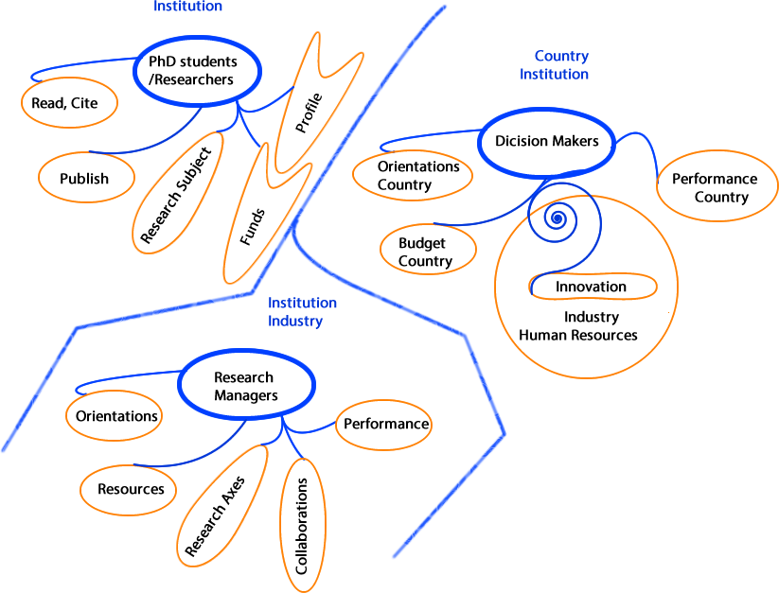
Challenges and Repartition

Slide 18
Researchers are challenged at the first moment, when defining their research subject area
The Start Point

Slide 19
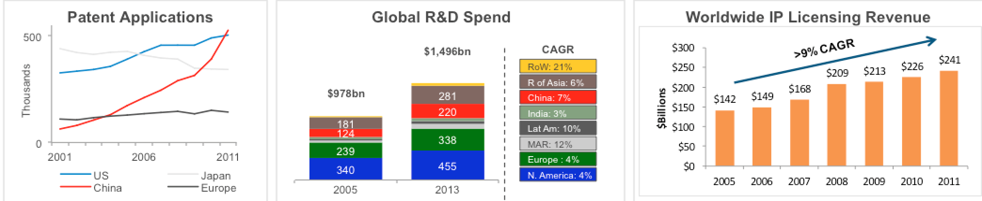
Topics Strategy
35 USD billions has been wasted developing things that are already documented in a patent specification (Source: British Patent Office, 2000)
Dr. Walid Hassan 11/9/2018

Slide 20
Patents Versus Publications

Slide 21
R&D Strategy

Slide 22
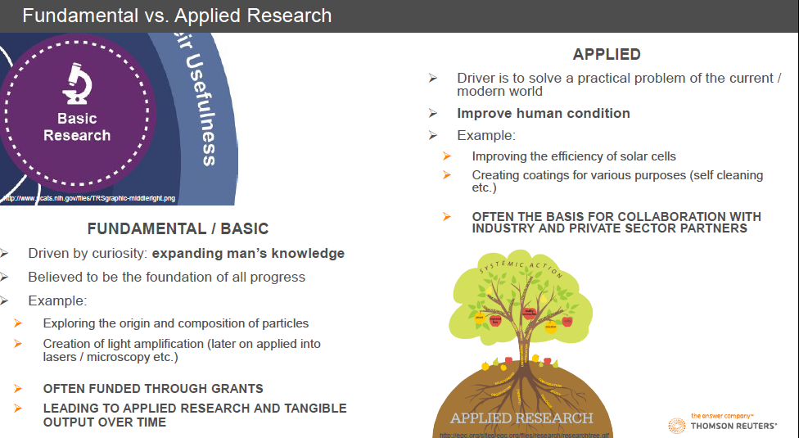
Types of Research

Slide 23
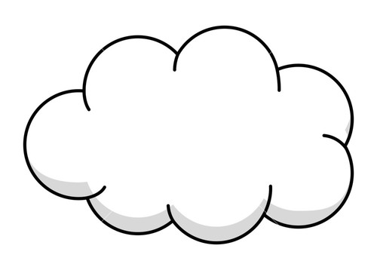
Pathway from Research to IP, Strategy
Fundamental
Theories, methodologies
Applied
Publications
Patents
Applications
Citations, Visibility
Licensing
Research Community (Academia)
Know How
Valuation
IP
Industry

Slide 24
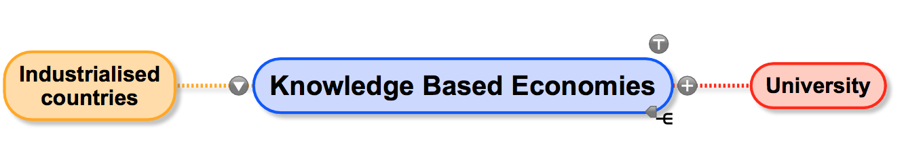
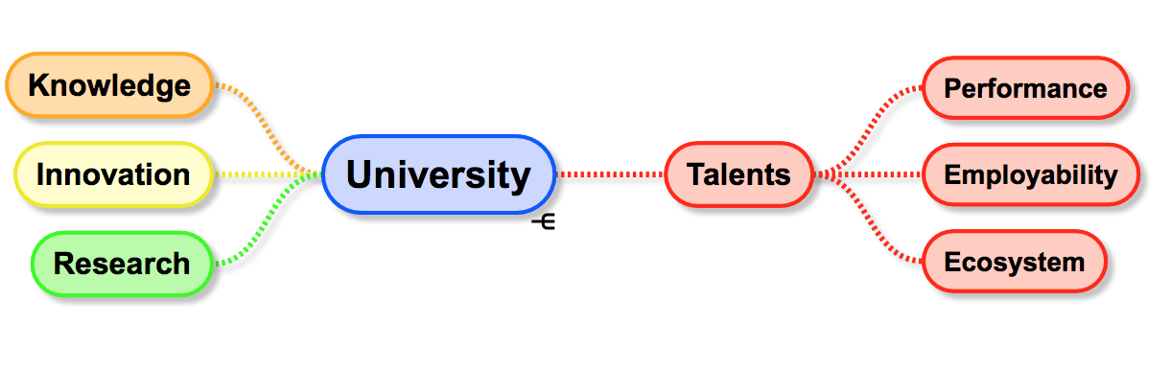
Positioning of needs: University
Notes:
Since the economies of the industrialized countries have become more knowledge based,
universities have become viewed as important players in regional economic
development. A survey in the “Economist” suggested the concept of the knowledgebased
economy serves to “portray the university not just as a creator of knowledge, a
trainer of young minds, and a transmitter of culture, but also as a major agent of
economic growth: the knowledge factory, as it were, at the centre of the knowledge
economy” (David, 1997: 4).
The university has become more critical than ever as a provider of
talent, knowledge, and innovation in the age of knowledge-based capitalism. It
provides these resources largely by conducting and publishing research and by
producing graduates to serve the industries. The university is further empowered by
generating new and significant discoveries to increase its status. In this way, academic
research differs markedly from the profit-motive and private-user driven industrial
research and development.

Slide 25
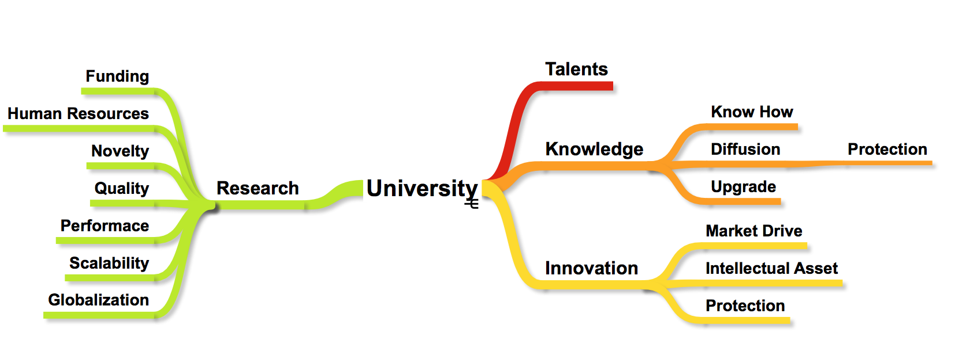
University: Opportunities and Challenges

Slide 26
Publish, READ and CITE

Slide 27
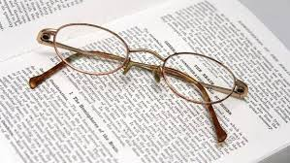
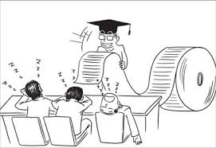
They Say:
Publish or Perish
Something is Missing !!!!!!!!
Publish ………. or Perish

Slide 28
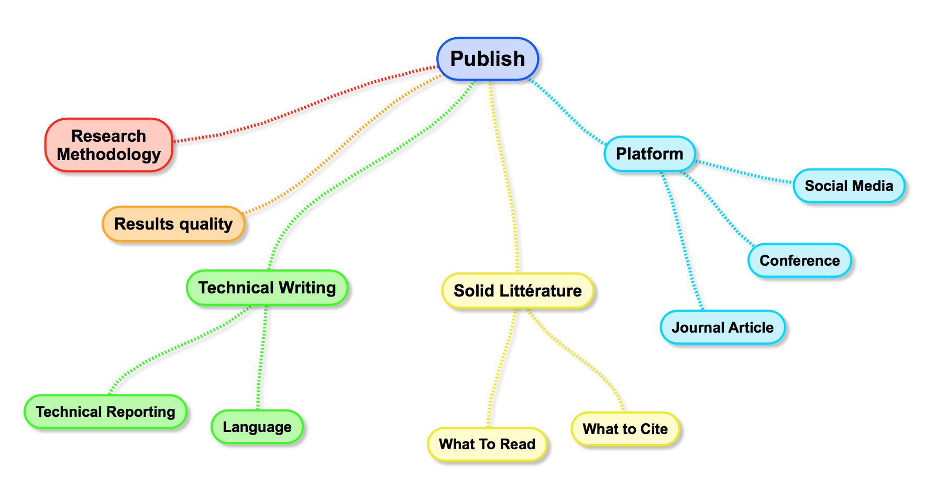
Publishing: Problem Positioning

Slide 29
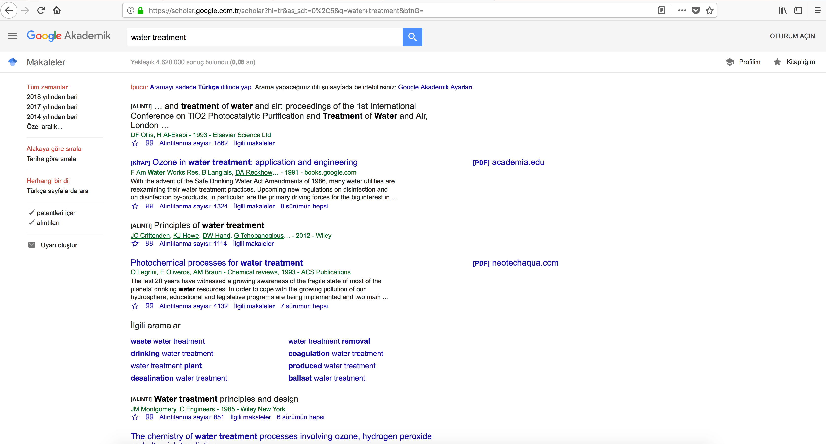
Today: What to Read

Slide 30

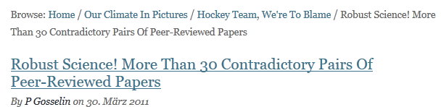


Contradictions?
Need a Benchmark
Research papers?
Need a Model

Slide 31
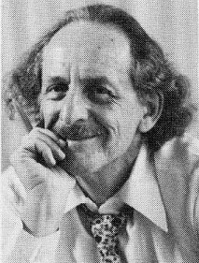
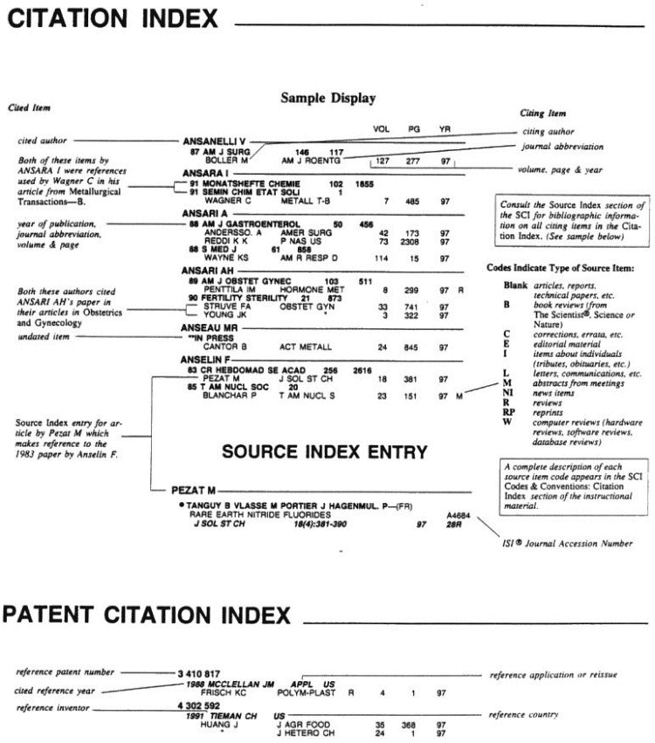
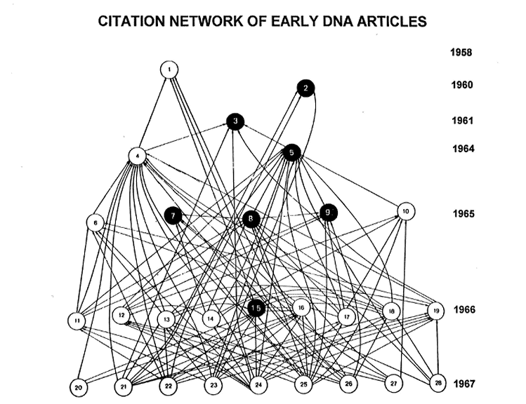
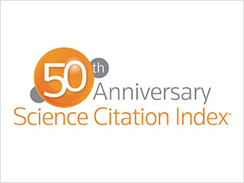
EUGENE GARFIELD’S “ASSOCIATION OF IDEAS INDEX”
A Model
A benchmark..

Slide 32
Millions of Records
SCIENCE CITATION INDEX EXPANDED
41.2 million records
1900-present
SOCIAL SCIENCES CITATION INDEX
7.9 million records
1900-present
ARTS & HUMANITIES CITATION INDEX
4.6 million records
1975-present
CONFERENCE PROCEEDINGS CITATION INDEX
8.2 million records
1990-present
BOOK CITATION INDEX
977,199 records
2005-present
CURRENT CHEMICAL REACTIONS
212,622 records
1985-present
INDEX CHEMICUS
337,305 records
1993-present
DATA CITATION INDEX
2.8 million records
1900-present
CURRENT CONTENTS CONNECT
18.1 million records
1998-present
BIOSIS CITATION INDEX
22.8 million records
1926-present
ZOOLOGICAL RECORD
4 million records
1864-present
MEDLINE
22 million records
1950-present
DERWENT INNOVATION INDEX
22.9 million basic inventions
1963-present
A comprehensive gateway to the most relevant research information: reliable, integrated, multidisciplinary.
Notes:
* IMPORTANT NOTES ABOUT DCI: New records are constantly being added to DCI. Please verify the latest count with GSS/Product Management is specific stats are required by a customer. Also note that 1900 represents the earliest data set in the collection and does not imply comprehensive coverage from 1900.
32

Slide 33
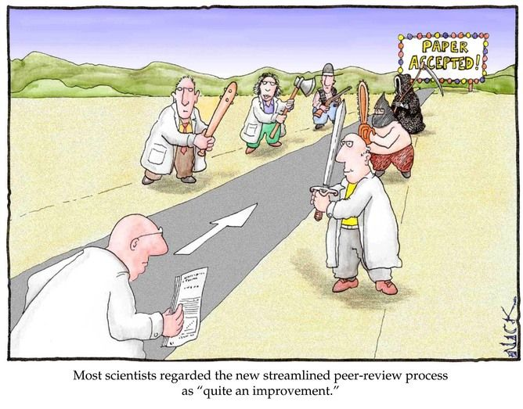
Challenges
Why to publish?
Where ?
When ?
How?
With Whom?

Slide 34
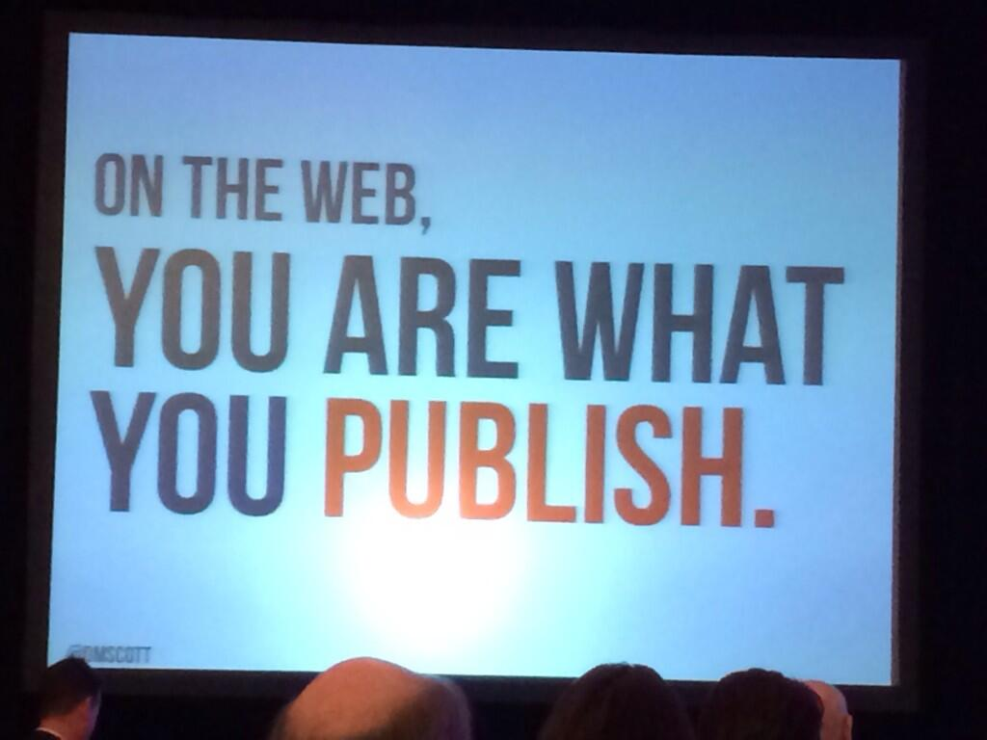
Why we Publish
Diffusion of Knowledge
Promotion
Community belonging
Professional Profile
Getting Feedback
Research Valorization
Sharing Ideas

Slide 35
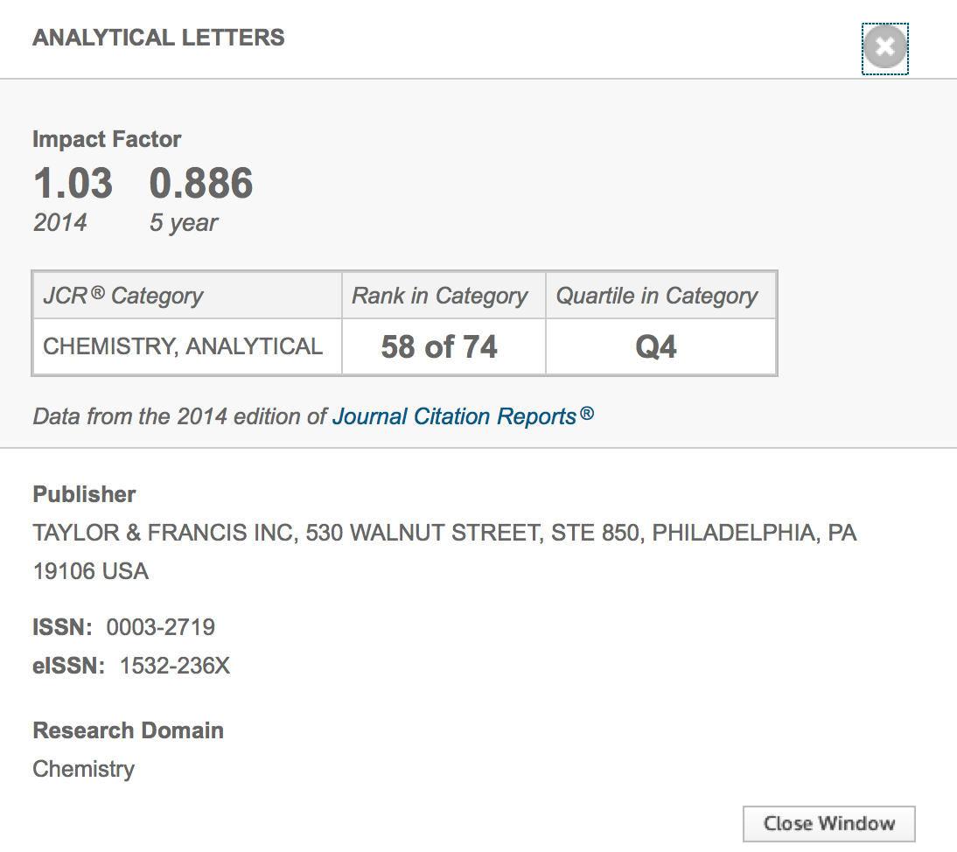
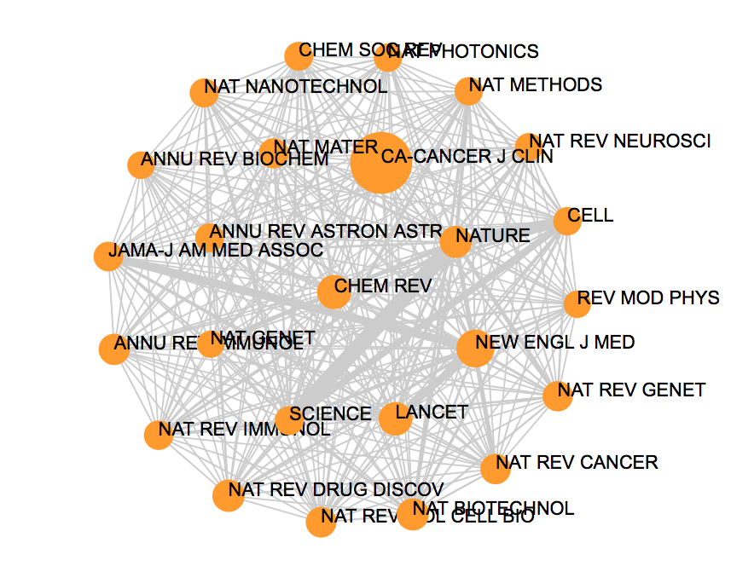
Where to Publish
Which journal? Indexed?
How journals are classified? Which is better?
Should I look at the Impact factor?
Would my publications be accepted in high-IF journals?
Open Access?

Slide 36
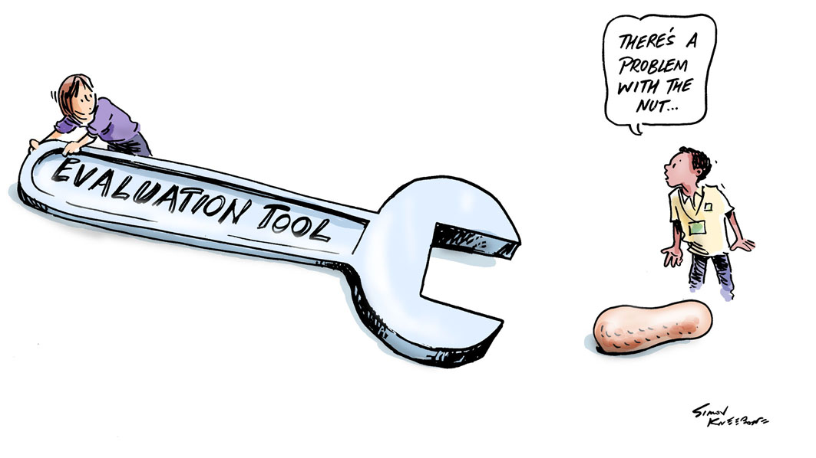
We need to ask the right questions

