Slide 1


Analog Neural Network based on Memristor Crossbar Arrays
Hacer A. Yildiz, Mustafa Altun, Ali Dogus Gungordu and Mircea R. Stan
Department of Electronics and Communication Engineering, Istanbul Technical University, Istanbul, Turkey haceryildiz@itu.edu.tr

Slide 2
Outline
Main motivation
The aim of this work
Brief explanation a neural network employing a memristor crossbar array
Proposed neuron circuit realization with memristor crossbar array
Using that circuit for Iris data recognation at the first time
Simulation Results
Conclusion

Slide 3
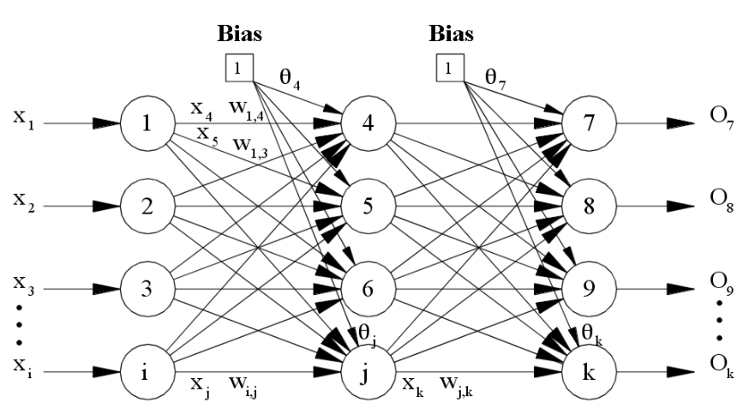
Main Motivation
Typical Neural Network Achitecture

Slide 4
Main Motivation
Multilayer feed forward neural networks require huge number of synaptic interconnections. Large chip area
With the discovery of the memristor (memory element), it is possible to perform multiplication and addition operations in the analog domain in a very effective way.

Slide 5
The aim of this work
In this paper, we discuss the design of the feed-forward neural network using memristive crossbar array.
The proposed feed-forward network consists of two level weighted summing process using memristive crossbar arrays.
Iris data recognition application is used at the first time.

Slide 6
The Benefits of the memristor based non-volatile memory
Analog neural network needs non-volatile memory in order to calculate weigted summing.
Many realizations of this kind memories are in practice. One of these is memristor non-volatile memory.
Memristor element has a number of advantages:
Low power consumption, non-volatile storage element, excellent scalability and integration.
Therefore, the fact that the memristor can be implemented as an electronic synapse in neural network applications, makes this element extremely attractive.

Slide 7
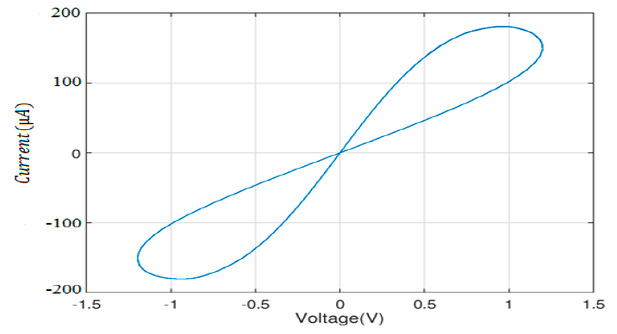



Memristor Device
Memristor structure
Circuit notation
$R_{MEM}\left(x\right)=R_{ON}x+R_{OFF}\left(1−x\right),$
$x=\frac{w}{D} ε (0,1)$

Slide 8

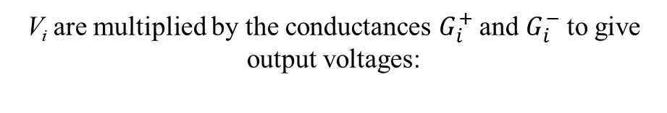
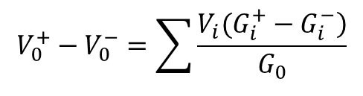
Analog vector-matrix multiplication with memristor array
Analog input values are symmetrical pulses.
Outputs are obtained as voltage pulses.
Thanks that, the basic arithmetic operation can be realized very effectively in a single step.
V_{i} are multiplied by the conductances $G_{i}^{+}$ and $G_{i}^{−}$ to give output voltages:
$$V_{0}^{+}−V_{0}^{−}=\sum{\frac{\left.V_{i}(G_{i}^{+}−G_{i}^{−}\right)}{G_{0}}}$$
$$G_{0}=G_{1}^{+}+G_{2}^{+}…G_{N}^{+}=G_{1}^{−}+G_{2}^{−}…G_{N}^{−}$$
$I_{1}=I_{2}$=0

Slide 9
Proposed Neuron Circuit with two level Memristor Crossbar Array
The MOS transistor at the input layer realize tanh type activation functions
The output neuron is a simple linear perceptron

Slide 10
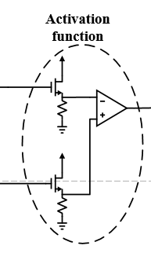
Activation Subcircuit
Balun
The MOS transistor at the input layer realizes tanh type activation functions as shown in the left Figure.
The non-linear activation function is achieved by using source follower non linear characteristic.

Slide 11
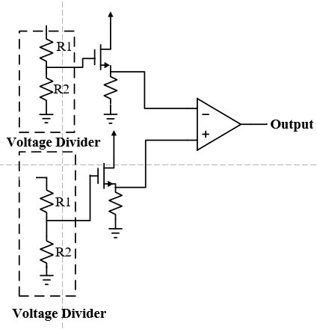
Scale-down subcircuit
The output neuron is a simple linear perceptron as shown in the Figure.
Two voltage dividers are used to scale down the signal levels applied to the inputs of the output transistors.
Balun

Slide 12
Models in Cadence Simulation
Structure of the SPICE model
The equivalent circuit (the model of Biolek) is used for each memristor element.
The memristive weights are obtained by training the network using iris data.

Slide 13
Cadence Simulation Result
We used three memristor crossbar arrays in the input layer and one crossbar array in the output layer.
All the memristors in the arrays are represented using the Bioleck memristor model.
In order to train the circuit, we have extracted mathematical model of the circuit.
The system model is inserted to the Simulink Matlab and trained based on iris flower data set using back propagation algorithm.
Cadence and Matlab are used in the simulations.

Slide 14
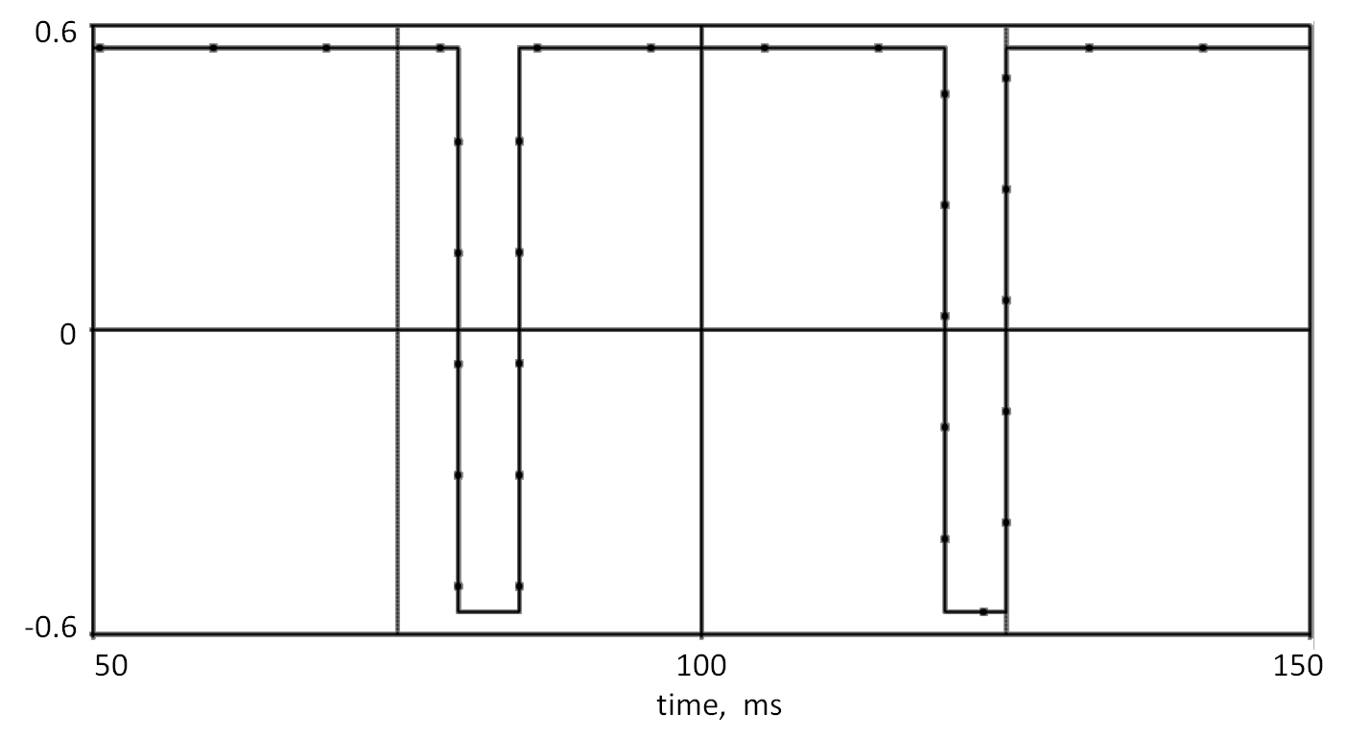
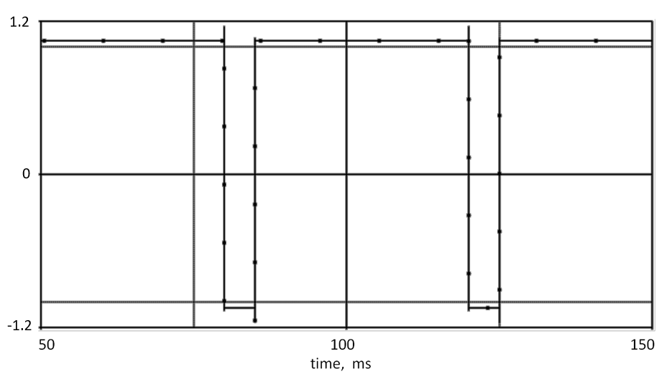
The simulation results of the neural network for three sample inputs.
 | V_{i1} | V_{i2} | V_{i3} | V_{i4} | V_{0, ideal} | V₀
Sample1 | -0.556 | 0.250 | -0.864 | -0.917 | -1.048 | -1.13
Sample2 | -0.111 | -0.167 | 0.390 | 0.417 | 0.727 | 0.8
Sample3 | 0.333 | -0.083 | 0.559 | 0.917 | 1.07 | 1.1
When we apply symmetrical pulse, time dependence of the conductance as small as possible.
Typical signal shown for V_{i1}=-0.556 V applied to neural network input
The corresponding output signal

Slide 15
Conclusion
The design of analog neural network with memristor crossbar arrays is considered.
The required activation functions are realized using sub-circuits consisting of Balun and CMOS transistors.
Iris data recognition application is used to test the performance of the proposed neural network.
The back propagation algorithm is used in MATLAB environment and performance of the proposed circuit is verified for the application of the iris data recognition.

Slide 16
Thank You for Listening
Thank you...

