Slide 1
Using Dimensions to Drive Insight
Re-imagining discovery and access to research:
Grants, publications, citations, clinical trials and patents in
one place

Slide 2

A brief biography
Currently working at Digital Science - Director of Strategic Accounts
Formerly open access publisher and launcher of mega journals at Nature and Elsevier
A career user of metrics in all of their many forms!
On a quest to understand how to use metrics to advance the communication of science

Slide 3

















Digital Science – a portfolio of innovative companies
Digital Science invests, supports and nurtures small innovative software companies
Rooted in research, most founders come from an academic background, started a company around solving a self encountered problem
Key principle: provide latitude, enable entrepreneurial spirit and activity, mix of ‘leaving alone’, ‘subtle guiding’, ‘having their backs’ and ‘open arguments’ like in every healthy family
Started in 2009, invested and started 12 companies to date about 300 colleagues

Slide 4


Challenges in the research information landscape
Metadata like publications / citations etc, main focus for decades - only reflecting research from 2-5 years ago
Relevant information for researchers, funders, universities etc. is highly fragmented and siloed (grants, publications, patents, clinical trials)
Vital data for the management of research orgs not accessible for the research community as required due to commercial interests and data monopolising strategies
Overall:
Not an innovation
promoting setting

Slide 5


The Digital Science team’s vision
Democratise / commoditise data – a precondition for innovation
Broader view
Rich contextualisation for discovery and research management
Balance of interests – Digital Science in a unique position to do this

Slide 6


Key aspects which we wanted to change
… available for researchers
at no cost, fair costs for institutions!
Citation data: High costs, limited use only!
Data is available to fuel multiple metrics, developed by the community
Simplistic metric driven
impact assessment
… data is a commodity, full
innovation potential of the research community is enabled
Data monopoly
blocks innovation

Slide 7


Enriched and interlinked – a modern approach to research data management
Dimensions data
Enrichment
Enriched metadata
Institution identification
Concepts
Clinical
trials
Categorization
Researchers
Policy docs
Publications
Concept
extraction
Organizations
Patents
Grants
Researcher
disambiguation
Classifications
Data sets
Altmetric
Reference extraction
References
Metrics

Slide 8



















Data integrated in multiple dimensions - pun intended
Research
Data sets
Tweets
Blogs
Clinical
Trials
Policy
docs
Grants
Conferences
Publications
Citations
Patents
Pre-publication
Post publication
1-5 years from grant to publication
immediate
2-3 years
years
years
decades

Slide 9






The data and links driving Dimensions...
97m
Publications
improved metadata
of 60m
700k links
435k
Clinical
trials
399k links
12m links
1.0bn links
11m links
84m
Altmetric
data
points
37m
Patents
10m links
9.9m links
16m to funders
865k links
370k to funders
155k links
202k to funders
318m links
4.2m
Grants
$1.3 trillion in funding
368k
Policy documents

Slide 10

Dimensions and metrics
We do not want to impose metrics ...
… metrics should be developed by the community
Example of a partner metric:
Relative Citation Ration (RCR)
… for a discipline, national or institutional level.
… please join the efforts for more and / or better metrics!

Slide 11

The metrics in Dimensions - close to the data...
Publication citations
Funding amounts
Altmetric attention scores
Annual citation rate*
…with an invitation to the bibliometric community to do research on innovative metrics on the Dimensions data and tool platform since Digital Science does not want to impose new metrics
* planned for future release
Patent citations
Highly cited*
Relative citation
ratio
SNIP/SJR
H-index*
Field citation ratio
Citation Recency

Slide 12

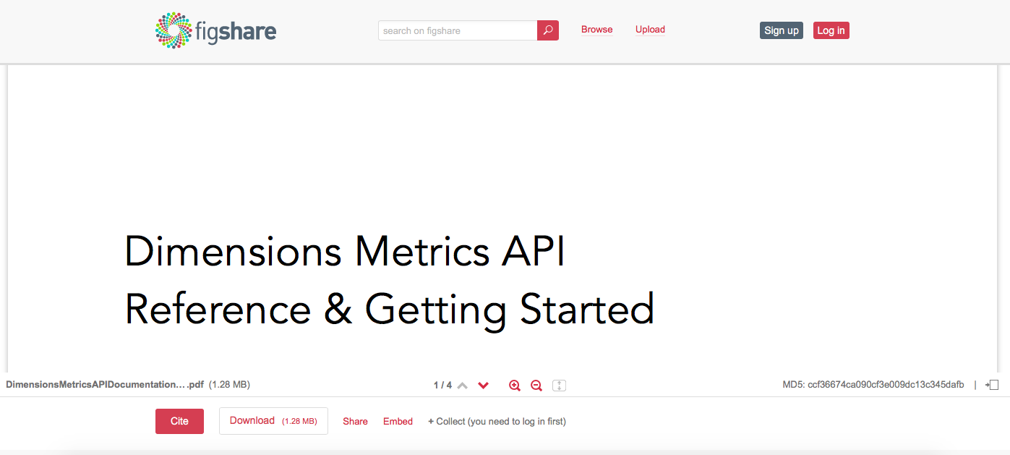
Dimensions Badges and open Metrics API
Dimensions is making publication and citation data available - also via badges and as an open metrics API
Find out more by going to:
https://figshare.com/articles/Dimensions_Metrics_API_Documentation/5783694

Slide 13
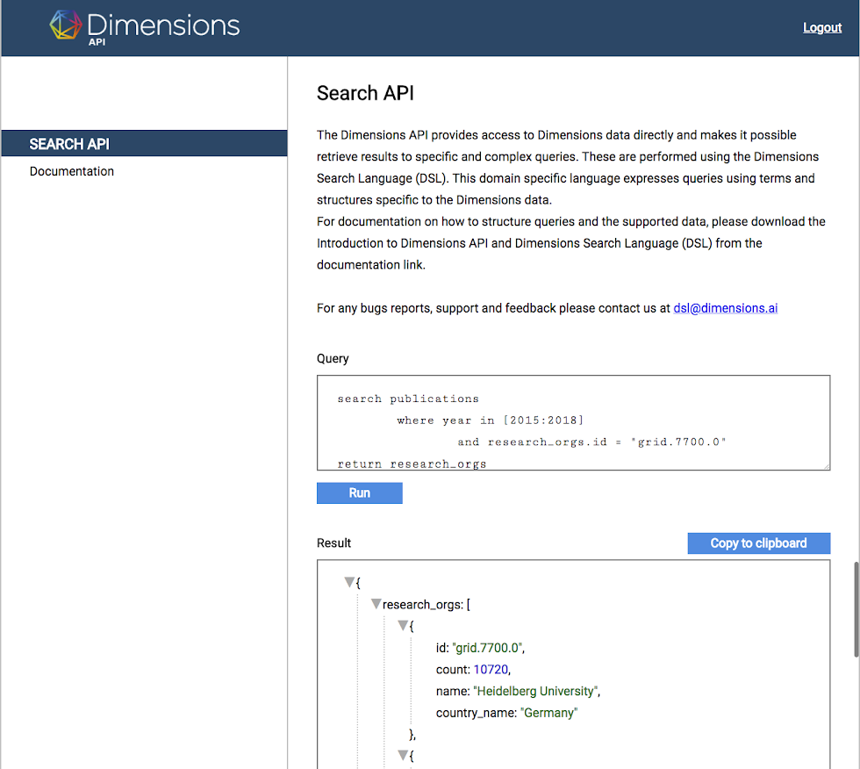
The Dimensions API
Powerful API - designed to allow flexible use of the enriched data
Use without constraints for internal purposes
Use data outside of the
web-app; e.g. in admin
systems or analytical software
Querying language made and
documented specifically
for new Dimensions

Slide 14
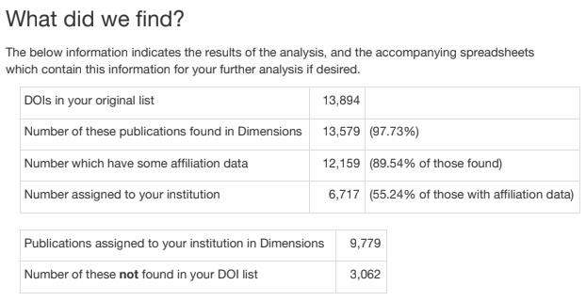
Free DOI Analysis
Custom report shows how many of your publications:
appear in Dimensions
are affiliated to your GRID ID
affiliated with your GRID ID, but NOT in the list provided
  some clients saw an increase up to 20%
Custom coverage report

Slide 15
Use cases
Use cases
Researchers
Discover research in my fields
Access that research
Keep on top of my fields
Identify and track my network
Strategize my publishing
Self-evaluate
Update my profiles
Bid planning
Research office
Support pre-award approvals
Statutory returns
Internal reporting
Library
Make research discoverable
Make full-text available
Analyze reading behaviour
Faculty or departments
Analyse competition and funding
Inform strategies
Support academic HR tasks
Notes:
Self explanatory

Slide 16






Dimensions application overview
Free
Plus
Ana-
lytics
APIs
· More than 97M publications
· More than 1 Billion citations
· Context to grants, patents
and trials on article level
· Free to use at no cost for
individual researcher
· Download 500 records
· Article-level Altmetric data
All ‘Dimensions’ and …
· Additional databases
For research grants,
Patents and trials fully
integrated and searchable
· Download 5,000 records
· SSO
· Full Altmetric badges/
aggregated metrics
All ‘Dimensions Plus’¹⁾ and …
· Workflow support for
funder / publisher (reviewer
identification and manage-
ment, coding support)
· Download 50,000 records
· Additional analytical views
· Additional filters
Search/analyze
Full flex data analysis with domain specific search language
Data
Feed for internal systems
Access OA articles
Access OA publications
beta
Enrichment APIs
(to be used in custom implementations)
Anywhere Access
Access open access publications and full text licensed by university
Citations: Dimensions Badges and Metrics API - openly available
Custom implementations / Consultancy services using Dimensions data and tools
¹⁾ Full Altmetric badges/aggregated metrics for academic institutions or Altmetric EFI license - otherwise article-level Altmetric badges

Slide 17
What can Dimensions tell us about research output in Turkey?

Slide 18
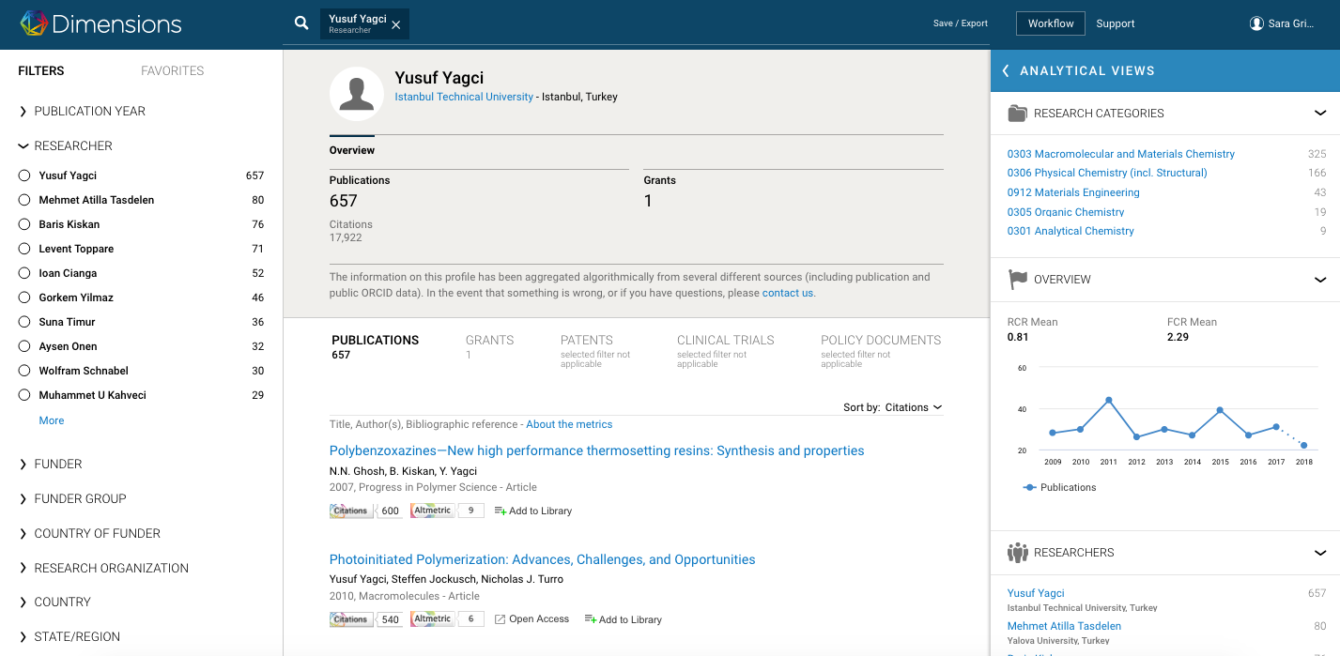
Let’s take a look at Yusef’s output!

Slide 19
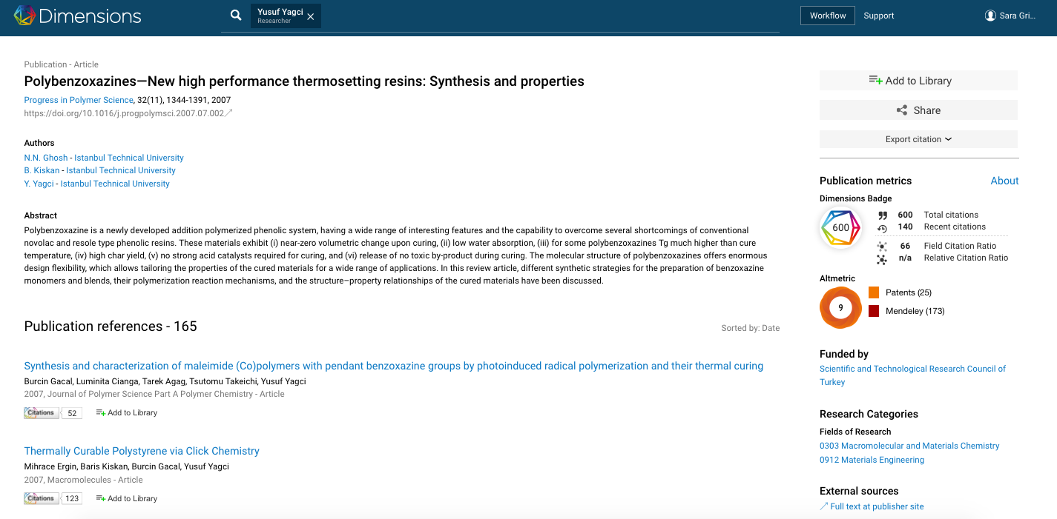
600 citations… what about the Altmetric data?

Slide 20
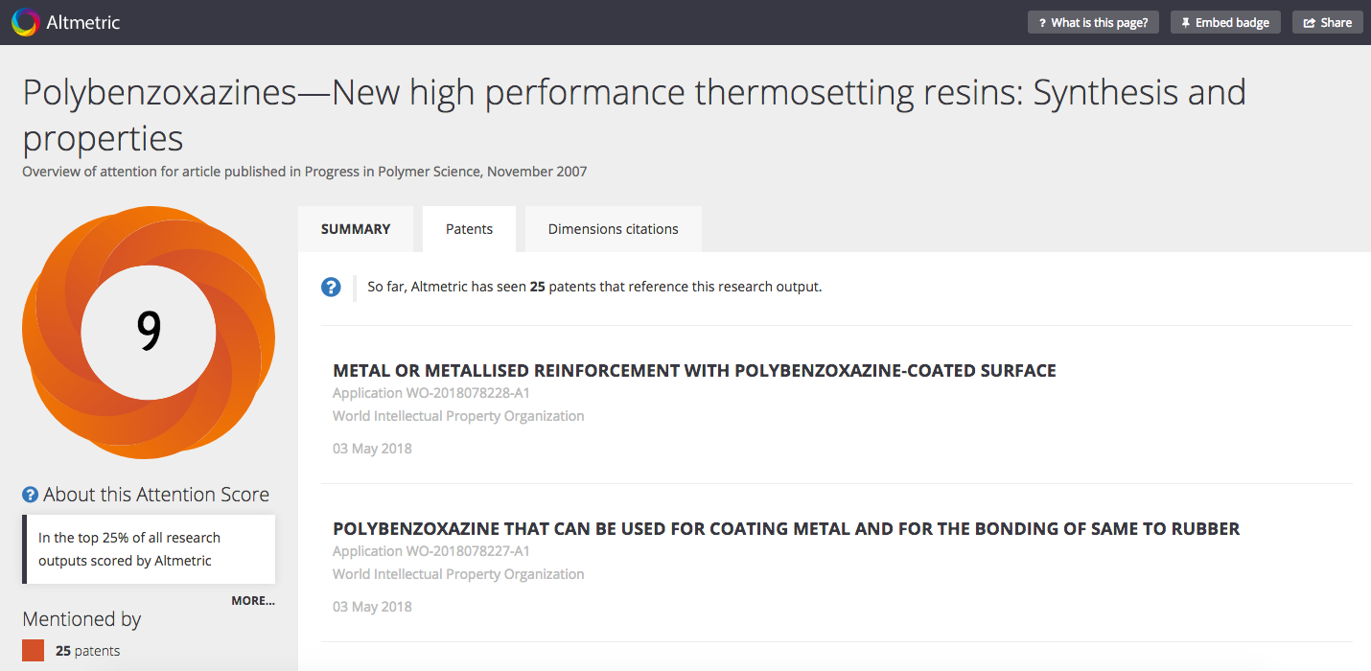
25 patents associated with this one article!
Notes:
Details page is free - make sure I say that

Slide 21
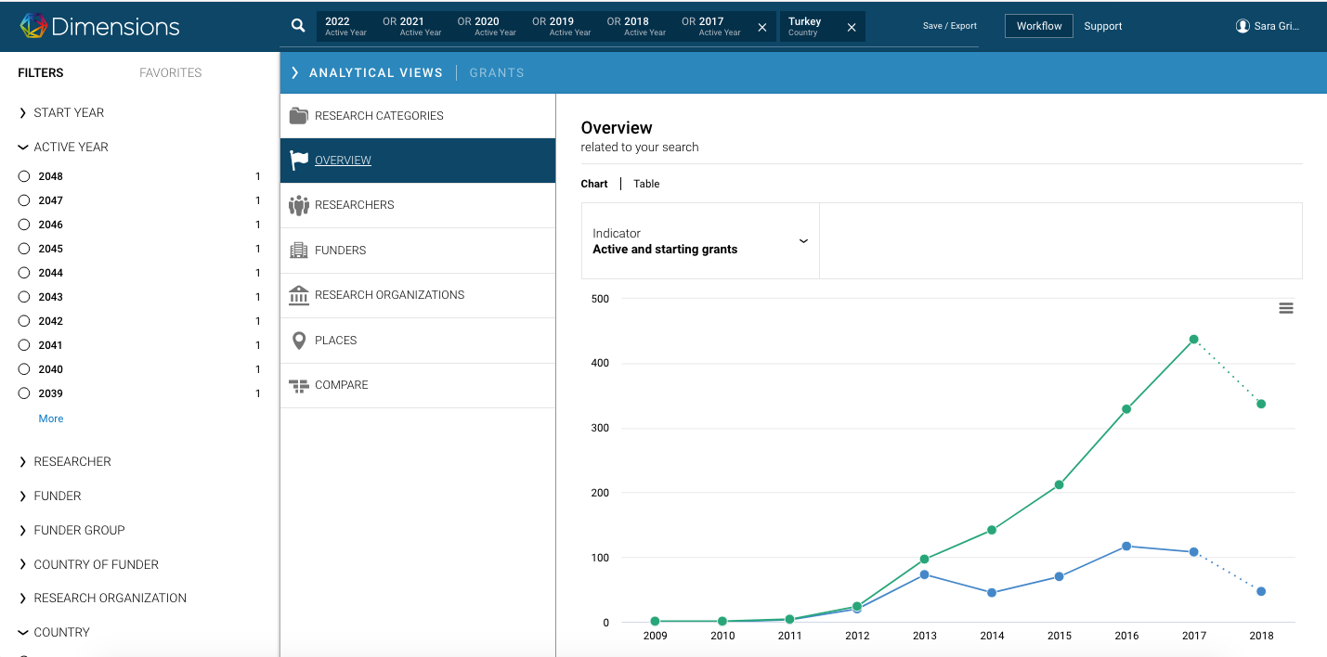
Grant funding in Turkey - future outlook

Slide 22
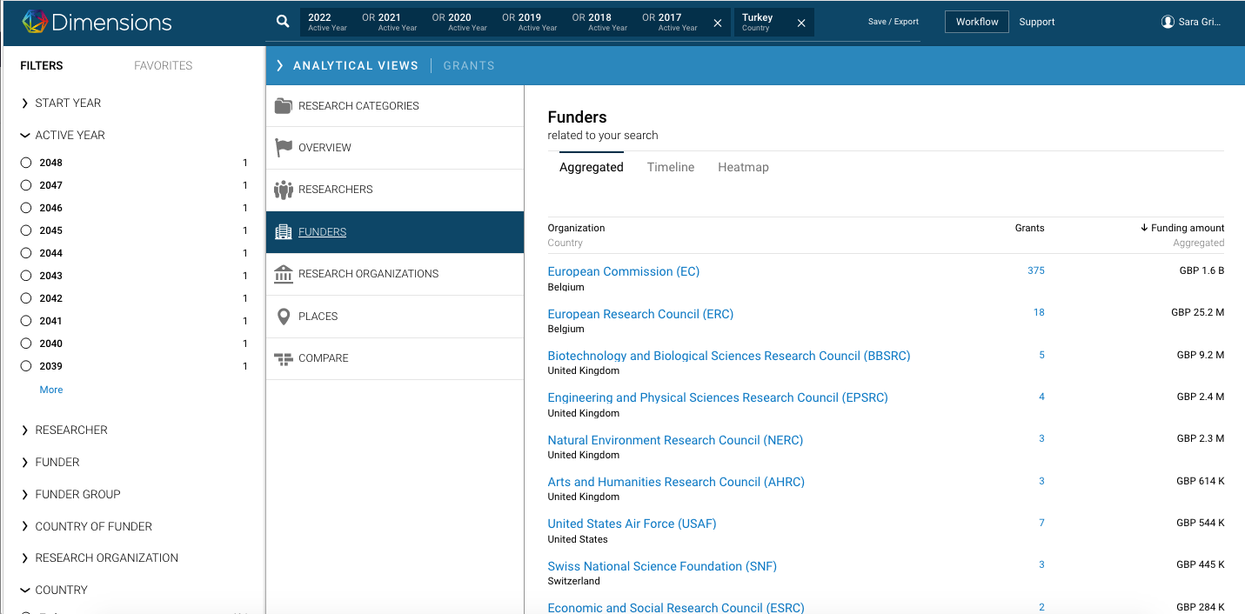
Grant funding in Turkey - international funding

Slide 23
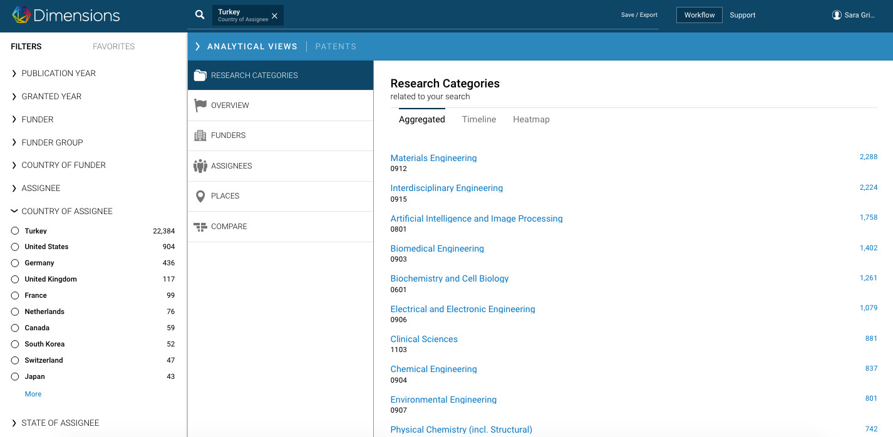
Industrial impact integrated in Dimensions - patents

Slide 24
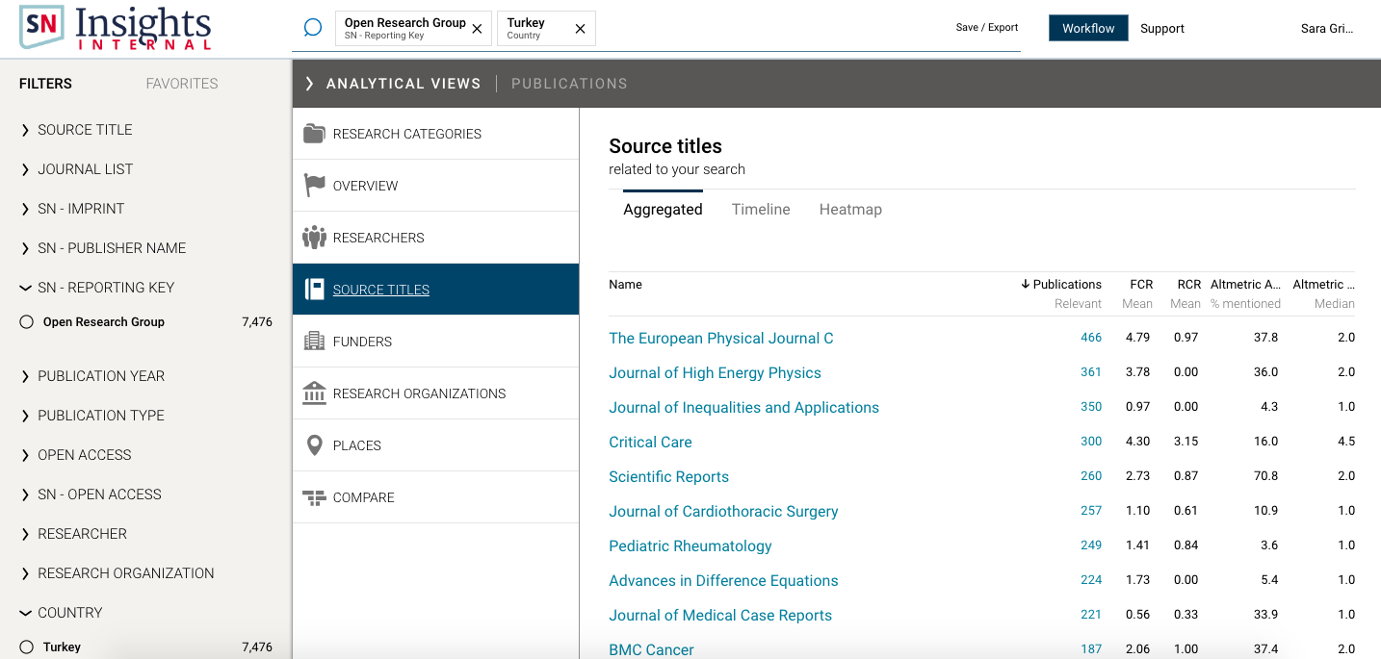
How Dimensions works with publishers

Slide 25
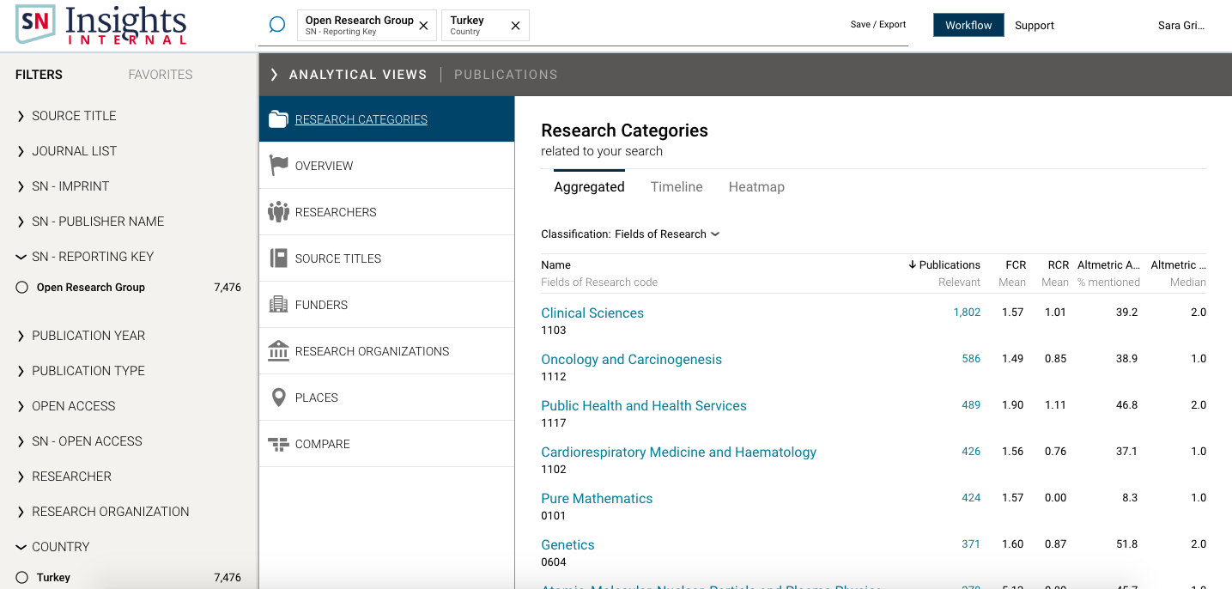
How Dimensions works with publishers

Slide 26
Questions?
s.grimme@digital-science.com

