Slide 1

İTÜ Scientific Research, Ethic & Seminar
Library Seminar : Scholarly Communication & İTU Library Services, Collections
1
Gülçin Kubat, Reference & Instructor Librarian (Academic )
https://akademi.itu.edu.tr/demirgul/
İTÜ Mustafa İnan Central Library
16 March 2022

Slide 2
Today Agenda
3
What is scholarly communication?
Scholarly Publishing Impacts Researchers
Key research(author/publication) metrics
Actors in the scholarly communication process
Why to publish a research paper? Tips for preparing a good scientific publication
How to start the research process? Creating a research
question, choosing topic, subject limitation…
ITU Library research support services, resources and tools

Slide 3
What is Scholarly Communication?
4
Scholarly communication is a multi-faceted term that encompasses various aspects of research and scholarship. It can be defined briefly as "the system of people, procedures, and tools through which the results of research and scholarship are registered, evaluated, disseminated, and preserved" (Ober, 2008)
include:
Authors’ rights,
Open science and publishing models especially Open Access(new normal mode of science),
Control of intellectual property,
Copyright,
Cost of commercial publications,
Role of scholarly associations,
Preservation of intellectual property, and
Institutional repositories.

Slide 4
Scholarly Publishing Impacts Researchers
6
Scholarly publishing is;
the process of creating and evaluating scholarly content, disseminating it to the scholarly community and the public, and
preserving it for future use.
It facilitates inquiry, collaboration, and the creation of new knowledge.

Slide 5
At the same time
7
Journal prices have increased significantly
Alternative models have emerged for disseminating scholarship
Faculty members are concerned about tenure and promotion
Scholars have lost control of the process

Slide 6
Ways the increase the impact:
8
International Collaborative research,
An author's use and dissemination of his or her work,
The accessibility of unpublished and published books, articles, and other products, and
The archiving of scholarly output.
Yet, most scholars pursue their research and disseminate the results with little or no expectation of direct financial reward.
(https://guides.lib.uni.edu/scholarly-communication)

Slide 7
Publish to Maximize Impact
9
Where you publish can maximize your research impact. Studies indicate that open-access articles are more immediately and more frequently cited than articles that are only available behind a paywall(commercial publ.) Increased citation rates lead to greater research impact.
How?...

Slide 8
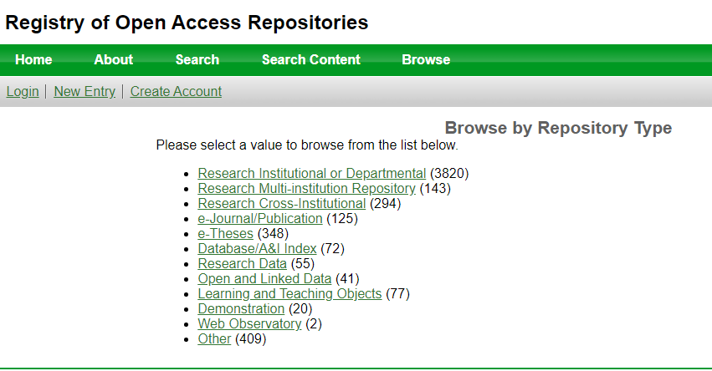
There are several options for making your research more widely available and maximize impact:
10
Start by retaining your copyright. This will allow you to disseminate your work more widely.
Consider making your work open access via for example:
The Directory of Open Access Journals (DOAJ), DOAB offers a list of free, full text, quality controlled scientific and scholarly journals & books in a broad array of disciplines. Select “For authors” to see the various open access options available.
Post/deposit your article to a repository, such as İTÜ Institutional Archive(POLEN )
Scholarly Communication –today more than open before

Slide 9
Research Metrics and its importance «conventional-unconventional measures»
12
Conventional
Bibliometrics; data about publications, or citation frequency, and related to. Common metrics are; Citation counts, , Citations per publication, H-index, Journal Impact Factor, scholarly output etc.
unconventional
Altmetrics; are measures that capture the attention a resource generates on the social web. They can be applied to websites, videos, people, and articles.
The Altmetric doughnut
https://www.altmetric.com/details/411736

Slide 10
You can use bibliometrics to:
13
analyse your research outputs
provide evidence of the impact of your research
find new and emerging areas of research
identify potential research collaborators
identify suitable sources in which to publish.

Slide 11
Big Notable Bibliometrics Tools
15
Sources of journals and books information that enable publication and citation analysis;
Web of Science (an index/abstract database that library has)
Scopus (an index/abstract database that library has)
Scival (a research mapping tool that library has)
Google Scholar (free)
Journal Citation Report (not has lib. subs.)
Dont forget!
You shouldn’t combine data from different sources to generate a specific metric, as their coverage is different.
When searching for specific researchers, ensure you include all their possible name variations.
Example;
Kişkan, Bariş
Kiskan, Baris
Kiskan, B.

Slide 12
Definitions of Common Bibliometrics metrics
Journal Impact Factor (JIF): based on the average number of citations received per paper in that journal during the preceding two years. Found in Journal Citation Reports database
h-Index: designed to measure an author's productivity and impact. It is the number of an author’s publications (h) that have h or more citations to them. Found in: Google Scholar, SciVal, Scopus and Web of Science database
Citation Count: the number of times a research output appears in the reference lists of other documents. Found in: Google Scholar, SciVal, Scopus and Web of Science database

Slide 13
Definitions of Common Bibliometrics metrics
Field-weighted citation impact: the ratio of citations received relative to the expected world average for the subject field, publication type and publication year. It can apply to a research output or group of research outputs. Found in: SciVal and Scopus
i10: The i10 metric from Google Scholar Citations is simply the number of times an entity has been cited in the past ten years.
Publication counts: Also known as scholarly output. The total number of outputs published by an entity. Found in: Google Scholar, SciVal, Scopus and Web of Science.
For more about metrics can be use METRICS TOOLKIT
https://libguides.library.albany.edu/citesearch
https://library.leeds.ac.uk/info/1406/researcher_support/17/research_metrics/3

Slide 14
Actors in the scholarly communication process
Author
Editor, Editor in Chief, Editorial Board, Additional Editors
Peer Review

Slide 15
Actors in the scholarly communication process
Author
The researcher is the person who determines a research question for the production of scientific knowledge; collects the necessary information and documents for his research; generates a hypothesis; analyzes and evaluates the information and documents it collects; interprets the analysis he has made and puts the research output into writing and has it published.

Slide 16
Actors in the scholarly communication process
Peer Review is “evaluation of scientific, academic or professional work by others working in the same field”. The terms "peer reviewed" and "refereed" mean the same thing. Peer review is widely used by many to referee quality journals:
to evaluate submitted manuscripts for publication (scholarly peer review);
professional groups to evaluate performance of their members,
grant agencies to evaluate requests for funding;
universities to evaluate faculty performance for promotion;
external survey groups to evaluate accomplishments of departments

Slide 17
Actors in the scholarly communication process
Editor
The editor is responsible for the overall quality of the journal's intellectual content as well as overseeing the review process to ensure it is complete, fair and timely. The editor is responsible for maintaining the journal's mission and scope, and for selecting articles that are new, original, and make significant contributions to science.
Editor in Chief
The main function of the EiC is to maintain and, when appropriate, enhance the reputation, profile, and editorial integrity of the journal. The EiC has final responsibility for all editorial content and the editorial decisions resulting in the publication of that content.

Slide 18
Actors in the scholarly communication process
Editorial Board
The editorial board, sometimes known as the (editorial) advisory board, is a team of individuals who are known experts in the journal’s field.
Roles:
Expertise in subject matter;
Reviewing submitted manuscripts;
Advising on journal policy and scope;
Attracting new authors and submissions;

Slide 19
Actors in the scholarly communication process
Additional Editors as follows;
Co-Editors;
Associate Editors;
Section Editors;
Editorial Advisors;
Editorial Committee Members

Slide 20
What is a Research Paper?
A research paper is an expanded essay that presents your investigation and argument on a focused topic based on the information you gathered. It demonstrates not only your understanding of available information from experts in the area of your research, but also your evaluation and insight on the subject matter through an orderly and logical presentation of your argument.

Slide 21
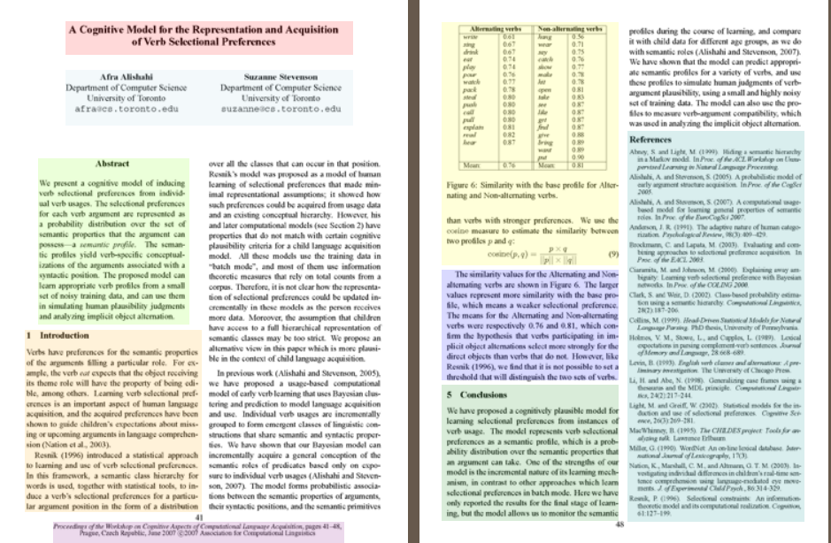
Understanding Research Papers
23
Presented by the North Carolina State University (NCSU) Libraries, this tool identifies and describes each element that comprises
a research paper: Anatomy of a Scholarly Article

Slide 22
Anatomy(sections) of a Research Paper is a consecutive flow
Title, Abstract
Introduction, context, background(prior work, literature survey)
Problem Identification, Definition(formulation)
Problem modelling, formulation
Approaches, solution, contrubution,insight
Validation, verification, experimentation,result
Conclusion, speculation
References, Bibliography

Slide 23
What Are the Qualities of a Good Research Paper?
in general qualities:
A strong and focused thesis statement-researh question
Logically organized arguments and main points
Each main point is supported by persuasive facts and examples
Opposing viewpoints are included and rebutted, showing why the author's argument is more valid
The paper shows the author's understanding of the topic and the material being used
The work is original, not plagiarized
Every source is correctly documented and credited in a recognized citation style-like APA, HARWARD,MLA
The paper is written in clear language

Slide 24
Why to publish a research paper?
23
To publish an article is an important step in an academic career. The way that scientific research is shared, validated, and visible in future journals is to publish academic articles.
When you publish an academic article;
Validity,
Persistence in the scientific literature,
Recognition and visibility of research,
Sustainability and development of science is ensured,
Also there are other factors.
https://libguides.northwestern.edu/scholcomm

Slide 25
Why to publish a research paper?
Validity is important for the proof of the research done. Articles submitted to academic journals require referee approval. Articles approved by the referee are validated in the scientific world.
Persistence in the scientific literature: With the publication of the article in a scientific journal, the research takes its place in the academic literature and is included in the science archive.
Recognition and visibility of research: Publishing in academic journals followed by scientists ensures that research is promoted and visible.
Sustainability and development of science is ensured: The published research results are the most important reason for the sustainability and development of science.
Other important reasons for the necessity of publishing can be listed as academic career and promotions, research support, social responsibility and idealism.

Slide 26
Tips for preparing a good scientific publication
The author must set a goal for himself before starting to work.
Is this study needed in the scientific field or how much is it needed?
Will it provide a solution to a problem or add any innovation?
It should be careful that it is not a subject that has been discussed many times and outdated.
The work to be done must necessarily present new information in the relevant field.

Slide 27
Also some resources or environments can be used to provide data that can give ideas or create infrastructure…
Some good examples;
Current or currently being studied master's or doctoral thesis
A study/research conducted on a global topic or problem
A presentation/statement made at a int. scientific meeting
A completed project: Projects that are carried out as a team are often carried out in the academic world
Ideas and researches developed on a new invention, formation or case
Scan and make literature readings

Slide 28
Writing a research paper process
Choose a Topic
Current or historical? Any geographic restriction (such as within Turkey or global), related to a specific group (such as teenagers, college students, women)?
Conduct Background Research
  Search for news articles, top hits on Google, and encyclopedia articles.(collect general trends)
Refine your Topic
  Narrow down what you want to investigate. Think about the who, what, when, where, and why for your topic.
Create a Research Question
  Come up with a tentative question you want to answer in your project.
Develop a Search Strategy
  Select your resources and develop your keywords

Slide 29
cont. Writing a research paper process
Search(its a literature review)
  Conduct multiple searches in relevant resources
Evaluate your Results and Sources
  Use the CRAAP Model: Currency, Relevancy, Authority, Accuracy, and Purpose
Adjust and/or Repeat your Search
  Try different keywords, resources, and strategies depending on your needs
Start Writing
  Incorporate your sources into your writing from the beginning
Review and Re-Search
  Fill in the holes, explore new areas of interest, dig deeper, etc.
Cite, Review, and Edit
  Put the final touches on your project

Slide 30
Select a Topic
29
generally, the research process consists of these successive stages.
Identify Keywords
Find Background Information
Formulate a Thesis Statement
Create an Outline
Locate and Retrieve Materials
Evaluate Information
Take Notes
Write the Paper
Review Paper and Citations

Slide 31
Research Process Step by Step(in briefly)
Step 1: Develop a Topic: Select Topic, Identify Keywords, Read Background Information, Develop Research Questions, Refine Topic
Step 2: Locate(find) Information-as a literature review
Step 3: Evaluate Information(CRAAP Model)
Step 4: Write
Step 5: Cite Sources (Legal / Ethical Use)

Slide 32
Types of scholarly publications
are written by and for faculty, researchers, or other experts in a field
use scholarly or technical language
include a full bibliography of sources cited in the article
are often peer reviewed (refereed)
Handbook - provides overview
Monograph - provides extensive, in-depth information
Journal article - recent research
Reference work - provides overview
Edited books - recent research
Conference material - recent research
Dictionary - about terminology

Slide 33
First step is to find topic-You can find topic ideas from different sources, such as:
Scan your textbook, review your class discussions, notes, and readings.
Peruse current magazines and newspapers to see what catches your eye.
Browse electronic encyclopedias, handbooks, manuals.
Browse websites.
Look at library databases that feature articles on current events and controversial issues
Discuss topics with your instructor, a reference librarian or a classmate.
Personal interests, Choose a topic that interests you and holds your attention. The research will be more enjoyable!

Slide 34

Identifying Keywords
Key terminology can be easily found by scanning:
Your research questions
Articles found from background research
Bibliographies found at the end of books and articles
If you are still struggling:
Use a thesaurus to identify synonyms.
Find pictures related to your topic, then describe them.
Brainstorm keywords with a librarian, your instructor, or a friend.
Use A concept map is a graphical tool used to organize and structure knowledge.
https://bubbl.us/
http://popplet.com/
Mindmup
Thinking Tool

Slide 35
Once you have identified keywords, the next step is to find background information on your topic
Background information serves many purposes:
If you are unfamiliar with the topic, it provides a good overview of the subject matter.
It helps you to identify important facts related to your topic such as terminology, dates, events, history, and relevant names or organizations.
It can help you refine your topic.
Background research might lead you to bibliographies that you can use to find additional sources of information.

Slide 36
Background information can be found in:
article databases
Print or electronic textbooks
dictionaries
general encyclopedias, ehandbooks, ebooks
subject-specific ebooks, manuals, handbooks
Wikipedia
Most of these sources are often listed on the «Databases" tab of our main webpage, also can be access at Tarıyorum and Library Catalog main search tools.

Slide 37
As you search, think about:
Do you need to broaden your search out, or narrow it down to a tighter focus?
As you search, you'll see synonyms or similar terms that may be useful. Write them down and try them out.
Try different combinations of words. Good research involves many searches, not just one.
If you are only getting a few results in a search, check your spelling. Databases can't correct for misspellings.

Slide 38
how do you choose the best search terms for your research
Write down what you already know
Use your textbook, assignment or general knowledge.
For example :simple keywords Anxiety and young adults
Think of synonyms and closely related words.
Orginal keywords anxiety, young adults, related words:panic, grown- ups, nervousness
Look for more academic keywords
Do little search; you can use Index/Abstract Database(Scopus, Web of Science)

Slide 39
How to Search a Database
When doing research for a paper, you will get your best results by using good search techniques. We are all used to using Google to find things easily, but Google is not the best tool for the first steps of university level research. It's much more efficient and productive to use library databases.

Slide 40
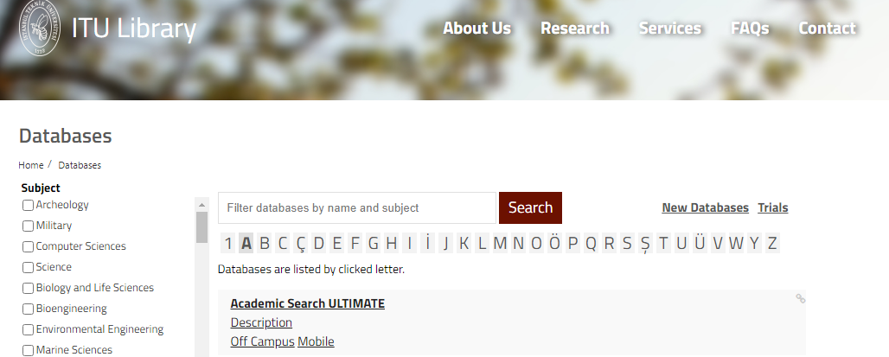
What is a Database?
https://kutuphane.itu.edu.tr/en/research/databases#harf-A
A collection of information organized for easy retrieval. Provide access to scholarly journal articles, popular magazines, conference proceedings, technical reports, newspaper articles, and more. Most of our databases offer links to the full text of articles. These databases are excellent starting points for your research because they have something on every subject:
ScienceDirect
Search for peer-reviewed journal articles and book chapters (including open access content)
To identify the most appropriate database for your research topic:
consult the database descriptions on the Library's Database A-Z page
If you need help locating the most relevant database, contact a Reference librarian

Slide 41
Usefull infos about library databases
In some databases you can open an account and save the references beyond your current session.
You can export references in different formats.
You can export them to Reference Management programs. ITU Library offers Mendeley program.
Many databases offer libraries a choice which subsets they subscribe to and which not. More and more databases show the complete content to the public, including nonsubscribed parts. It is always possible to limit your search to the content that can be accessed.
You can tick or untick boxes like:
- hide unsubscribed content
- full access only

Slide 42
Type of İTÜ Library databases
bibliographic databases; i.e. databases with references to publications
e.g. Index/Abstract database Scopus, Web of Science
databases with the full text of publications; ebooks, journals, standards, theses.
ProQuest Ebooks Central
EBSCOhost eBook Collection
Springer eBooks
Elsevier eBooks
Wiley eBooks
Cambridge Ebooks

Slide 43
Type of İTÜ Library databases
Science Direct e journals
Sage eJournals
Wiley eJournals
Taylor & Francis eJournals
Oxford Academc Online eJournals
SIAM eJournals
ACM eJournals
ACS eJournals, ebooks
IEEE eJournals
ASTM Standards
BSOL Standards

Slide 44
Type of İTÜ Library databases
EMIS (Emerging Market Information Systems) industrial/consumer market statistics
Web of Science, Scopus, Scival-Reserach Impact
Mango Language Learning Program(70 languages)
JoVe-Journal of Visualized Experiments video journal
Open Access Resources;
DOAJ, DOAB, Google Books, Arxiv, Aperta. Etc.

Slide 45
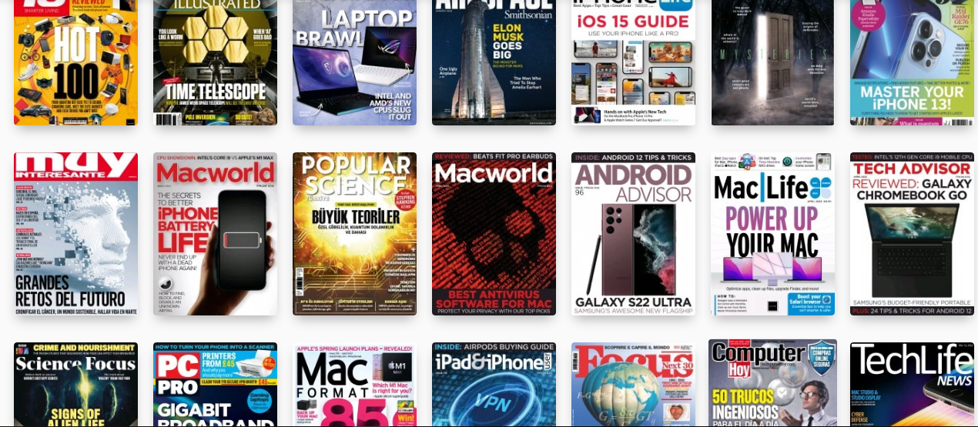
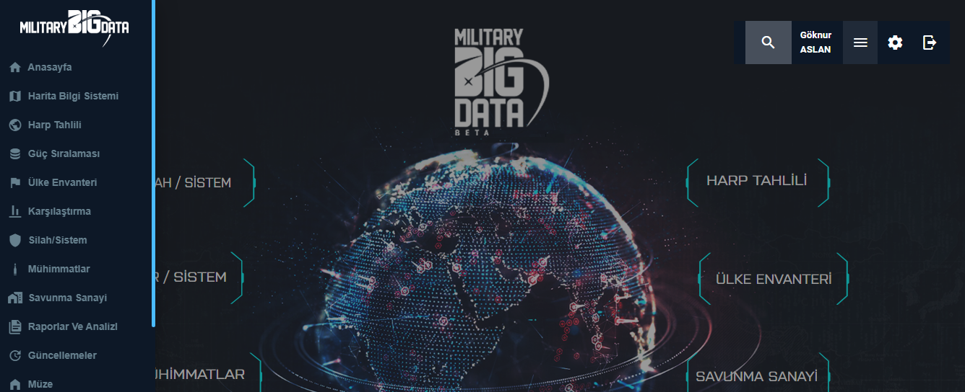
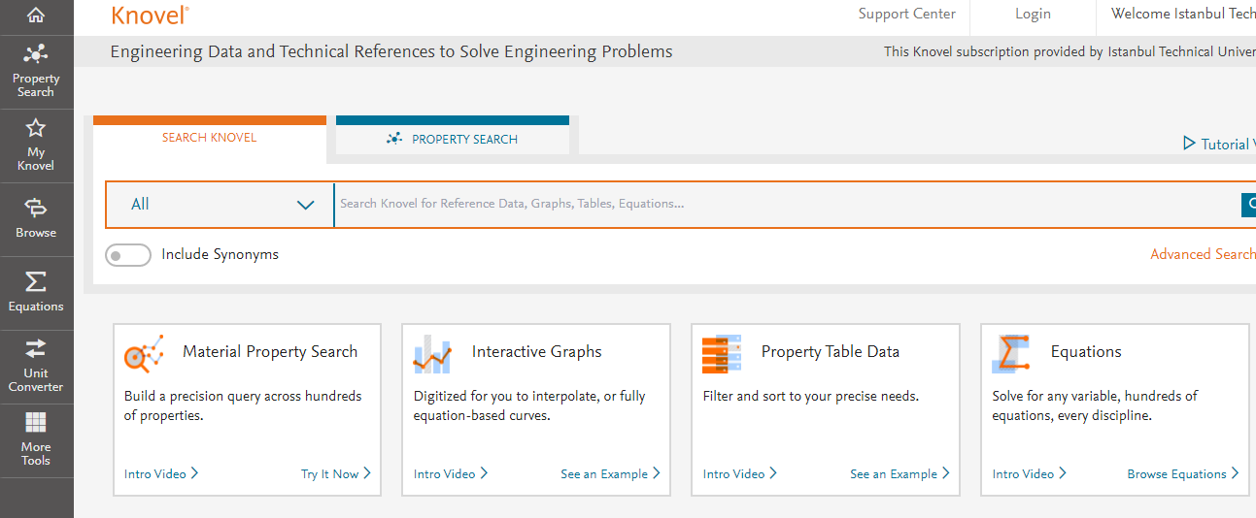
Databases New Subscriptions
McGraw Hill Access Engineering(textbooks)
Knovel Ebooks
Geoscience World
Military Big Data
Press Reader(international/national newpapers, journals, magazines)
ProQuest Central(journal,book, report)

Slide 46
Combining Keywords
When researching, we are like detectives trying to combine the right terms in the right place to find the information we need. This information will help you combine search terms to find relevant sources.
Broad Search
Search for information using the single most important term related to your topic. Use this type of search when looking for basic background information.
Specific Search
Search for information by combining key concepts using the words you have brainstormed. Each concept/word should be separated by the word "AND". Use this kind of search when looking for specific evidence related to your claim or thesis.
Getting Too Many Irrelevant Results?
Add more specific search terms, use limiters (e.g. between specific years, or peer-reviewed articles only, search for an exact phrase (use double quotation marks).
Getting Too Few Relevant Results?
Change or remove some search terms, search with OR, use synonyms, use Truncation/Wildcards .

Slide 47
Make your reseach more specific--- Use Boolean Operators
Boolean operators are logical algorithms that name comes from mathematician George Boole who lived in 18. century. These operators have known conjunctions as AND, OR, NOT. Boolean Operators enable a researcher to use data effectively and efficiently in the research process.
Using AND :
narrow your results
tell the database that ALL search terms must be present in the resulting records
example : research AND ethics- combines these two words
Using OR :
connect two or more similar concepts (synonyms)
broaden your results, telling the database that ANY of your search terms can be present in the resulting records
example: research OR survey OR search

Slide 48
Boolean Operators
Using NOT :
exclude words from your search
narrow your search, telling the database to ignore concepts that may be implied by your search terms
example: cloning NOT sheep

Slide 49
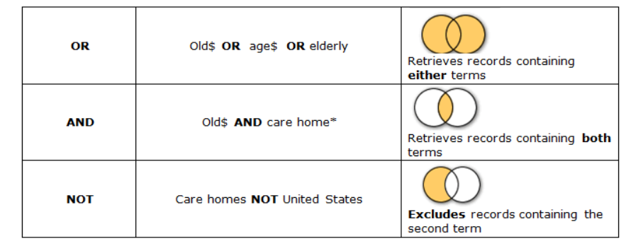
As an image of Boolean Operators

Slide 50
Use Truncation & Phrases
Truncation, also called stemming, is a technique that broadens your search to include various word endings and spellings. Truncation symbols are *, !, ?, or #-(asteriks, exclamation mark, question mark, or hash)
To use truncation, enter the root of a word and put the truncation symbol at the end.The database will return results that include any ending of that root word.
Example : child* = child, children, childrens, childhood
Using Phrases :
Phrases are a variation on how databases and search engines recognize concepts. Using parentheses or quotes around search words is a common way to do phrase searching, but not all databases or search engines use them.
Example : “ electronic engineering”- quotes narrow your results quite.

Slide 51
How to Formulate Effective Research Questions
Once you have selected a topic, the next step is to develop research questions.
Write down what you already know or don't know about the topic.
Use that information to develop questions.
  Use probing questions. (why? what if?)
  Avoid "yes" and "no" questions.
  Good research question should be
  Focused
  Researchable
  Feasible
  Spesific
  Complex
  Relavent

Slide 52
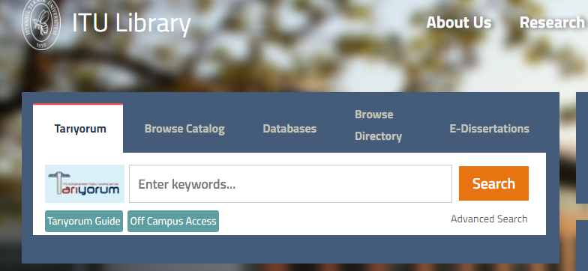
Library main search tools- accesible on Campus & off Campus
When you visit the library web page www.library.itu.edu.tr you can see different 5 search tools.
Tarıyorum-for all collections-find fulltext eazly
Browse Catalog-to find a specific publication; e.g. book, journal
Databases-books, articles, videos, theses, statistics
E-Journals/Books-to find fulltext scholarly articles, books
E-Theses- -to find fulltext foreign theses
Ebooks-textbooks, handbooks, manuals, encyclopedias available on Tarıyorum, Library Catalog and Databases Page

Slide 53
Locate Information; hard copy or electronic books, journals, textbooks etc.
The İTÜ Library Catalog is a collection of records includes all pbooks, eBooks, CDs, DVDs, print journals among others.
You can access the library catalog directly using the link above, by visiting the ITU Library main page.
The researcher can search by, keyword, title, author and subject heading. Researchers who are sure of which type of publication they are looking for can use this field.

Slide 54
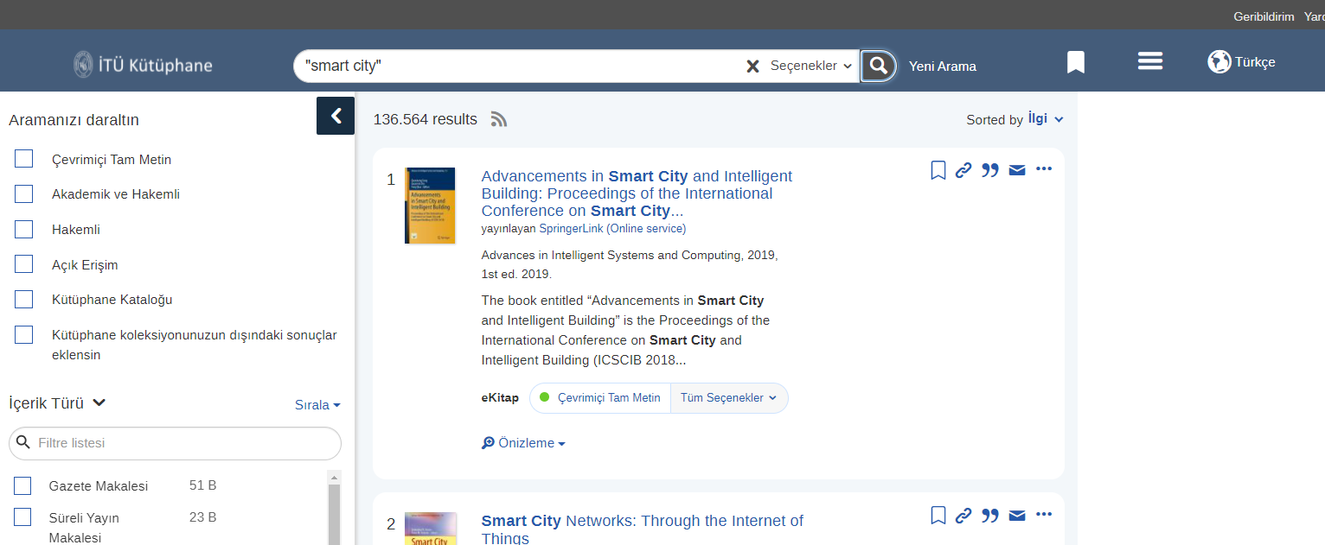
“Tarıyorum” e-collection discovery tool
«like a google scholar of the library»
“Tarıyorum” is the search engine and researchers can make literature searches and see all library collections here.
It is possible to search by keywords, phrases, authors, titles
While doing research you can use boolean operators; AND, OR, NOT

Slide 55
when doing a «literature review» start with research databases
Scopus and Web of Science are good databases to start with for any research topic and literature review.
Scopus is a large multidisciplinary database covering published material in the humanities and sciences. It also provides citation analysis of authors and subject areas
Web of Science - Core Collection The leading citation index' of scholarly literature, chemical reactions and author information. Includes citation databases: Sciences Expanded,Social Sciences, Arts & Humanities Conference Proceedings and Emerging Sources Citation .

Slide 56
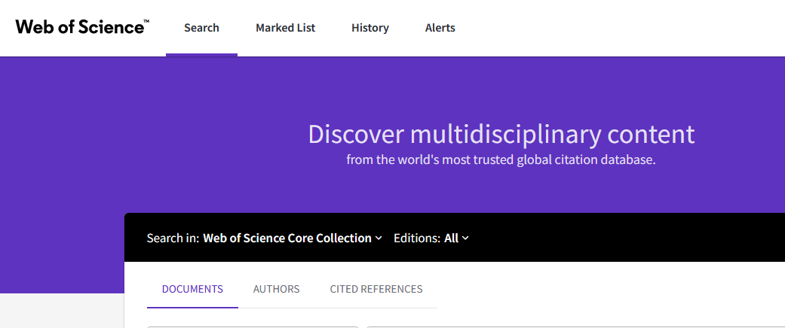
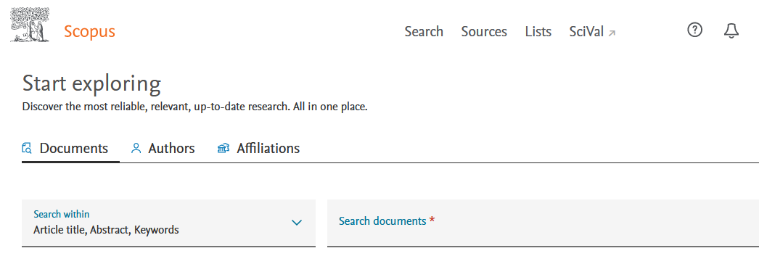
Scopus & Web of Science-fundamental literature review sources
https://kutuphane.itu.edu.tr/arastirma/veritabanlari#5948
https://kutuphane.itu.edu.tr/arastirma/veritabanlari#5965

Slide 57
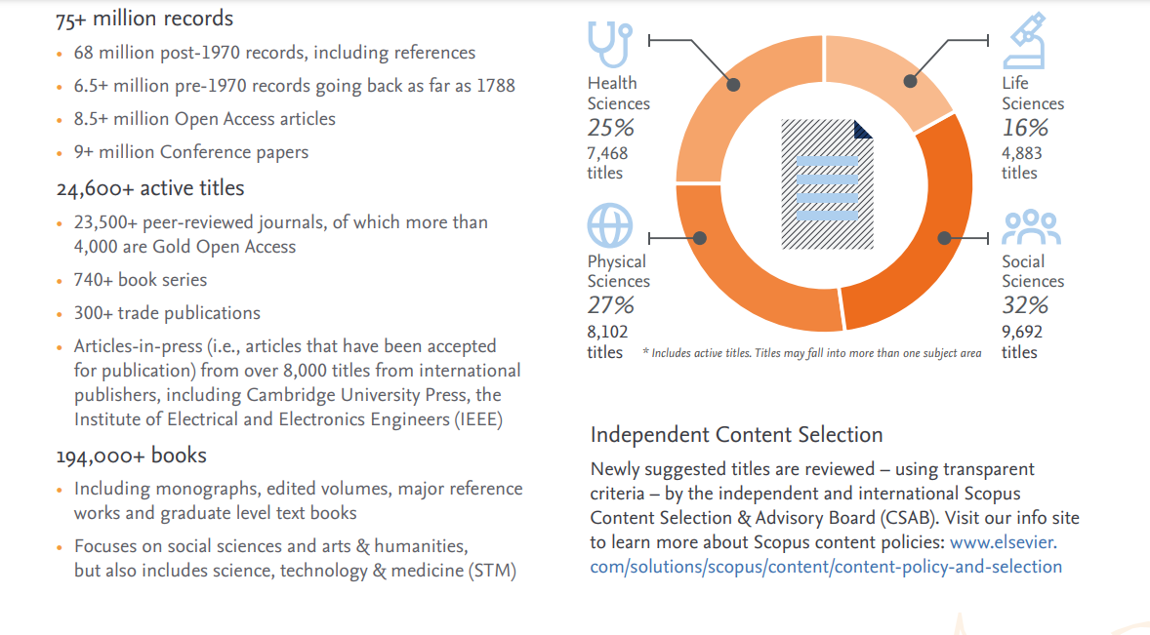
Scopus; index-abstract database

Slide 58
Locate Information at ITU Library- e-scholarly journals
Searching an Article Database on campus and off campus
Searching on campus and off campus İTÜ Library Electronic Journal List
Searching on TARIYORUM discovery tool on campus and off campus (it works like Google Scholar and it covers whole electronic collections)
Searching on Scopus and Web of Science are good databases to start with for any research topic and literature review.

Slide 59
Locate Information at ITU Library; print books
Interlibrary Loan(ILL)
How are books organized at ITU Library?
Request materials not owned by ITU Libraries
Fill out the Interlibrary Loan Request Form and you will be notified when your publication is available for pickup.
Books are organized using the Library of Congress Classification System at the library.

Slide 60
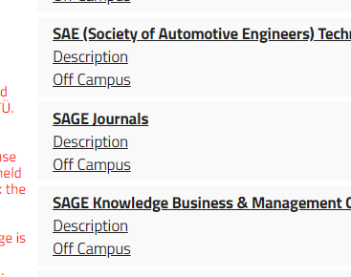
Searching ITU databases on campus;
you should click only database name through the library Databases page

Slide 61
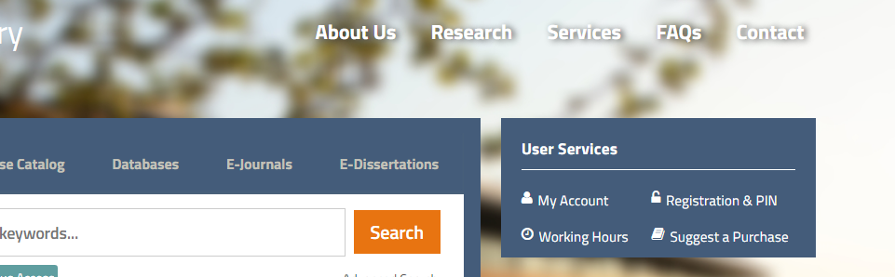
searching library databases «off Campus»
Searching off campus you need library account and library PIN.
if already have, only follow Off Campus links on the library webpage.
If you dont have a library account:
fill the online membership form under the User Services on the main page through the «registration and pin page»
You can apply for the library registration using your İTÜ email account.
Your application will be reviewed and approved soon then you will be notified via e-mail sent to your İTÜ account.
Than take your library PIN from the PIN Procedures page.

Slide 62
For «literature searching» try to «Cited Reference Search» on Scopus or Web of Science databases that library has
Tracking cited references provides many insights. For example, you can:
Track the research trajectory of an individual researcher
Track the history of a research idea
Locate current research based on earlier research
Determine how many times and where a publication is being cited
Learn who is citing a particular source
Track how a research topic supports other lines of scientific inquiry
Analyze the impact of a scholarly work
https://libguides.library.albany.edu/citesearch

Slide 63


İTÜ Library "cited reference search« tools
WEB OF SCIENCE go to Library DATABASES page
https://kutuphane.itu.edu.tr/arastirma/veritabanlari#5965
SCOPUS go to Library DATABASES page
https://kutuphane.itu.edu.tr/arastirma/veritabanlari#5948

Slide 64
Academic writing tools that library provides
Mendeley : Reference Manager Software
Turnitin
Ithenticate
İntihal.net
to get more detail about products please reach Reference Librarians

Slide 65
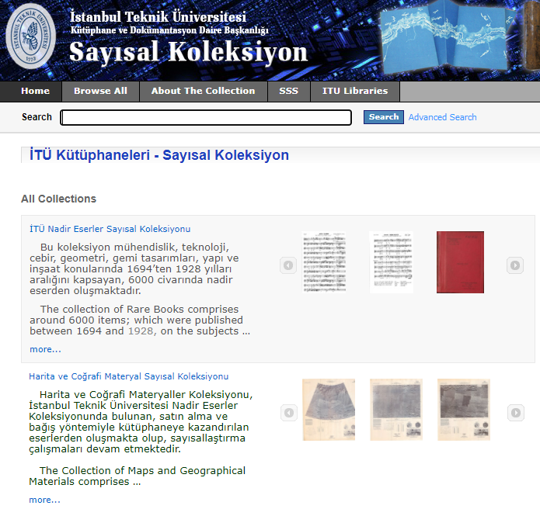
İTÜ Digital Collections comprise of four main collections http://www.library.itu.edu.tr/en/research/digital-collection
-ITU Rare Books Collection : Inheriting the heritage of Mühendishane (Imperial School of Engineering) Printing Press and the Library of Mühendis Mektebi (Ottoman School of Engineering), ITU Rare Books Collection comprises a primary resource for the study of history of science and technology in the Ottoman Empire and early Repuplican period of Turkey.
-Collection of Maps and Geographical Materials : The bulk of the collection comprises approximately 5000 maps on geology, which were donated by Prof. Dr. Celal Şengör.
-ITU Turkish Music State Conservatory Digital Collection : The musical nota collection in the Turkish Music State Conservatory Ercümend Berker Library, which originally belonged to Cüneyd Orhon, was donated by the Orhon family in 2014
-Prof. Dr. Kazım Çeçen Slide Archive: This archive, which was created by scanning 5855 slides and 700 negative films, mainly includes slides and negatives taken during the Ottoman and Roman periods of water structures and water pipelines researches starting from the last years of the 1970s to the mid-1990s.
İTÜ Digital Collections can be accessible on campus and off campus via your library account.

Slide 66
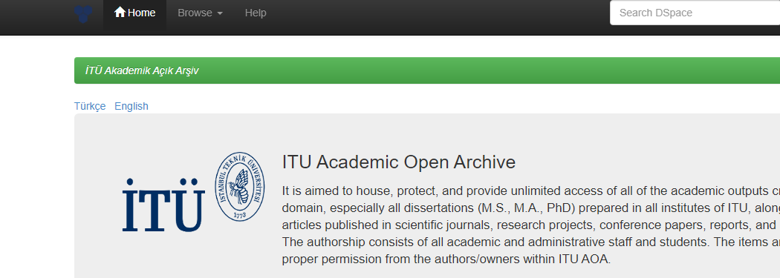
İTÜ Institutional Academic Open Archive(open access)
https://polen.itu.edu.tr/xmlui/
It is aimed to house, pro​tect, and provide unlimited access of all of the academic outputs created in the ITU domain, especially all dissertations (M.S., M.A., PhD) prepared in all institutes of ITU, along with scholarly articles published in scientific journals, research projects, conference papers, reports, and lecture notes.
The items are published, with proper permission from the authors/owners within ITU AOA.

Slide 67
Research support services
Reference Services provide library users with direction to library materials, advice on library collections and services, and expertise on multiple kinds of information from multiple sources.
In this context, reference librarians; answers research questions via face to face, online chat, e-mail, telephone,
gives information literacy training seminars to researchers,
prepares video training content for researchers about library resources and use,
performs promotion and access services of new subscribed databases and potential databases.

Slide 68
ITU Library one to one research support service
Ask a Reference Librarian
Enquiries about Library Resources
Library Orientation & Tours
Instructional Classes
Research Assistance
Email: kutuphanedanis@itu.edu.tr
Phone: (0212) 285 30 13 ext. 4110,4111, 4118, 4121,4151
Live chat on weekdays 10.00-12.00—14.00-16.00 https://kutuphane.itu.edu.tr/
Follow us on Twitter @LibraryITU

Slide 69
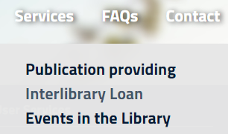
Other research support services
Inter Library Loan:
ILL is a service whereby a user of one library can either borrow library materials or receive their photocopies that are owned by another library through reciprocal lending arrangements.
To request the publication, it is enough to fill in the publication request form after clicking the “services” button.

Slide 70
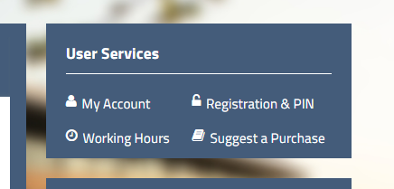
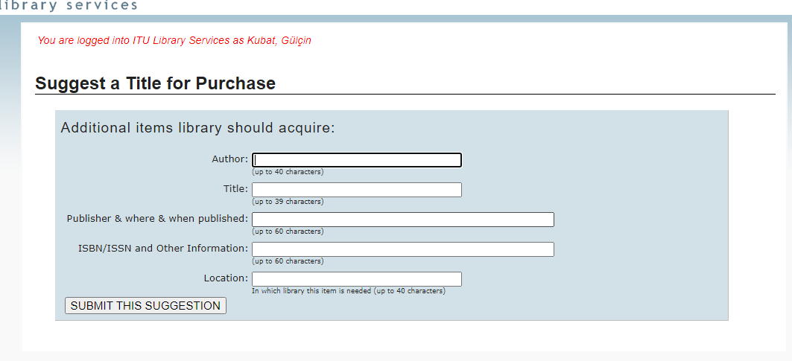
Other research support services
Publication purchasing
Every ITU member can request publications from the library, to request any publication please use Suggest a Purchase
Publications are provided according to the Library Collection development policy.

Slide 71
Resources for early career researchers
Elsevier Researcher Academy
Springer Journal Author Academy
The Publons Academy

Slide 72
The new normal for science: open science
Open Science: the practice of science in such a way that others can collaborate and contribute, where research data, lab notes and other research processes are freely available, under terms that enable reuse, redistribution and reproduction of the research and its underlying data and methods. (FOSTER Open Science)

Slide 73
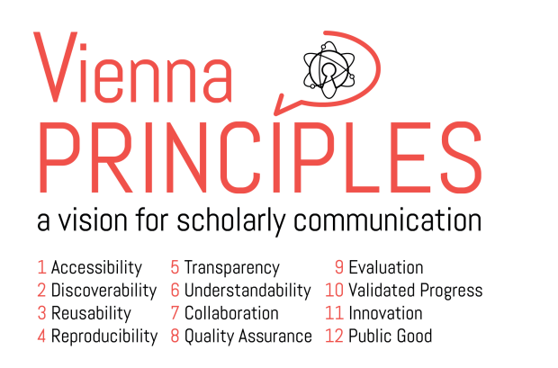
The Twelve Principles of Scholarly Communication
5

Slide 74
Thank you for your attention
now time to go our mini survey☺
İTÜ VETİ

