Slide 1
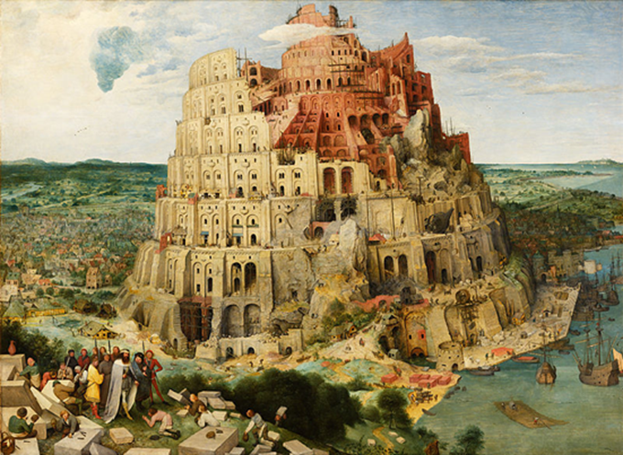
F
Bibliometric Services @ Vienna University Library:
Put into Practice
Bibliyometri Calistayi 18, Istanbul, 23 October 2018
2018, Vienna
Juan Gorraiz
Bibliometrics &
Publication Strategies
Vienna University Library
University
of Vienna

Slide 2
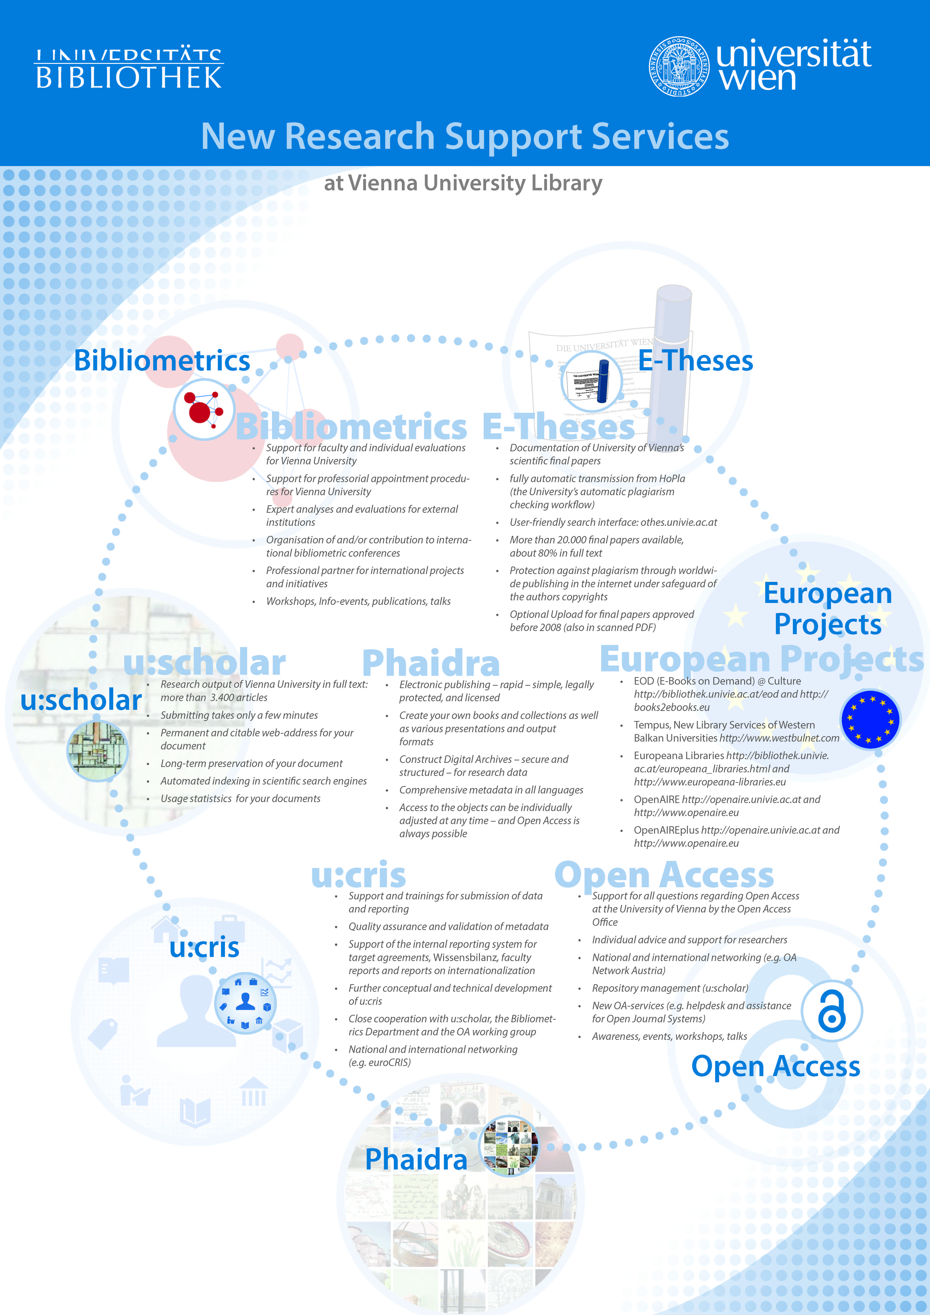

Slide 3
Scientometrics @ University of Vienna
in 2006 → formation of working group „Scientometrics“
since 2008 → Bibliometrics Department implemented as part of
Library and Archive Services
Quality Assurance
Vice Rectorate
Research & Development
Research Services
Library and Archive Services
Consortias
Bibliometrics
Phaidra: Digital Asset
Management System
u:scholar: Repository
eResource Management
(WoK, InCites, ResearcherID,
Scopus)
Open Access Team
Research Documentation
u:chris (PURE)

Slide 4
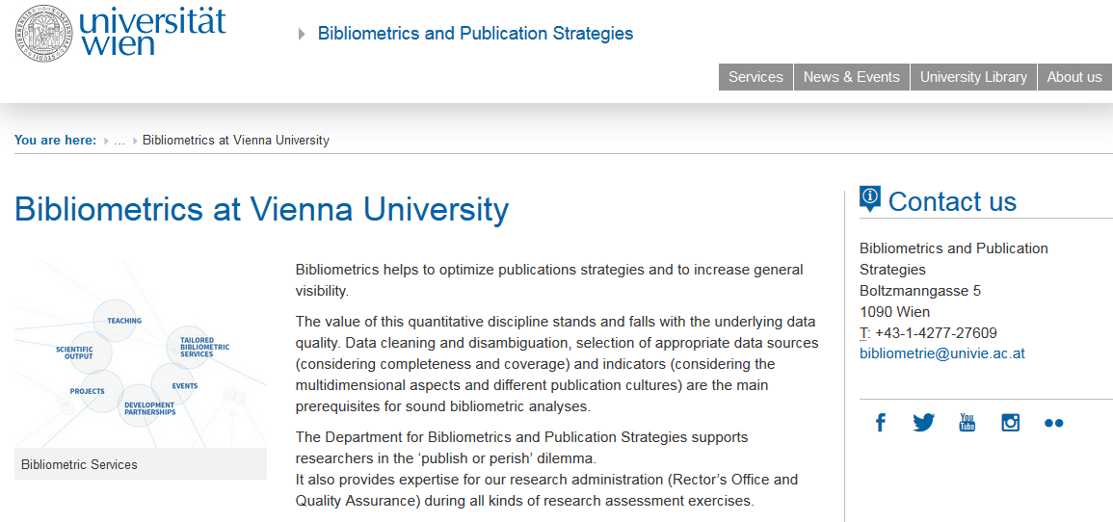
http://bibliometrie.univie.ac.at
Notes:
4

Slide 5

Departmental activities

Slide 6

Our departmental philosophy
to stimulate a positive attitude towards bibliometrics
to support scientists in ‘publish or perish’ dilemma: (especially for young scientists)
to enhance the visibility: the institutional one (Rankings & Web presence, monitoring) and the individual one (adoption of permanent identifiers, help and assistance in the promotion game)
to prevent administration from bad use of bibliometric practices (stimulating informed peer review)
to face the new challenges of the digital era and the use of the new metrics

Slide 7


Slide 8

Bibliometric profiles: support for scientists in ‘publish or perish’ dilemma
Publications data retrieved from different data sources (Web of Science (WoS), Scopus, other subject specific databases, etc.) incl. manual data disambiguation
Comparison with provided publication lists and coverage analysis
Cross-check with the scientists
Bibliometric analysis
Validation and discussion of the results with the scientists
Optional:
Support with increasing the scientist’s visibility
(ResearcherID, ORCID, Google Citations Profile, etc.)
Mapping with Open Source Tools like Bibexcel, Pajek and VOSViewer
Knowledge basis: References analyses (Cited sources)

Slide 9

Bibliometric reports for individual professors
  some professors are being evaluated 5 years after their appointment under the terms of their contract
  depending on the discipline the rectorate asks the Bibliometrics Department for a bibliometric report
  Such reports are only complementary to the professor’s self-assessments and are always generated and finalised in mutual agreement between the Bibliometrics Department and the professors to be evaluated.
  Once finalised these reports are checked by the Quality Assurance Department and then forwarded to the Rectorate and the peers.
  Peers should focus on qualitative aspects

Slide 10

Bibliometric reports for faculties
Periodic and cyclic evaluation of publication output of the 15 faculties and 3 centres (approx. 5 year cycle)
„Performance Agreements“ between rectorate and faculty prepared by Quality Assurance Department
Discussion if and to what degree a bibliometric analysis makes sense
Data retrieval and cleaning
Bibliometric analyses in form of a report or profile
Reports are NOT results of evaluation, but a discussion paper presented to the dean in advance, to the selected peer in revised form, and to the rectorate in revised and annotated form
Optional: benchmarking (only possible in certain subject areas or WoS categories, however, not on organisational/structural level)

Slide 11
Bibliometric profiles for individual scientists
  Interview with researcher or faculty under evaluation
  Bibliometric analysis:
    Coverage according to the scientist‘s publication list
    Activity / Visibility (IF) /Impact (Top Percentiles)
    Analysis of the citing documents
    Cooperation analyses at different levels (countries, institutions, co-author)
    Reference analyses
  Discussion of the results with researcher or faculty under evaluation
  Optional: delineation of hot topic (guided by researcher under evaluation), new metrics analyses

Slide 12
Interviews with scientists
Frequently Asked Questions I
Which data sources do you use regularly for retrieving literature in your research field? Do you use alert services?
Do you use permanent person identifiers (like ORCID, ResearcherID, etc.)?
Do you have a complete record in our CRIS? Do you use repositories?
Have you submitted preprints in order to claim priority?
What are the most important publication channels in your field?
Does the order of authors (first, last or corresponding author) play a role in your research field? If not, why not?
Which criteria are relevant for your publication strategy?
Is Open Access also a valid criterion according to the recommendation of our university?
Do you actively participate in conferences?

Slide 13
Interviews with scientists II
Frequently Asked Questions II
Are you an editor of one or more scientific journals? If yes, which ones?
Do you actively support the peer-review system by providing reviews?
If yes, how many per month?
Do you maintain a personal website? An entry in Wikipedia? A Google Scholar Citations profile?
Do you use a reference manager system? If yes, which one? Do you actively engage in mailing lists or blogs? If yes, which ones?
Do you use other Social Media tools? If yes, which ones?
What do you think about usage metrics (downloads) and altmetrics?
Do you generate research data? If yes, how do you manage and archive them?
How do you (or would you) select and assess colleagues or potential collaborators? If yes, do you also embrace quantitative methods?
Is there anything else we have not covered so far and you would like to share?

Slide 14
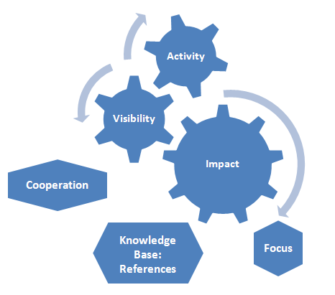
Bibliometric profile: multidimensional approach
Web attention
Notes:
14

Slide 15
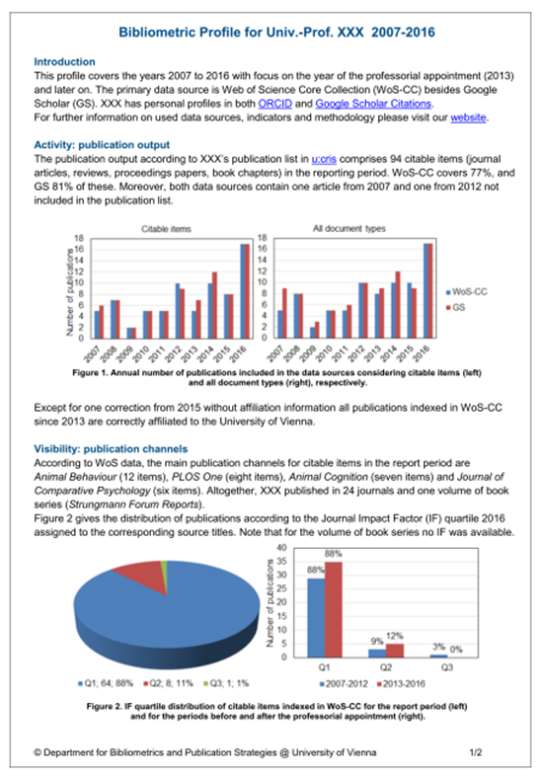
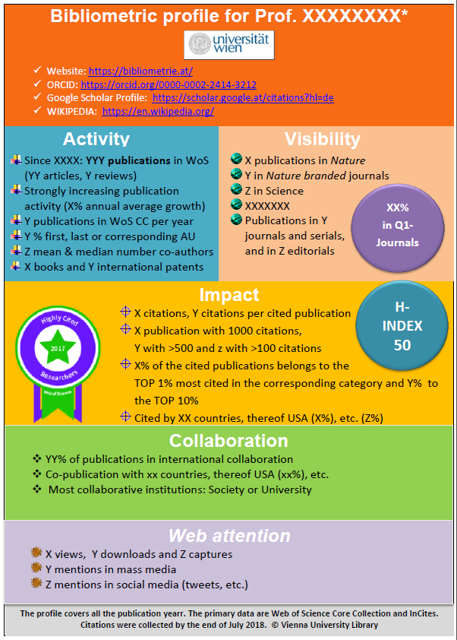
Bibliometric profile: multidimensional approach
Notes:
15

Slide 16
Why visibility?
Evaluation is usually related to the most recent years.
Shortcomings of citations: always delayed!
→ Citation analyses are not significant for the most recent years!
Significance varies according to the discipline: especially for fields with a long cited half-life
Visibility analysis is meant to be alternative & complementary to citation analysis
  It should be stressed that the visibility analysis is NOT used in order to assess the quality or the impact of single publications, but in order to assess the reputation or impact of the journals in which original research was published.

Slide 17
Visibility analysis
A visibility analysis at the University of Vienna comprises of three parts:
Number and percentage of publications indexed in the different international, well-respected selected data sources
Number and percentage of publications in top journals or sources
Number and percentage of Open Access publications
Promotion strategies related to “altmetrics” are considered separately, as well as the use of individual permanent identifiers (ORCID, etc.) and correct affiliations.

Slide 18
Bibliometric Profiles: measures & indicators

Slide 19
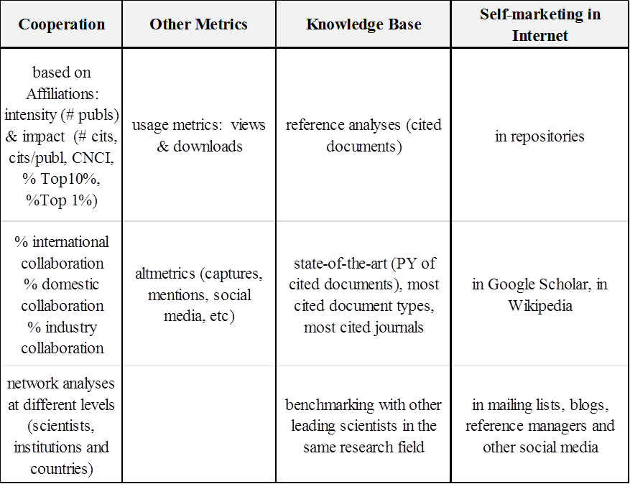
Bibliometric Profiles: measures & indicators

Slide 20
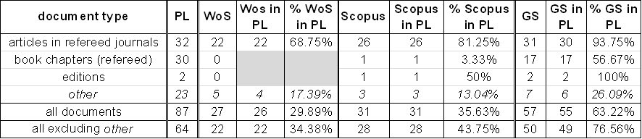
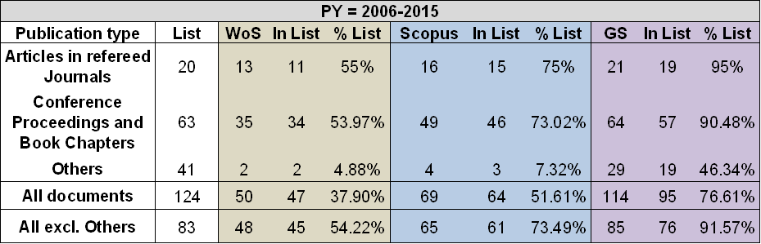
Bibliometric reports for individual scientists
Examples: Coverage in different databases
Degree of coverage informs about the significance of the analysis

Slide 21
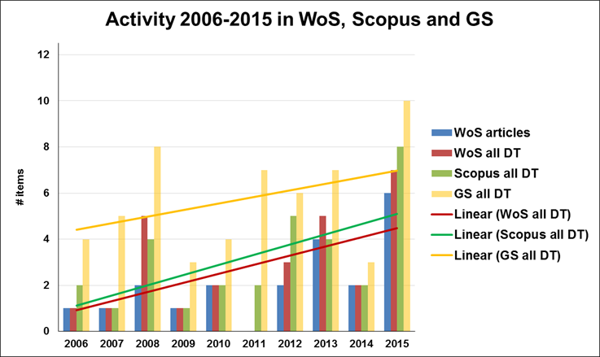
Bibliometric reports for individual scientists –
Example: Activity Analysis
# co-authors
The average number of co-authors for the overall period 2006-2015 in WoS is 6.6 and has remained constant in both half periods: in 2006-2010 (with a maximum of 36) and in 2011-2015 (with a maximum of 41).
author‘s role
Funding information
Furthermore, 11 out of 17 records (~65%) indexed in WoS from the second period 2011-2015 do contain data in the field ‘Funding Agencies’. Mentioned funding agencies in this field are predominantly different Austrian and German Ministries.

Slide 22
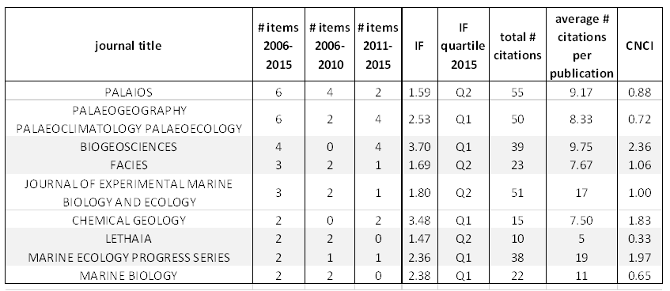
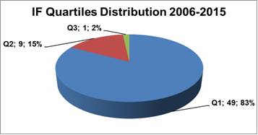
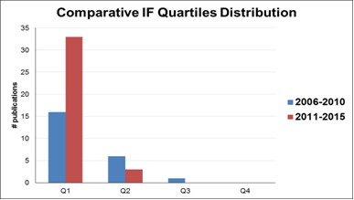
Bibliometric reports for individual scientists –
Example: Visibility
Most frequently used publication channels: comparative analysis
IF quartiles distribution: timeline

Slide 23
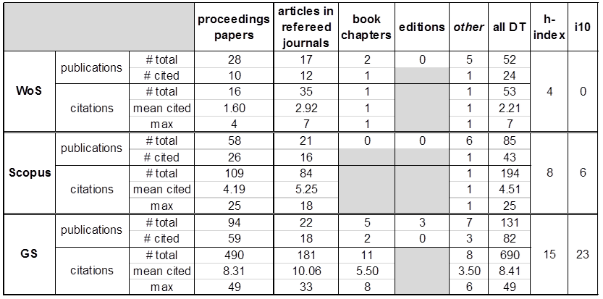
Bibliometric reports for individual scientists –
Example: Impact –Citation analysis: Main Indicators
In different data sources
And for different document types
% Self-citations as control data

Slide 24
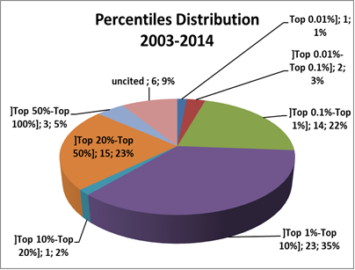
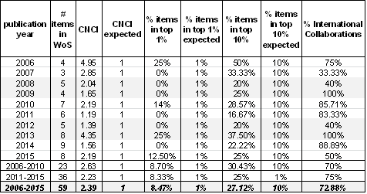
Bibliometric reports for individual scientists –
Example: Impact –Normalized Citation Counts
The “Category Normalized Citation Impact” provides the citation impact (citations per paper) normalized for subject, year and document type. Citation percentiles were calculated according to the corresponding WoS Core Collection Categories in InCites.
Percentile (or Top) 10% provides the number and percentage of the Top 10% most cited papers in the corresponding category and for the corresponding publication year.
The levels selected for listing by field and year are 1.0% and 10%.
Top 10% is usually considered as a measure for “excellence”.

Slide 25
Bibliometric reports for individual scientists –
Example: Citing analysis
Top citing journals, institutions & countries
Short citation analysis of the citing documents
Publications indexed in WoS in 2011-2015 (n=36) were cited by a total of 544 documents (by end of June 2016). According to a citation analysis performed via InCites, these citing documents have a high impact too, as their total CNCI score of ~1.8, and percentiles of ~16% in Top 10% and 3.4% in Top 1% corroborate.
Notes:
25

Slide 26
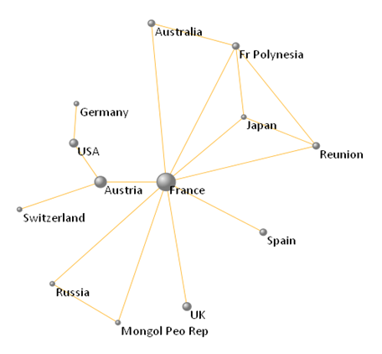
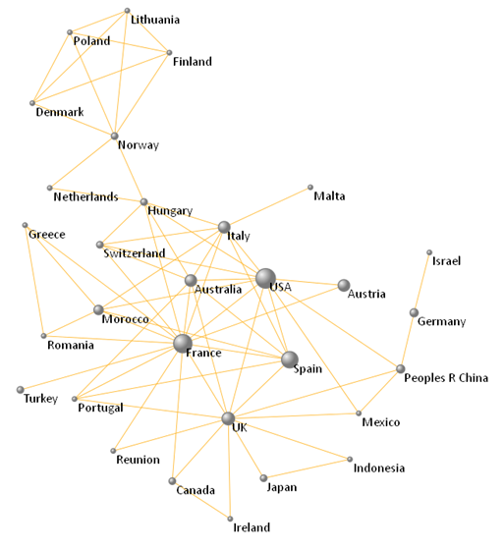
Example: Cooperation versus impact – (country level)
Is impact broader than pure collaboration?
Notes:
26

Slide 27
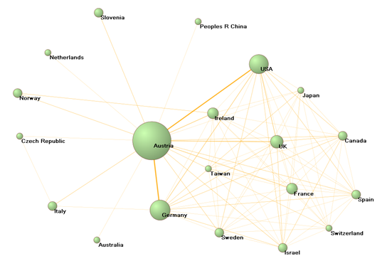
Bibliometric reports for individual scientists –
Example: Cooperation analysis: 1. Country level
Top collaborating countries
Map informs about network and type of collaboration (bilateral, etc.)
Notes:
27

Slide 28
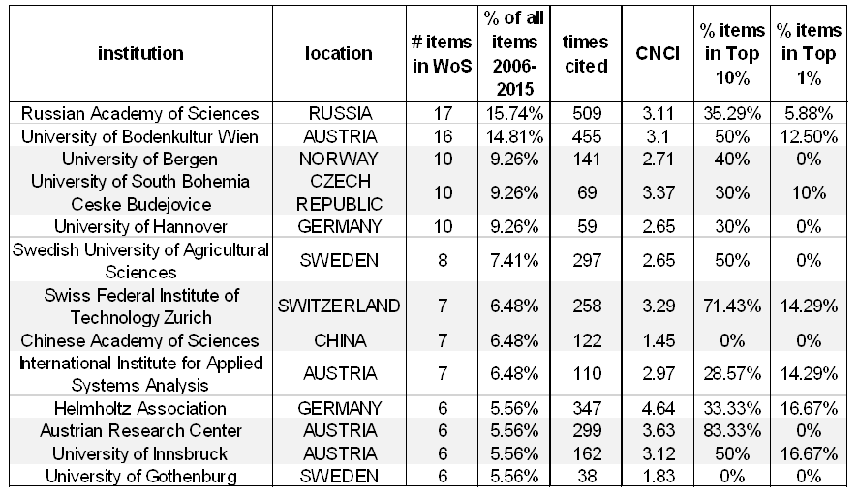
Bibliometric reports for individual scientists –
Example: Cooperation analysis: 2. Institution level; 3. Author level
Summary
author network
Top collaborating institutions
Scientist collaborated with a total of 102 authors in the period 2006-2015.
The most collaborative author, XXX (47 co-publications), contributes with ~71% to the overall publication output 2006-2015, followed by YYY and ZZZ with 9 and 8 co-co-publicationsrespectively.
Only these three co-authors were involved with more than 10% of the total number of publications. About half of the co-authors were only part of a single publication.
Notes:
28

Slide 29
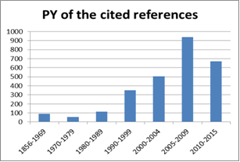
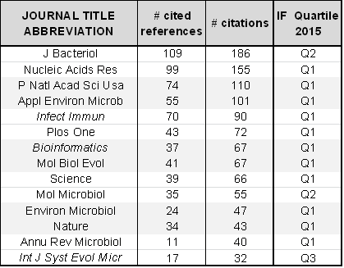
Bibliometric reports for individual scientists –
Example: Reference Analysis
Summary: Approximately 40% of the cited references (n=~1800) are non-journal contributions (monographs, book chapters, etc.).
State-of-the-art of the references:
comparison with cited half-life in the research field
Most cited sources

Slide 30
Bibliometric reports for individual scientists –
Example
Reference Analysis: most cited references
Most cited by the scientist
Most cited in the data source

Slide 31
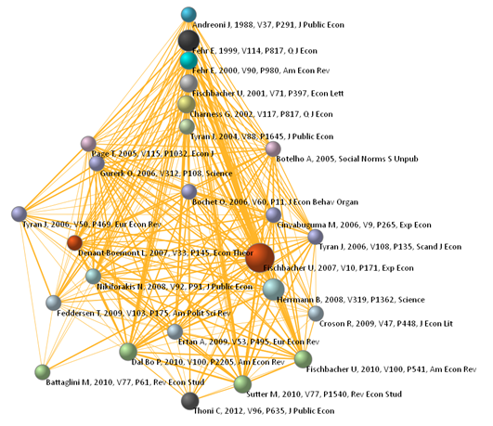
Bibliometric reports for individual scientists –
Example Reference Analysis: most cited references
Chronological visualization of the most cited references

Slide 32
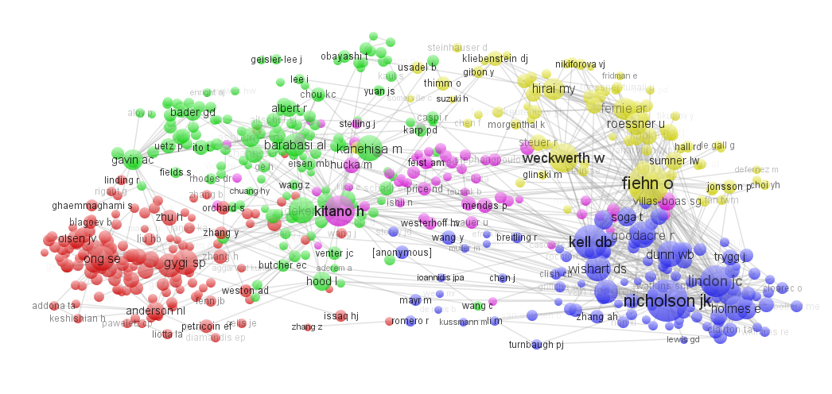
Example: Hot Topic: Knowledge base analysis
– cited 1st authors
Notes:
32

Slide 33
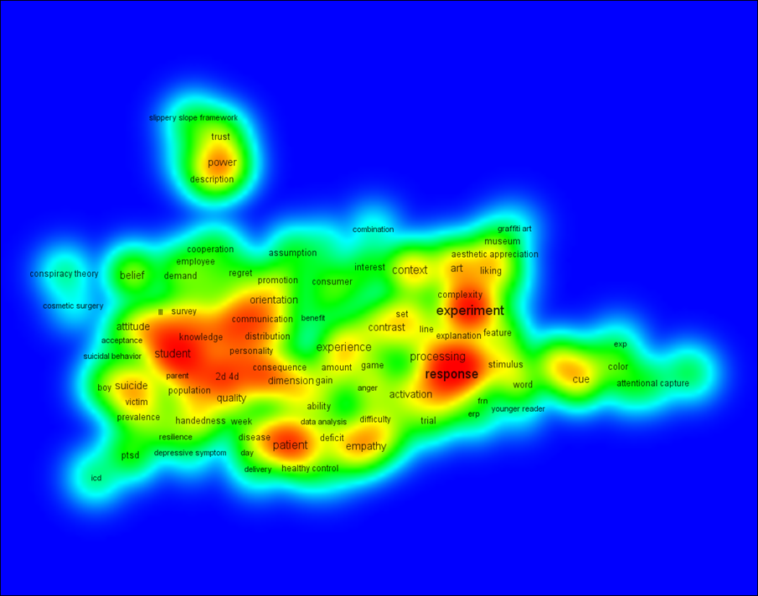
Bibliometric reports for individual scientists –
Focus Analysis: map - title words & abstracts

Slide 34
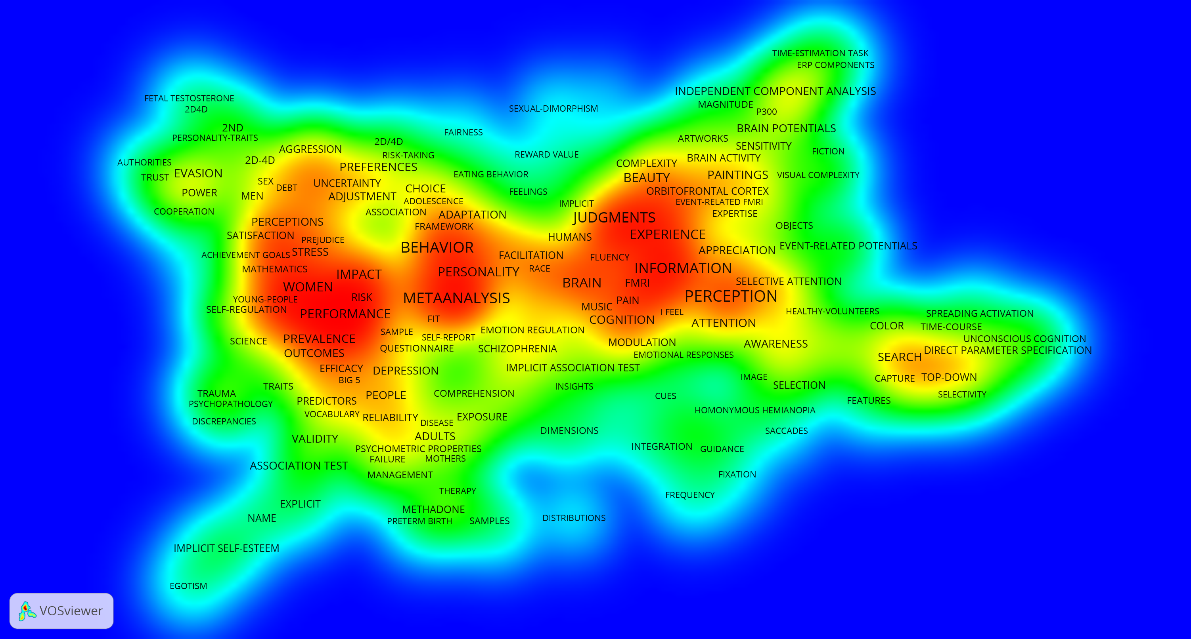
Bibliometric reports for individual scientists –
Focus Analysis: Keywords Plus® (= ID in WoS CC)

Slide 35

Professorial appointment procedures
offered service for faculty administration to analyse applications for vacant chairs (in collaboration with Quality Assurance department)
critical discussion about standards and criteria with faculty
agreed standards and criteria then applied to analyses of either all publications retrieved from database searches and/or provided publication lists
Main characteristics:
Preference of basic instead of composite indicators
Top counts approach allows for the multi-dimensionality of the analyses → taking into account different publication cultures as well as different strategic considerations in a flexible way

Slide 36
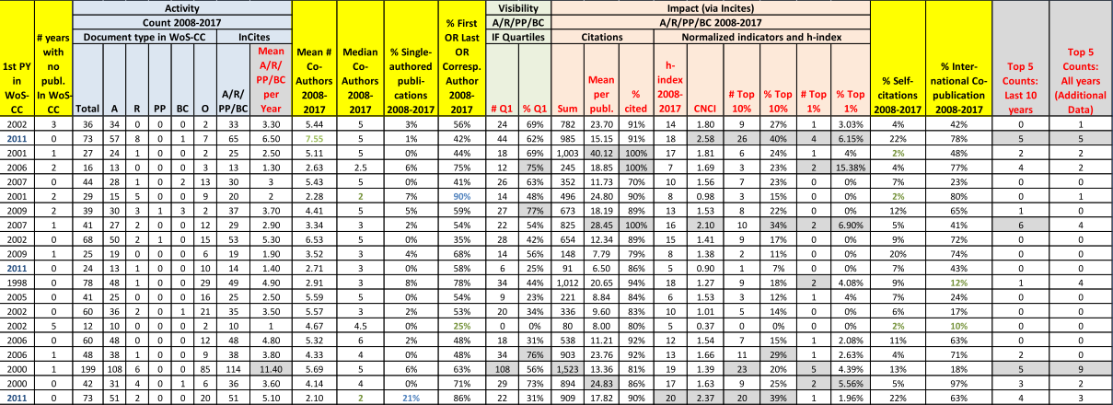
Example: Tops Counts: last 10 publication years
Notes:
Beim h-Index zwei ** machen.
Zusätzliche Fußnote:
** analysis restricted to the last 10 complete years

Slide 37
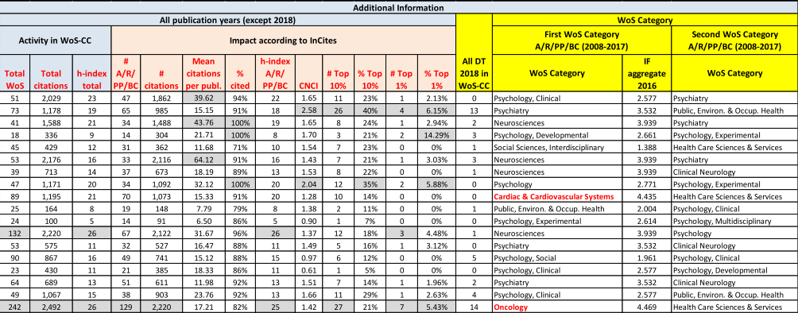
Example: Additional Information: all publication years
Notes:
Beim h-Index zwei ** machen.
Zusätzliche Fußnote:
** analysis restricted to the last 10 complete years

Slide 38
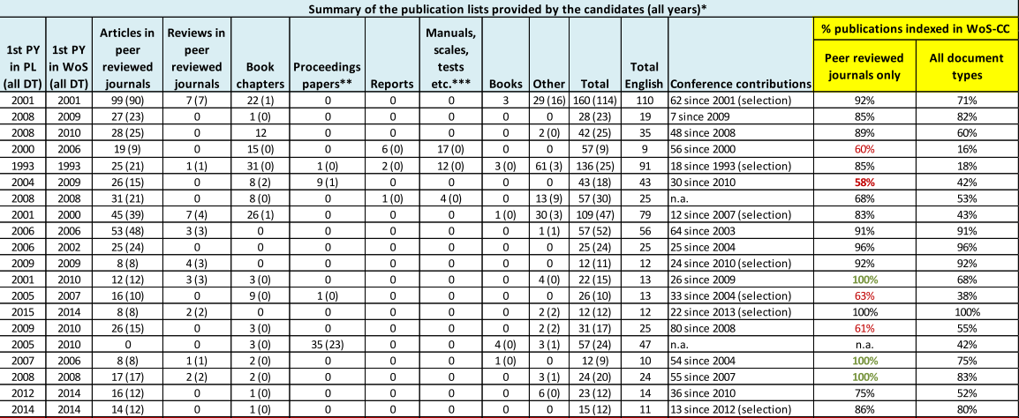
Example: Control Data
Notes:
Beim h-Index zwei ** machen.
Zusätzliche Fußnote:
** analysis restricted to the last 10 complete years

Slide 39
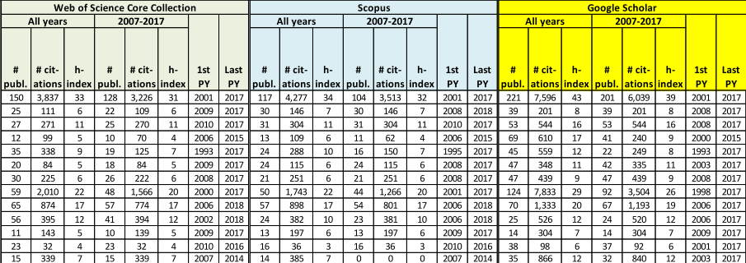
Example: Control Data
Notes:
Beim h-Index zwei ** machen.
Zusätzliche Fußnote:
** analysis restricted to the last 10 complete years

Slide 40
Selected comments
Our analysis also comprises the section “Selected Comments”, which is intended to provide information about any observed peculiarities in the main or additional analysis.
deviations or discrepancies resulting from the control or additional data (e.g. self-citations, different main focus with lower or higher aggregate IF, document type with an expected high number of citations, etc.)
activity trend lines for the last 10 years
degree of internationalisation (considering the number of countries in the affiliations)
Co-publication network analysis
Notes:
Beim h-Index zwei ** machen.
Zusätzliche Fußnote:
** analysis restricted to the last 10 complete years

Slide 41
Selected comments
Notes:
Beim h-Index zwei ** machen.
Zusätzliche Fußnote:
** analysis restricted to the last 10 complete years

Slide 42
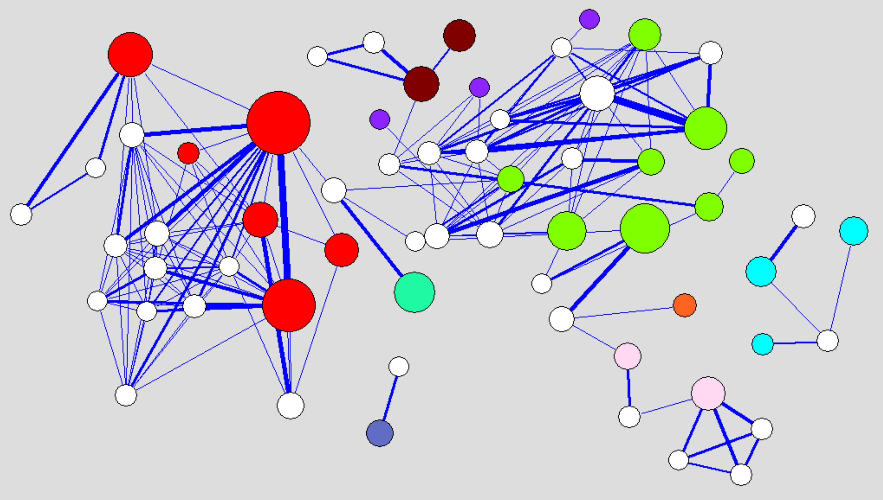
Example: Candidates network
This analysis reveals:
weak co-publication activity between the candidates:)
strong “co-author dependence” (i.e. co-authorship with the same author (>70%)
peer incompatibilities
Notes:
Beim h-Index zwei ** machen.
Zusätzliche Fußnote:
** analysis restricted to the last 10 complete years

Slide 43
Conclusions & outlook
  Positive feedback from researchers, research managers and peers
  Growing reputation and expertise
  Increasing demand in all services
  Expanding the portfolio of services
  Consolidation of bibliometric services as a permanent task of modern scientific libraries
  Towards a standardisation (cataloguing rules for research documentations in order to enable a compound and sharing structure, standards for bibliometric approaches & methods, etc.)
  Modern scientific libraries facing the challenge of the new digital era and the upcoming new metrics → to provide adequate new innovative services
Notes:
Individual: After a pilot phase in 2010, the assessment service started in 2011 with eight bibliometric profiles and increased steadily since then to ten in 2014 and 15 in 2015, > 30 in 2016, already 45 in 2017.
Faculties:

Slide 44

How can we assess the level of adoption of altmetrics in the scientific community?
To carry out surveys
To promote permanent monitoring exercises

Slide 45
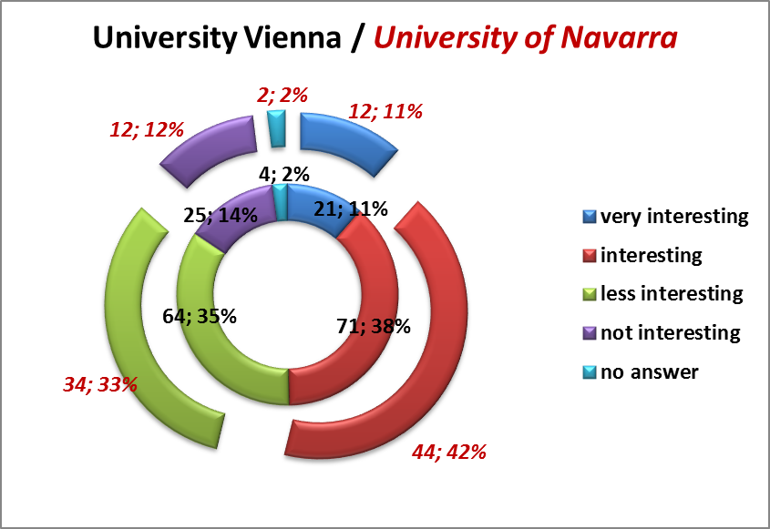
What do the scientists think in the Humanities?
Are you interested in the resonance of your research output in forms of discussions, blogs, bookmarks, tweets, etc…
Healthy scepticism!

Slide 46
Monitoring Results
highest % coverage by # readers in Mendeley independently of the area
lowest % coverage in “Arts & Humanities”, nevertheless usage scores still high
% of uncited data in this area is 2-3 times higher than in the other areas (due to longer citing half -life and the lower reference densities)
Behaviour of the 4 hard sciences (Engineering & Technology, Health Sciences, Life Sciences and Physical Sciences) very similar in all dimensions, except in the social media, where Health and Life Sciences account for highest % of coverage, followed very closed by the Social Sciences
percentage values for Social Sciences in the other three dimensions (captures, citations and mentions) in-between the ones for the hard sciences and the ones for Arts & Humanities
Social media: low % of coverage for the Physical Sciences and relative insignificance in the “Arts & Humanities”
Density results correspond very well with the ones concerning data coverage
All densities are decreasing according to the reduced measuring window
Tweets intensity has even been increasing within the last years despite the reduced time window in all areas

Slide 47
General Conclusions _ Monitoring Services
Monitoring practices provide an interesting information and help to reveal new trends and to assess the degree of implantation
Study hints at an increasing use of Social Media within the scholarly community in general and a particularly increase of Twitter usage in Austria
PlumX has proven to be a very useful tool in order to monitor the broad impact of the publication output at country or institution level → multidimensional aspect is well addressed!
It is further necessary to clarify the stability and reproducibility of altmetrics data and to improve technical aspects: possibility to select different measuring windows is missing!
Therefore, temporal monitoring currently only works by archiving obtained results and later comparison at different time intervals
Correlations should be taken with a pinch of salt:
Measures and dimensions have different obsolescence patterns!
Long term / short term measures (→ different windows)

Slide 48

Can we use altmetrics for academic evaluation?
Validity – measuring what is intended to measure
Relevance – results must be meaningful in the context of what they are produced for
Reliability – assessability of correctness of measures and errors
Reproducibility – Under identical conditions results should be reproducible
Robustness – results may not be sensitive to marginal fluctuations or minor corrections in the underlying data sources
Notes:
48

Slide 49

& Bibliometrics
Supporting the OA activities of the University of Vienna:
Representative of the OA-Board
Expert support for further development of u:scholar (IR) and u:cris (CRIS)
Bibliometric analyses concerning the availability and impact
of OA Publications and Gold OA journals
(to avoid contradictory strategies)
Administration of Gold Open Access publications fees
Expert support for in-house publishing activities
(https://openaccess.univie.ac.at/beratung/publikationsberatung)
Checklist for editors and publishers:
(https://typo3.univie.ac.at/fileadmin/user_upload/p_oana/oana/OANA-Checkliste-OA-Journals.pdf)

Slide 50
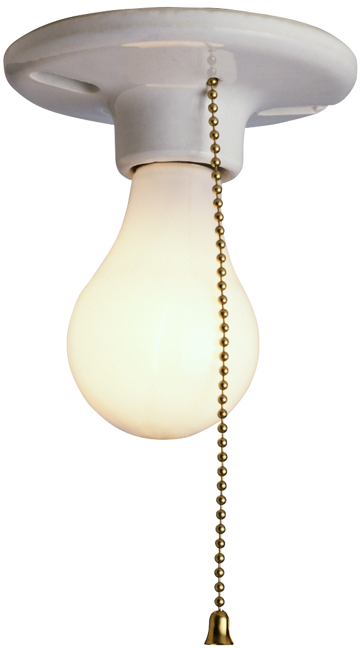
Increasing visibility in SSH at the University of Vienna
First project launched in July 2014 supported by the Rectorate
29 professors of different SSH faculties were interviewed
Phase 1 ended with a workshop for SSH researchers in summer 2015
Recommendations published by the Rectorate
Follow-up project launched in January 2016, Questionnaire developed based on the interview guidelines of the previous project
Online survey: 3567 questionnaires sent out, 524 complete responses received (14.7% response rate)
Phase 2 ended with a report and a workshop (20 June 2017)
Follow-up project launched in September 2018 : Qualitative interviews (Predocs, Postdocs and Tenure Track researchers)
First set of 20 interviews scheduled for winter semester 2018/19

Slide 51

Our experience illustrates:
  the crucial role modern scientific libraries are predestined to play in research assessment exercises.
  the field of bibliometrics is ideal for academic librarians to strengthen their on-campus position.
  bibliometrics offers a wealth of opportunities to provide innovative services for both academic and administrative university staff.

Slide 52

Looking forward to seeing you in Leuven 2019!

Slide 53
References
Individual Bibliometric Assessment@ University of Vienna: From Numbers to Multidimensional Profiles (2016) J Gorraiz, M Wieland, C Gumpenberger
Profesional De La Informacion, Vol 26. Nr.6 )
http://arxiv.org/abs/1601.08049
https://recyt.fecyt.es/index.php/EPI/article/view/epi.2016.nov.07
A flexible bibliometric approach for the assessment of professorial appointments (2015) J Gorraiz, C Gumpenberger
Scientometrics, 105 (3), 1699-1719
Bibliometric practices and activities at the University of Vienna (2012)
C Gumpenberger, M Wieland, J Gorraiz
Library Management 33 (3), 174-183
Monitoring the impact on the web (https://link.springer.com/chapter/10.1007/978-981-13-1053-9_4) Gorraiz J., Blahous B., Wieland M. (2018) Monitoring the Broader Impact of the Journal Publication Output on Country Level: A Case Study for Austria. In: Erdt M., Sesagiri Raamkumar A., Rasmussen E., Theng YL. (eds) Altmetrics for Research Outputs Measurement and Scholarly Information Management. AROSIM 2018. Communications in Computer and Information Science, vol 856. Springer, Singapore

