Slide 1
Bibliometrics and Science Policy
Dr Peter Darroch - Senior Manager, Engagement strategy
22nd October 2018

Slide 2
Agenda
Elsevier and research metrics
Research metrics use in national assessments
Research metrics use in other Funding and Policy circles
European Open Science and metrics/indicators
Some data-food for thought - UK

Slide 3




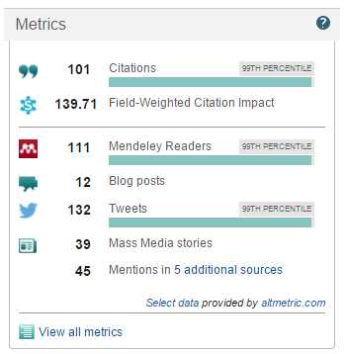
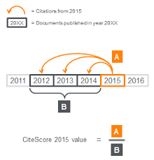
Elsevier and research metrics
Our Metrics approach
Need to use different metrics and common sense
  Decisions should be based on both quantitative and qualitative input
  Should always use at least two metrics (more than one way to ‘excellence’)
The methodologies should be open, transparent, valid and replicable
Definitions should be owned by the community
  Need trust between the parties using metrics to evaluate

Slide 4
A ‘basket’ of metrics for research excellence
Theme | Sub-theme
A. Funding | Awards Can I support my research?
B. Outputs | Productivity of research outputs How productive am I?
 | Visibility of communication channels What is the impact of the channels that my outputs are published in?
C. Research Impact | Research influence How are my outputs used in academia?
 | Knowledge transfer How are my outputs used in industry?
D. Engagement | Academic network How good is my collaboration network within academia?
 | Non-academic network How good is my collaboration network outside academia?
 | Expertise transfer How do I transmit knowledge to others within academia?
E. Societal Impact | Societal Impact What is my wider impact?
Available for outputs, researchers, journals, institutions, subject fields…
F. Qualitative input
Expert feedback on quality and impact of my research
Notes:
Let’s talk about the second golden rule “Always use more than one research metric as the quantitative input”. Scopus aims to provide a basket of research metrics to measure research performance.
This slide is showing a basket of metrics for measuring research excellence, where each theme has a different set of metrics associated with it.
These research metrics are supported by qualitative input (remember golden rule #1) as represented by the grey bar on the left side.
It’s important to make metrics available for all the different entities that you would want to measure: authors, institutions, journals, subject fields, etc.

Slide 5
Research metrics use in National Assessments

Slide 6
… national assessments are on the rise worldwide
FOKUS 2018
KEJN
Governmental Program on Development of Science and Technologies, 2013-2020
REF2014/2021
BFI
RIV
SEP
HCERES
FCT 2014
NIAD-UE, 2016
ASN & VQR, 2012, 2013, 2016
Ministry of Education (China)
MOST
(Taiwan)
ERA 2010/2012/
2015/2018
NRF / Dept. Of Higher Education
RAE
(Hong Kong)
PBRF
Notes:
- HCERES (France) + RIV (Czech Republic) + BFI (Denmark) + SEP (Netherlands) are all yearly exercises
Czech RIV uses SNIP/SJR for first time in 2014 (but also WoS impact factors)
For the SEP (Netherlands) and BFI (Denmark) individual institutions use customized assessment module in Pure

Slide 7
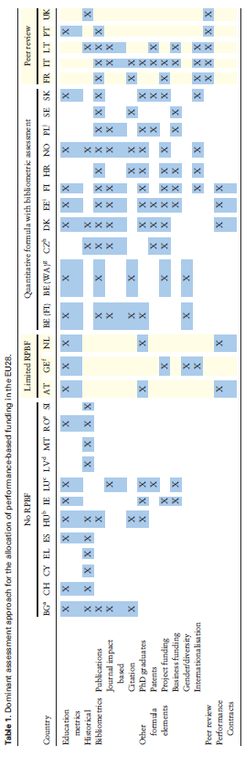
Performance Based Research Funding in EU Member states
Thomas Zacharewicz, Benedetto Lepori, Emanuela Reale, Koen Jonkers; Performance-based research funding in EU Member States—a comparative assessment, Science and Public Policy, , scy041, https://doi.org/10.1093/scipol/scy041

Slide 8
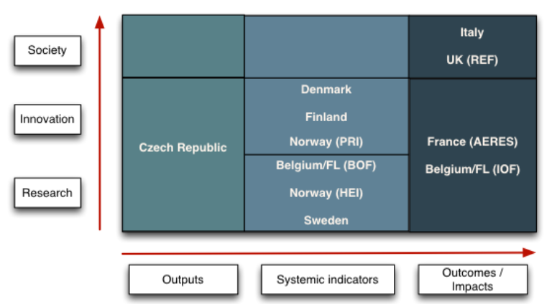
Indicator categories in Performance-based Research Funding allocation models in Europe
Scope of indicators
Indicator categories
Technopolis. (2014). Measuring scientific performance for improved policy making. www.europarl.europa.eu/RegData/etudes/etudes/join/2014/527383/IPOL-JOIN_ET(2014)527383(SUM01)_EN.pdf
Notes:
A 2014 study by Technopolis examined 12 EU member states and Norway. This includes a comparative consideration of systems using performance-based research funding (PRF systems). The report shows that Czech Republic is the only country that limits the indicators used to the output of research, (even though it is the PRF system that covers research and innovation-related outputs in the most detailed and comprehensive manner). In a second group of countries – Denmark, Finland, Norway (PRI), Belgium/PL (BOF), Norway (HEI) and Sweden – the PRFs include both output and systemic indicators; (in Denmark, Finland and Norway this includes indicators related to innovation-oriented activities). Only a few countries also examine research impacts: Italy, UK (REF), France (AERES) and Belgium/FL (IOF). While the PRFs in France and Belgium focus on impacts in the spheres of research and innovation, Italy and the UK also consider societal impacts.
Systemic indicators are those used for monitoring and assessment of the various elements of the system such as actors, context, infrastructures etc. See page 15 of report. Horizontal axis is thr indicator categories used and vertical is scope of the indicators, so innovation-oriented activities such as reseacrh-industry interactions and then societal impacts

Slide 9
Standard Evaluation Protocol (SEP) - Netherlands
Three assessment criteria:
Research Quality - Quality of the unit’s research and the contribution that research makes to the body of scientific knowledge
Relevance to society - Quality, scale and relevance of contributions targeting specific economic, social or cultural target groups, of advisory reports for policy, of contributions to public debates, and so on
Viability - Strategy that the research unit intends to pursue and the extent to which it is capable of meeting its targets in research and society during this period. It also considers the governance and leadership skills of the research unit’s management
Across each of the three criteria, research units are assigned one of four categories
    World leading/excellent
    Very good
    Good
    Unsatisfactory
Notes:
The FCT assessment of R&D Units in Portugal in 2014 used Snowball Metrics – the first time for any national assessment.

Slide 10
Standard Evaluation Protocol (SEP) - Netherlands
Output indicators
Quality Domains
 | Research quality | Relevance to society
Demonstrable products | Research products for peers Research articles Scientific/scholarly books Instruments, datasets, software etc… | 4. Research products for societal target Groups Reports (for example for policymaking) Articles in professional journals for non-academic readers Instruments, datasets, software tools that the unit has developed for societal target groups Outreach activities
Demonstrable use of products | 2. Use of research products by peers Citations Use of datasets, software tools, etc. by peers Use of research facilities by peers Reviews in scientific/scholarly journals | 5. Use of research products by societal groups Patents/licences Use of research facilities by societal parties Projects in cooperation with societal parties Contract research
Demonstrable marks of recognition | 3. Marks of recognition from peers Science awards/scholarly prizes Research grants awarded to individuals Invited lectures Membership of scientific committees, editorial boards, etc. | 6. Marks of recognition by societal groups Public prizes Valorisation funding Number of appointments/positions paid for by societal parties Membership of civil society advisory bodies
Assessment dimensions
Indicators in table are examples. The research unit may select these or other indicators compatible with its own profile and mission, within clearly defined boundaries
Notes:
The FCT assessment of R&D Units in Portugal in 2014 used Snowball Metrics – the first time for any national assessment.

Slide 11
FORSCHUNGSRATING - GERMANY
Dimensions and criteria of the assessment:
‐ Research (Quality of research, Impact/effectiveness, efficiency)
‐ Promotion of young researchers
‐ Knowledge transfer (Transfer to society, knowledge dispersion)
Indicator category | Indicators
Quality of research | Citations per paper (raw and standardised) number of publications; other research products, e.g. databases, software; third‐stream projects; prizes
Impact/effectiveness | Number of publications number of patents third‐stream funding in total percentage of externally funded personnel |  | number of citations guest researchers Self‐report on inter-disciplinarity citations in other disciplines.
Efficiency | Impact" relative to human resources publications/citations/third‐stream funding/patents per FTE
Promotion of young researchers | Number of people working for their doctorate Number of (female) doctorates PhD programmes | PhD process Number of postdoctoral grants Prizes to junior researchers
Transfer to society | Number of (licensed) patents Money gained by licenses Funding by industry/business Spin‐offs; consultancy work
Knowledge dispersion | Number of vocational trainings finished Lifelong learning Examples of spreading knowledge outside the scientific community
Notes:
The FCT assessment of R&D Units in Portugal in 2014 used Snowball Metrics – the first time for any national assessment.

Slide 12
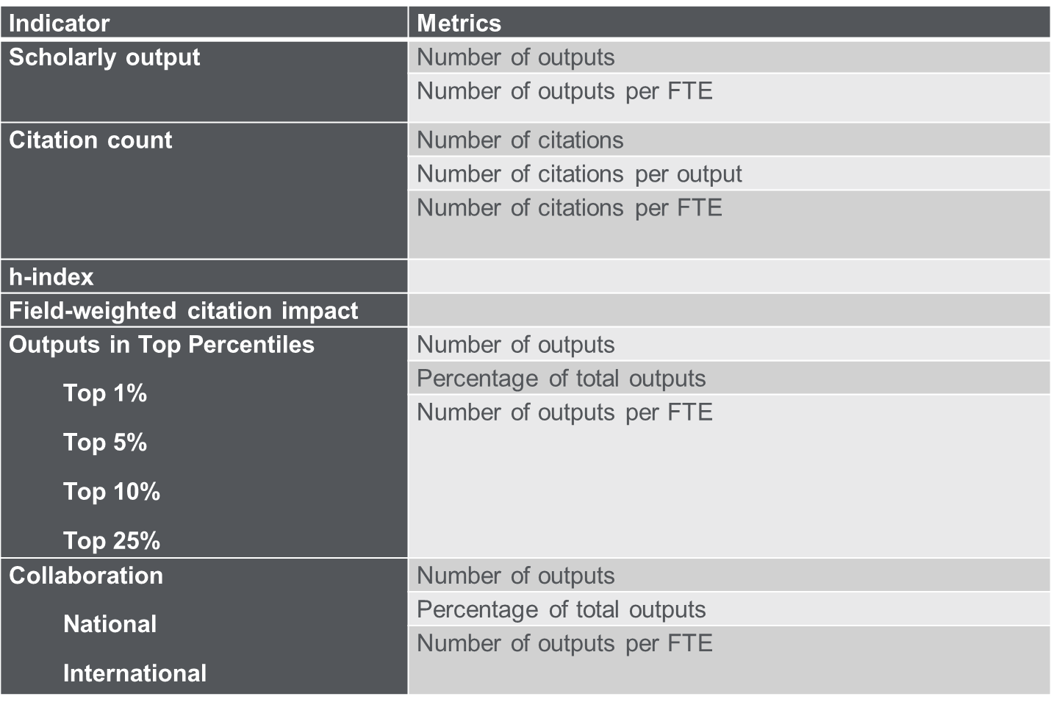
From the FCT tender document for assessment of R&D units in Portugal 2014:
“All [metrics] should be calculated according to Snowball Metrics definitions - global standards for institutional benchmarking.”
Researchers required to create a personal research profile in ORCID
Notes:
The FCT assessment of R&D Units in Portugal in 2014 used Snowball Metrics – the first time for any national assessment.

Slide 13
Research metrics use in Funding and Policy circles
(outside National Assessments)

Slide 14
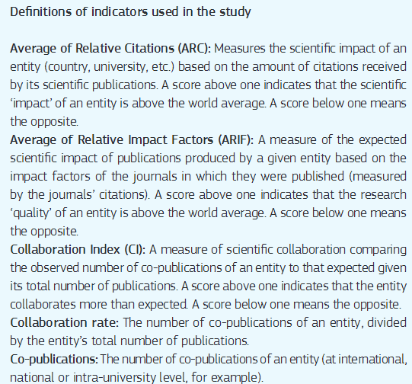
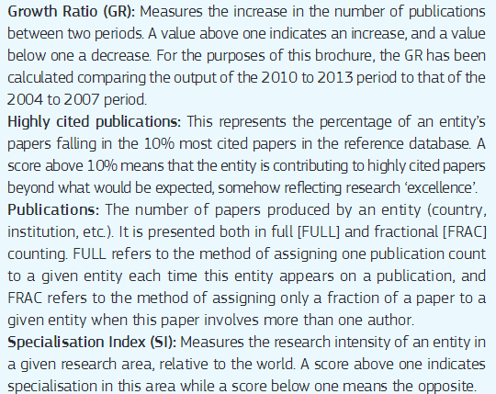
Analysis of Bibliometric indicators for European Policies
Indicators used for bibliometrics analysis to support development of research and innovation policies
https://ec.europa.eu/research/innovation-union/pdf/bibliometric_indicators_for_european_policies.pdf
Notes:
The FCT assessment of R&D Units in Portugal in 2014 used Snowball Metrics – the first time for any national assessment.

Slide 15
EU tender – Study on “Provision and Analysis of key indicators in Research and Innovation”
Indicators used for bibliometric, altmetrics relating to scientific output
Number of scientific publications
International co-publications
Public-private co-publications
Citations (Totals and Field-weighted)
Highly cited publications (Top 1% and Top 10%)
Altmetrics:
This part of the data collection will also have an experimental character and refers to measuring the impact of articles by various aspects, such as viewed, discussed, saved, cited, recommended including in web-based social media and news media.
The relationship between the data from altmetrics and conventional bibliometric data shall be explored. There shall be detailed analysis on the quality and representativeness of altmetric data and on the comparability of results between countries and within time series.
Notes:
The FCT assessment of R&D Units in Portugal in 2014 used Snowball Metrics – the first time for any national assessment.

Slide 16
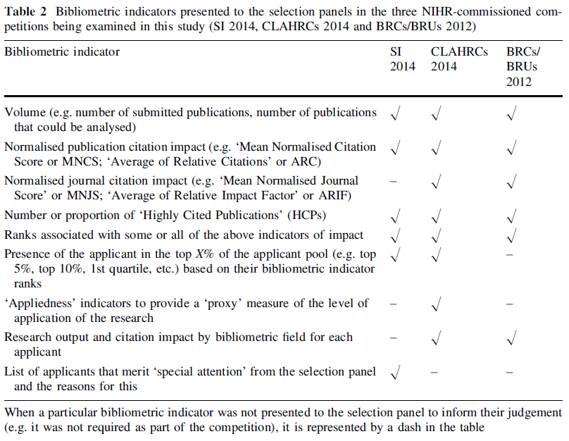
National Institute of Health Research UK and use of bibliometrics to support decisions
https://link.springer.com/article/10.1007%2Fs11192-017-2417-8
Bibliometrics used by selection panels for the following 3 NIHR Competitions:
7th NIHR Senior Investigators (SI)3 competition 2013–2014
NIHR Collaborations for Leadership in Applied Health Research and Care (CLAHRC)4 competition 2013–2014
NIHR Biomedical Research Centres (BRCs)5/Units
Notes:
The FCT assessment of R&D Units in Portugal in 2014 used Snowball Metrics – the first time for any national assessment.

Slide 17
European Open Science Monitor

Slide 18
Aim of the Open Science Monitor
Deliver a monitoring system (for Europe) and (global) an observatory for trends in Open Science
Set up a global reference point for the Open Science community to interact with
Determine the impacts of Open Science in the scientific domain
Provide structured analysis of policy-relevant trends in Open Science
Be as comprehensive as possible - no single data sources
Be inclusive, open for comments for improvement and reference to data sources
The monitor is not a research(ers) assessment tool, but is to be used for clarifying conditions under which open science evolves and flourishes
The monitor supports but does not determine EC policies

Slide 19
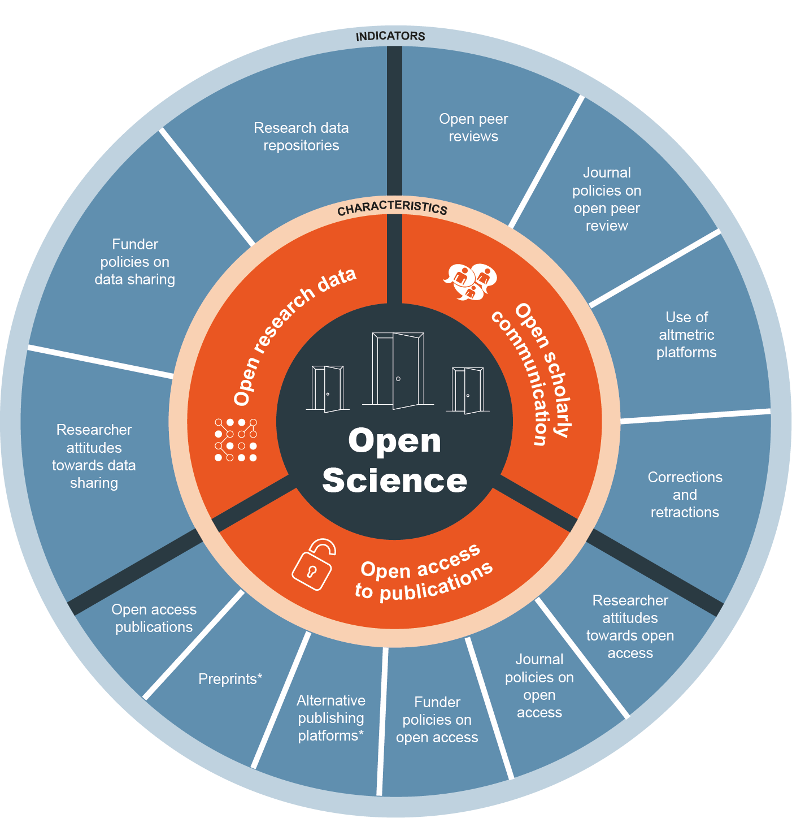







Open Science Monitor (https://ec.europa.eu/research/openscience/index.cfm?pg=home&section=monitor)
New release – 25 May 2018

Slide 20
Some data-food for thought - UK

Slide 21

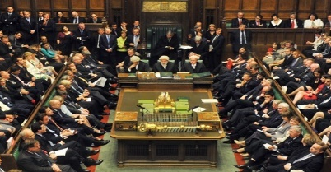


UK Research (and Education) faces great uncertainty
BIS/BEIS
  Industrial strategy
Brexit
  Surprised some university leaders
  Funding/H2020?
  Movement of people/researchers?
  Collaboration?
Higher Education and Research Bill
  UKRI
  REF 2021
  TEF
  KEF
Global political landscape
  E.g. US research priorities post-Trump?
  USA Research Funding
General outlook for evidence-based research
  “People… have had enough of experts”
  “Post-truth”
[Please add image]
Notes:
There has been increasing uncertainty of the role of science in UK society and economy.
With events such as BREXIT where:
Senior officials have declared that People in this country have had enough of experts.
Whether this statement accurately reflects public opinion or not, and the fact that someone of Gove’s level of seniority used this phrase, does this foreshadow a devolution of the role of science in society?
A key aspect of a (hard) Brexit would be the loss of freedom of movement for workers and access to EU-funded research programmes such as Horizon 2020.
While contributing 12% of total EU budget, the UK receives almost 16% of funding monies from the EU.
The expected loss of these funding opportunities would amount to £1bn a year.
And it’s unfortunate to hear cases of scientists and projects already suffering due to expected bureaucratic difficulties in potential collaborations with UK institutions and researchers.
This uncertainty is present not only in the UK with Brexit but also in the US following the election result.
With approximately one third of total R&D spend coming from federal funding - how drastic an affect in output, quality, and diversity can we expect from a sharp decrease in funding for science?
What role does science have in an increasingly post-truth society?

Slide 22
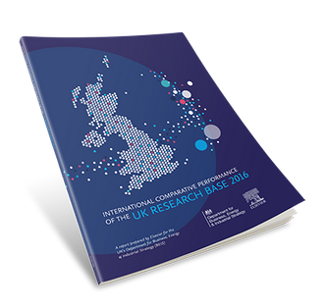
The UK continues to punch above its weight as a research nation
2016 report – 3rd in series
Tracks the investment in and performance of the national research system
Core findings - 5 key themes
The UK continues to punch above its weight as a research nation. While the UK represents just 0.9% of global population, it accounts for 6.3% of global journal articles, 10.7% of citations and 15.2% of the world’s most highly-cited articles.
The UK research base is well-rounded and demonstrates excellence in diverse research fields
The UK is a key partner for global research collaboration and researcher mobility
The UK has a robust cross-sector knowledge exchange
While the UK leads in many worldwide rankings, the world is changing.
https://www.elsevier.com/research-intelligence/research-initiatives/beis2016
Notes:
Elsevier, is the world’s largest science and health information company
We are part of Reed Elsevier, which is Europe’s largest digital content company and the fourth largest in the world.
We serve every day around 30 million+ scientists, students, health and information professionals in over 180 countries by delivering over 2,000 E journals, over 2,000 E books, and dozens of research databases
We are fortunate to have a unique vantage point on the world of research
Our journals alone receive over 1 million manuscripts submissions every year, of which we publish around 300,000 online and in print, which is about 16% of the world’s published journal articles
They are downloaded by around 10 million researchers globally, amounting to 700 million digital downloads per year
We also have Scopus, which is the world’s largest database of published articles and their citations. It tracks the output of some 21,000 journals globally - around 2 million articles and 40 million citations per year.
Together these assets add up to terabytes of data that we process via our SciVal Analytics group using state of the art technology. These are the assets that we brought to bear in our study with Science Europe.

Slide 23
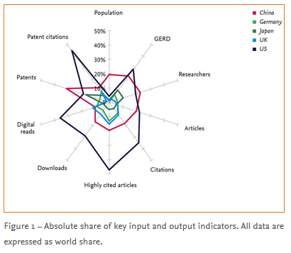
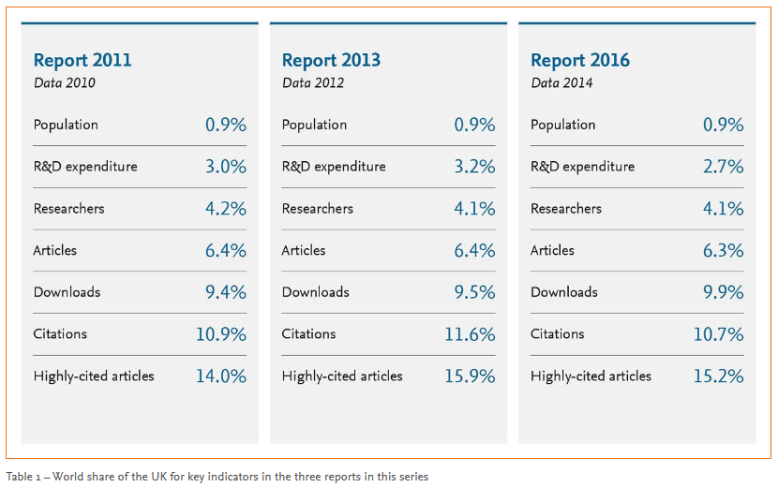
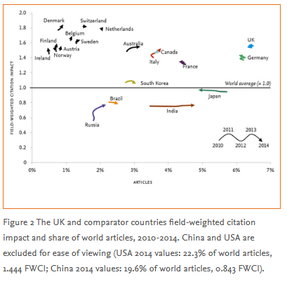
Key measures used across 3 reports
https://www.elsevier.com/research-intelligence/research-initiatives/beis2016
Notes:
Elsevier, is the world’s largest science and health information company
We are part of Reed Elsevier, which is Europe’s largest digital content company and the fourth largest in the world.
We serve every day around 30 million+ scientists, students, health and information professionals in over 180 countries by delivering over 2,000 E journals, over 2,000 E books, and dozens of research databases
We are fortunate to have a unique vantage point on the world of research
Our journals alone receive over 1 million manuscripts submissions every year, of which we publish around 300,000 online and in print, which is about 16% of the world’s published journal articles
They are downloaded by around 10 million researchers globally, amounting to 700 million digital downloads per year
We also have Scopus, which is the world’s largest database of published articles and their citations. It tracks the output of some 21,000 journals globally - around 2 million articles and 40 million citations per year.
Together these assets add up to terabytes of data that we process via our SciVal Analytics group using state of the art technology. These are the assets that we brought to bear in our study with Science Europe.

Slide 24
And with Brexit?

Slide 25
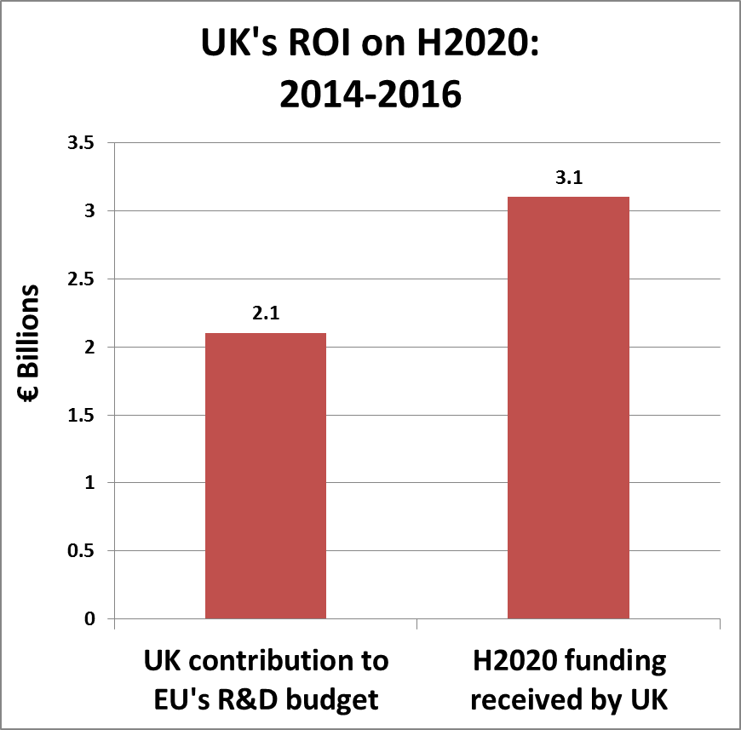
Notes
H2020 funding received by the UK (2014-2016) is based on an analysis of CORDIS data
As the EU’s R&D expenditure is more than just H2020 (although it largely consists of H2020), UK’s ROI on H2020 from above chart is more than €1 bn

Slide 26
UK’s top 20 international collaborators – 2011-2015
Non-EU country
UK collaborates most with US, Germany, France, Italy and China
EU countries make up 11 of the UK’s top 20 collaborators by article count
EU country
Notes:
The UK collaborates across the world.
It’s biggest collaborator is the USA.
EU countries make up 13 of the UK’s top 20 collaborators by article count.

Slide 27
UK’s overall top 20 corporate collaborators – 2011-2015
UK collaborates (co-authors) most with Pfizer, Microsoft, Novartis, AstraZeneca and Eli Lilly
EU-based corporations make up 6 of the UK’s top 20 collaborators by article count
Non-EU country base
EU country base
*Note: Novartis, F. Hofflann-La roche are Swiss-based
Notes:
Top 10 corporate collaborators OVERALL
- Overall, high proportion of non-EU based companies

Slide 28
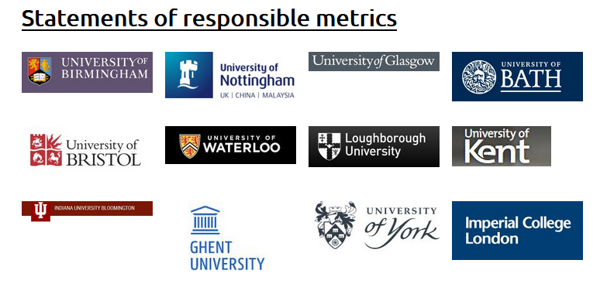
https://thebibliomagician.wordpress.com/resources/

Slide 29
Thank you!
Dr Peter Darroch
Email: p.darroch@elsevier.com
Tel: +44(0) 7990 567 488

